Slide 1



Status of the ODR Project
L. Bobb^{1, 2}, T. Aumeyr¹, M. Billing³, E. Bravin², N. Chritin², J. Conway³, P. Karataev¹, T. Lefevre², Y. Li³, S. Mazzoni², J. Sexton³, C. Strohman³, S. Wang³
John Adams Institute at Royal Holloway, Egham, Surrey, United Kingdom
CERN European Organisation for Nuclear Research, CERN, Geneva, Switzerland
Cornell University, Ithaca, New York, USA

Slide 2
Topics
Overview of ODR Project
Implementation at CESRTA
Dec 2012 Measurements
Conclusions & Plans

Slide 3
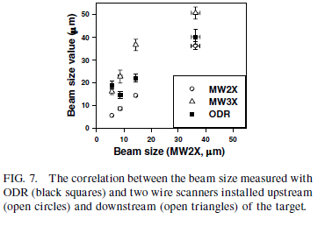
Most recent experiments using Optical Diffraction Radiation (ODR) for beam diagnostics
Other ODR Experiments
E. Chiadroni, M. Castellano, A. Cianchi, K. Honkavaara, G. Kube, V. Merlo and F. Stella, “Non-intercepting Electron Beam Transverse Diagnostics with Optical Diffraction Radiation at the DESY FLASH Facility”, Proc. of PAC07, Albuquerque, New Mexico, USA, FRPMN027.
A.H. Lumpkin, W. J. Berg, N. S. Sereno, D. W. Rule and C. –Y. Yao, “Near-field imaging of optical diffraction radiation generated by a 7-GeV electron beam”, Phys. Rev. ST Accel. Beams 10, 022802 (2007).
P. Karataev, S. Araki, R. Hamatsu, H. Hayano, T. Muto, G. Naumenko, A. Potylitsyn, N. Terunuma, J. Urakawa, “Beam-size measurement with Optical Diffraction Radiation at KEK Accelerator Test Facility”, Phys. Rev. Lett. 93, 244802 (2004).
σ_{y} = 14 µm measured ATF2@KEK

Slide 4
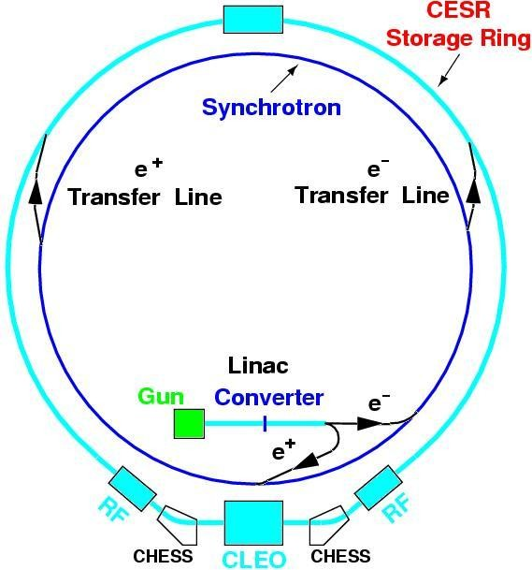
ODR Experiment
Project aim:
To design and test an instrument to measure on the micron-scale the transverse (vertical) beam size for the Compact Linear Collider (CLIC) using incoherent Diffraction Radiation (DR) at UV/soft X-ray wavelengths.
Cornell Electron Storage Ring Test Accelerator (CesrTA) beam parameters:
 | E (GeV) | σ_{H} (µm) | σ_{V} (µm)
CesrTA | 2.1 | 320 | ∼9.2
 | 5.3 | 2500 | ∼65
D. Rubin et al., “CESRTA Layout and Optics”, Proc. of PAC2009, Vancouver, Canada, WE6PFP103, p. 2751.
http://www.cs.cornell.edu

Slide 5
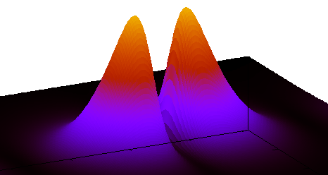
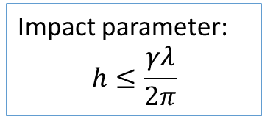
Reminder: Diffraction Radiation
Principle:
Electron bunch moves through a high precision co-planar slit in a conducting screen (Si + Al coating).
Electric field of the electron bunch polarizes atoms of the screen surface.
DR is emitted in two directions:
  along the particle trajectory “Forward Diffraction Radiation” (FDR)
  In the direction of specular reflection “Backward Diffraction Radiation” (BDR)
DR Angular distribution
θ_{y}
e⁻
θ₀
Impact parameter:
$$h≤\frac{γλ}{2π}$$
h
Generally: DR intensity ⇧ as slit size ⇩

Slide 6
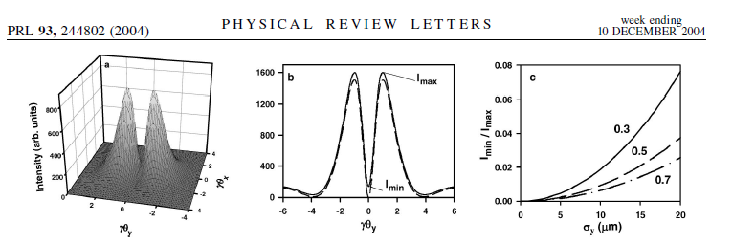
Vertical Beam Size Detection
Vertical Beam Size Measurement using the Optical Diffraction Radiation (ODR) model + Projected Vertical Polarisation Component (PVPC)
P. Karataev et al.
Vertical polarisation component of 3-dimensional (θ_{x}, θ_{y}, Intensity) DR angular distribution.
PVPC is obtained by integrating over θ_{x} to collect more photons.
Visibility (I_{min}/I_{max}) of the PVPC is sensitive to vertical beam size σ_{y}.

Slide 7
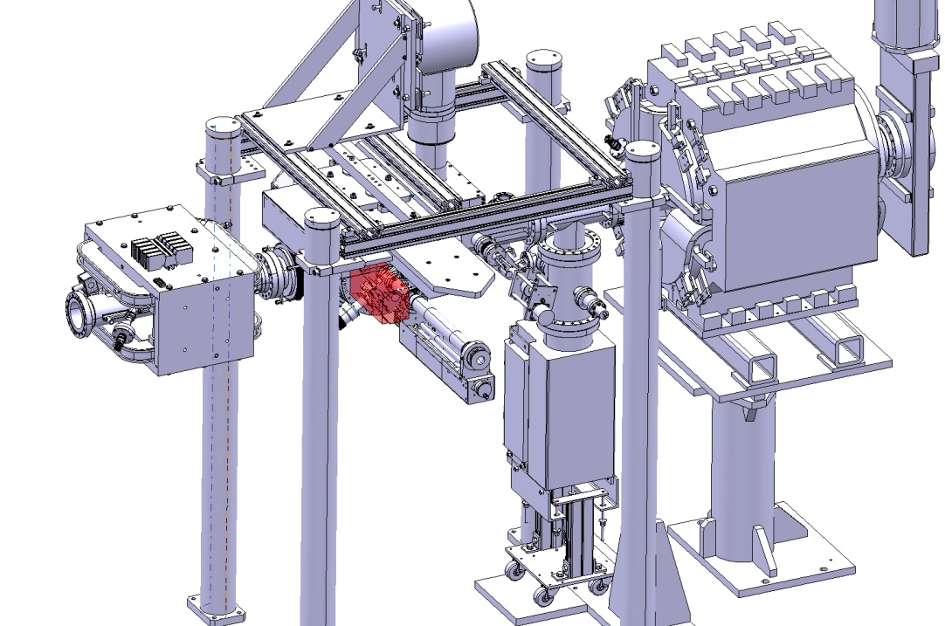
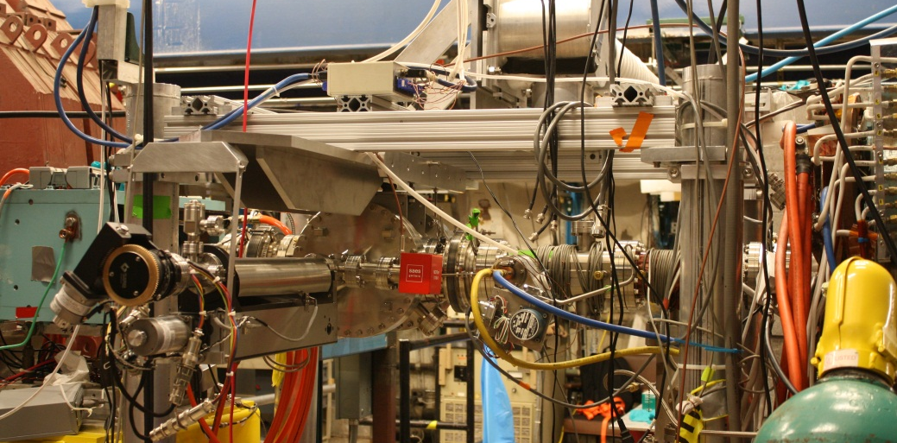
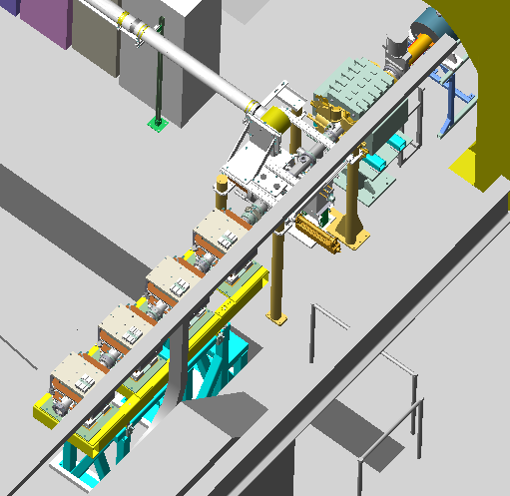
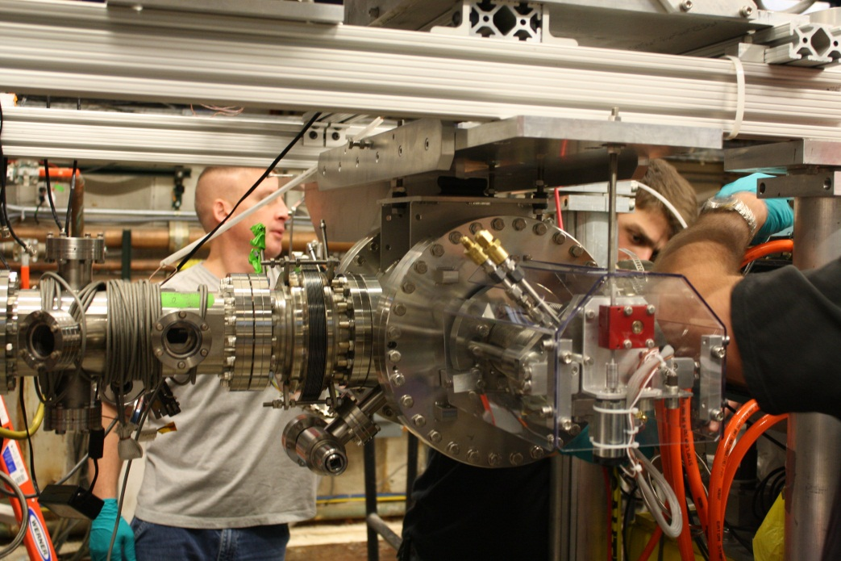
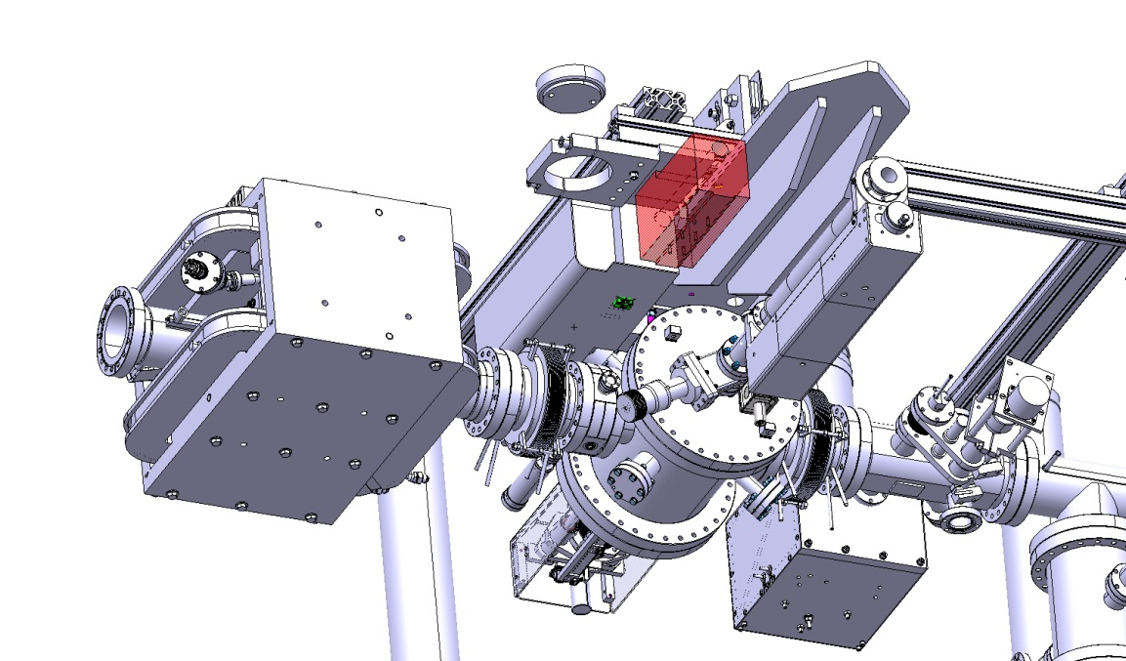
L3 Layout
Electron beam direction
DR experiment
Technical drawings by N. Chritin

Slide 8
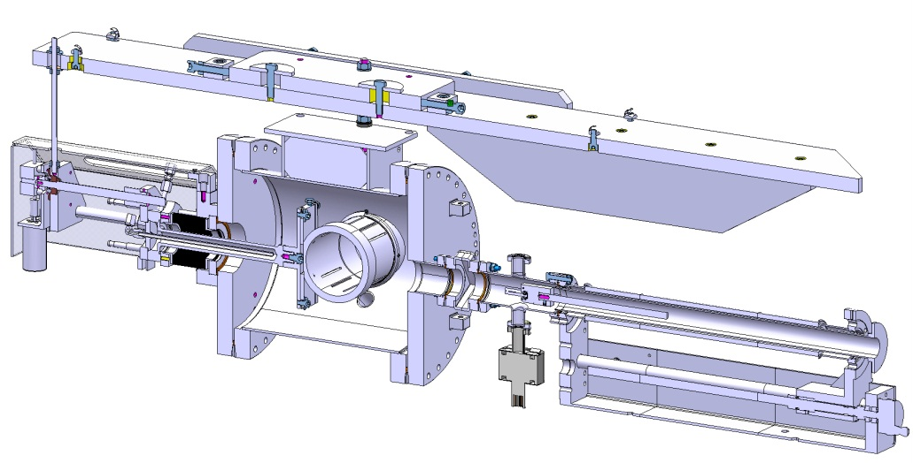
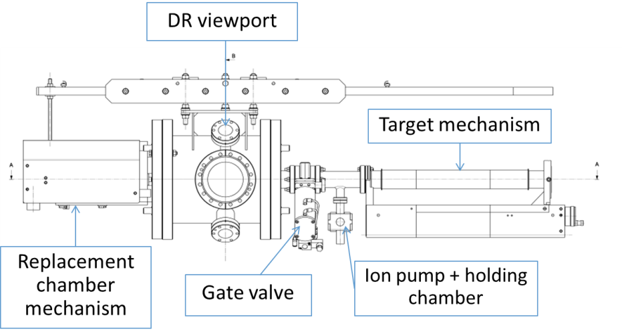
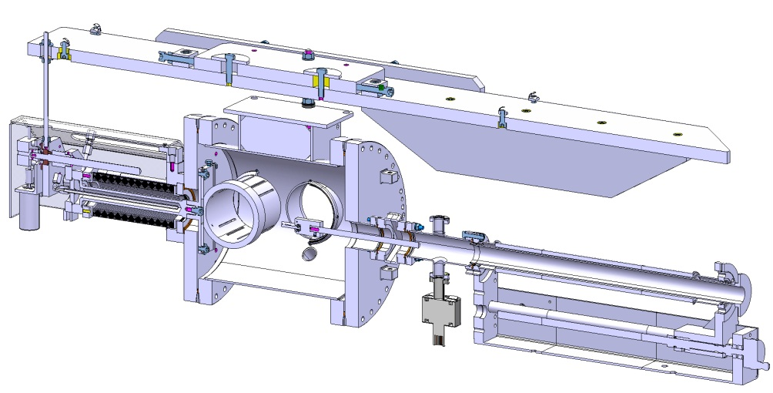
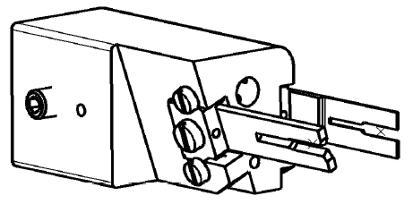
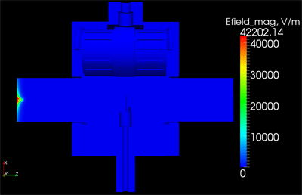
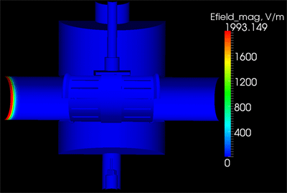
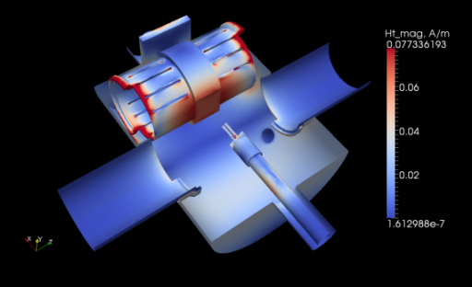
Vacuum Chamber Assembly
Simulations by A. Nosych
Technical drawings by N. Chritin
E-field magnitude of a single bunch pass in time domain (Gaussian bunch, length = [-4σ, 4σ], σ = 10mm)
H-field surface tang complex magnitude (Loss map)
Mode F = 1.19 GHz, Q = 3309, P-loss = 0.075 W
Total power loss for CHESS Operations ~ 35 W ODR Experiment: single10 mA bunch = 0.6 W

Slide 9
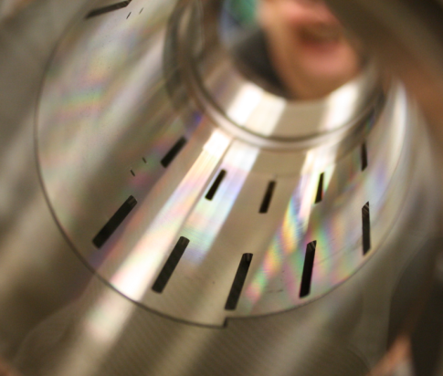
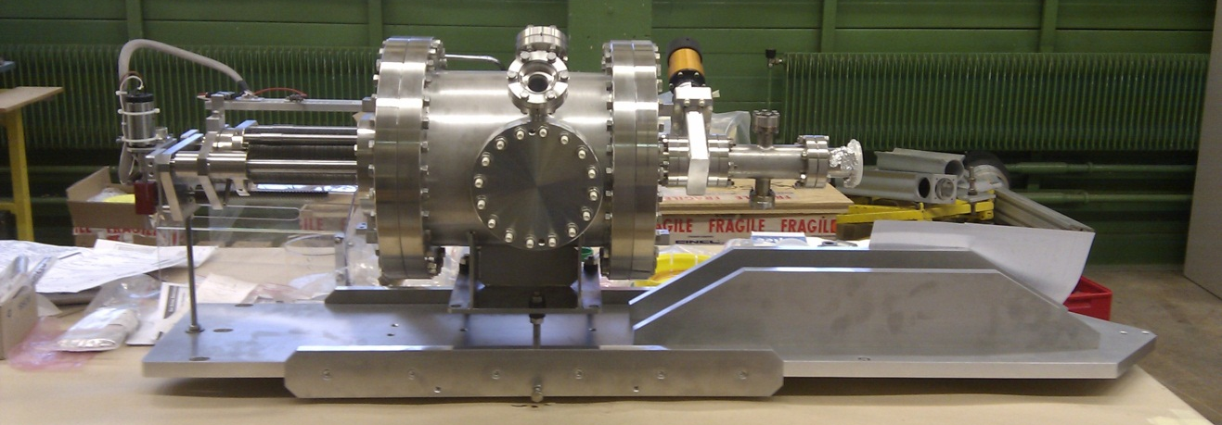
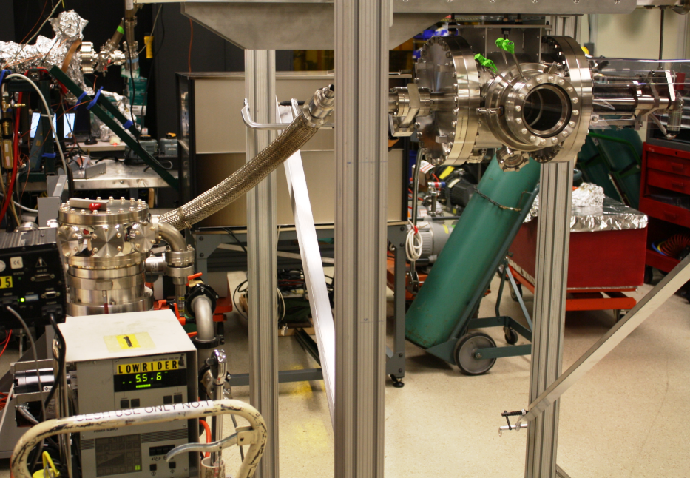
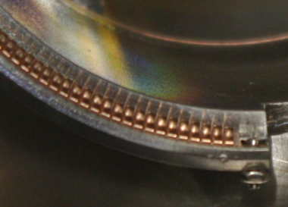
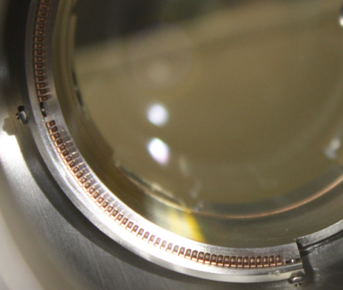
Vacuum Chamber Assembly
Images taken during assembly at CERN and Dec ‘12 testing at Cornell.

Slide 10
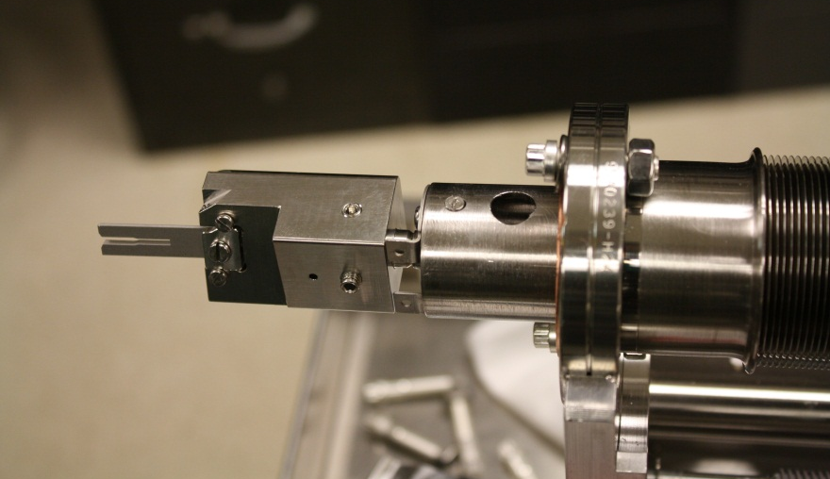
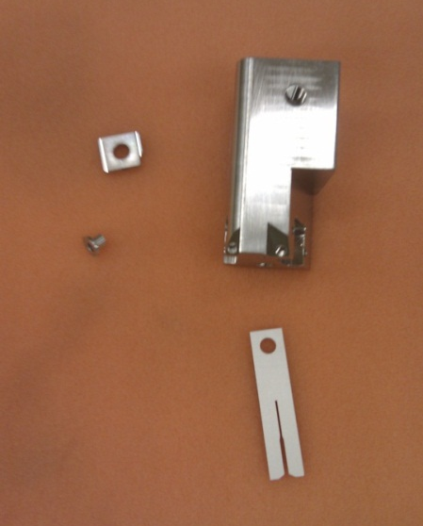
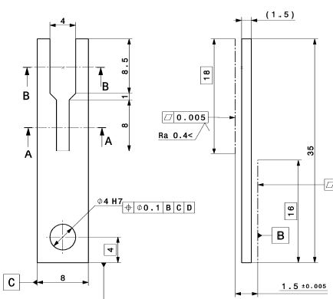
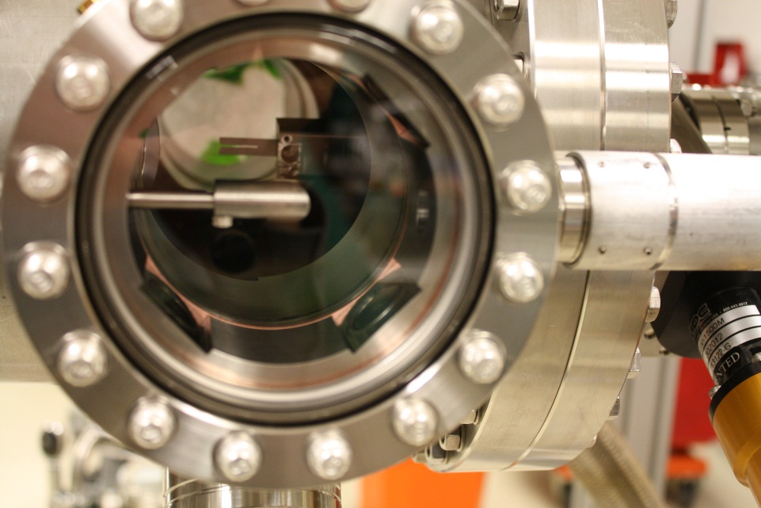
Dummy Target
Planned aperture sizes:
2 mm and 4 mm
{Actually was
0.4 mm and 1 mm}
Material: Stainless steel
Note: This dummy target was not polished
35 mm
Technical drawings by N. Chritin Images by Y. Li

Slide 11
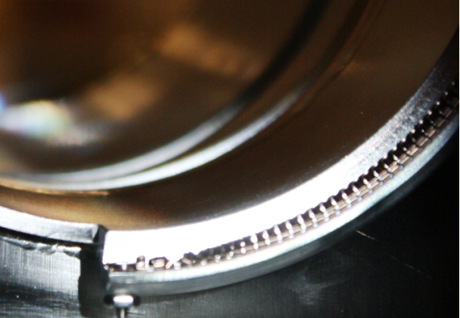
Preparation
Vacuum chamber
  Designed and assembled at CERN; transported and tested at Cornell
  Replacement chamber
    After arrival the finger contacts looked very good & cycling the replacement chamber caused no distortion of the fingers
    BUT after the bake-out, the IN limit switch was not placed correctly and approximately 1 finger on each end was bent (estimated total of 4)
      Although the fingers were still in place, this implies a potentially poorer contact or a wider gap at the top and bottom
      Estimate of worst case (σ_{z}=14 mm)
      for CHESS 200 mA for each beam:
      Normal HOM Power = 35 W
      ΔPower < 35 mW from damaged fingers
  Chamber was installed during a
  brief access period - Dec. 17-18

Slide 12
Project Goals
Measure Optical Diffraction Radiation (ODR) from a narrow vertical slit
  Detector located on the L3-side of Q48W
  Slit height – Dec ‘12 tests 2 & 4 mm; actually 1 & 0.4 mm
Conditions
  2.1 GeV - Big D Optics
  Single bunch of few mA
  Small vertical emittance
  In these conditions vertical scraper measurements predict
    From measurements of beam tails – exponential beyond ~ 7 σ_{v}
    If the vertical motion & vertical beam size are included
    There should be adequate beam lifetime even with 0.4 mm slit

Slide 13
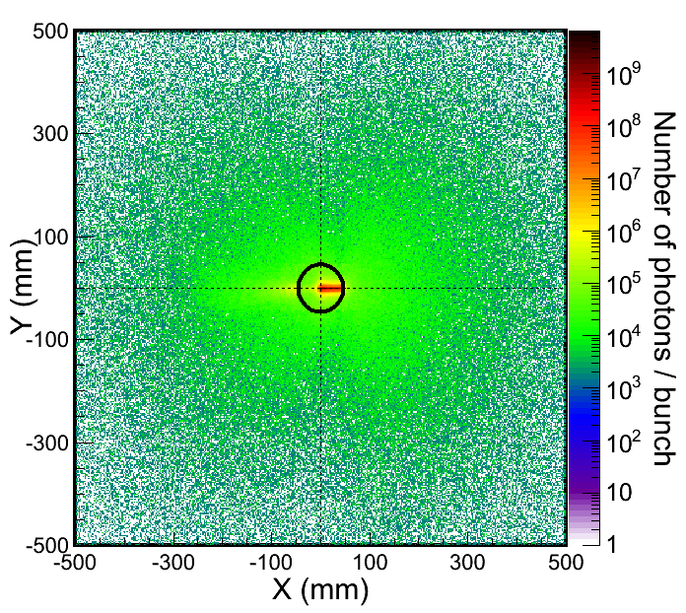
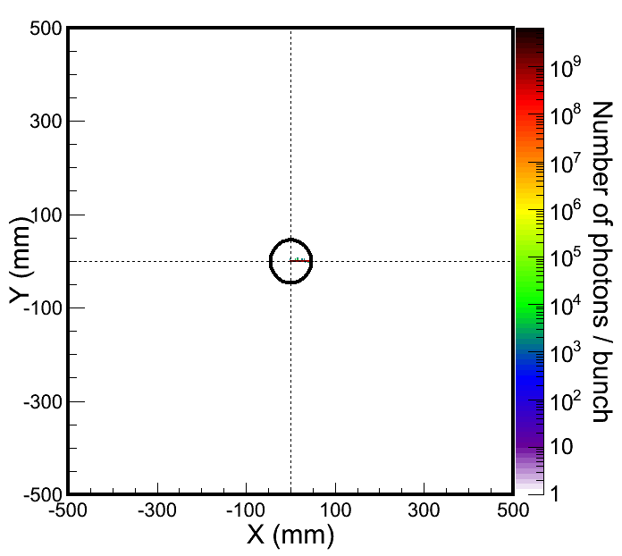
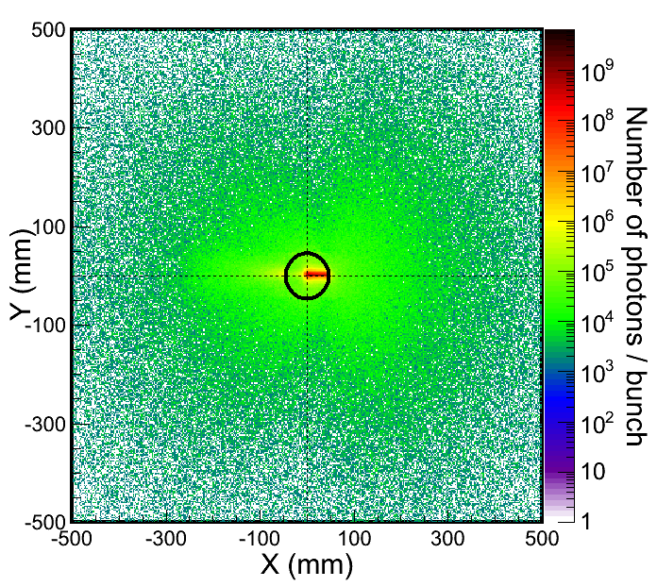
Placing Beam within the Slit
Method of Operation
Quadrupole
Alignment of the electron beam with the target aperture:
  BPMs for centering
  Target imaging to look for OTR from beam halo
  Correlate with BLMs: (Simulation below)
Si
1
2
Dipole
3
Virtual BLMs
4
Virtual Detector 3
-400μm off
center
+400μm off
Single bunch of electrons
Simulations by A. Apyan
Gradually move target in

Slide 14
Placing Beam within the Slit
Method of Operation cont’d
To find the position of the aperture centre:
Rotate the target such that the aperture is in the horizontal plane. (Center of rotation at aperture center).
Adjust the beam vertical position to approach the target from above.
Record the vertical position with BPMs; BLMs pick up beam scattering.
Repeat steps 2 and 3 starting with the beam below the target.
Take the average of the 2 recorded positions as the aperture center.
Rotate
Upper limit
Estimated aperture center
Lower limit

Slide 15
ODR MS Results
ODR Projects
  Tested continuous readouts for 2 BPMs (48W & the new 48AW)
    Initial result: a few μm resolution at a few Hz (watched using GDL)
    Found the center of Q48W & determined “BPM zero offsets”
  After a few attempts able to steer the beam & place the target’s “fork” around the beam
    Fork opening is tilted slightly downward wrt to plane of CESR
    When placed within the 1 mm slit, the lifetime was a few minutes with 1 mA bunch (& current dependant) – somewhat lower than expected
  Camera imaged DR & TR spot on top and bottom tines
    These spots moved with the beam’s position
    Appeared to be a much fainter Synch Radiation signal
  Repeated V scraper measurements of the beam tails with the target retracted – to try to understand poorer lifetime
    Data suggests the tails are not much different than Oct 2012

Slide 16

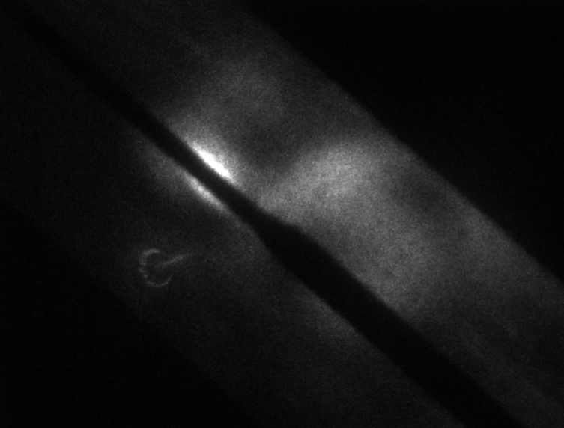
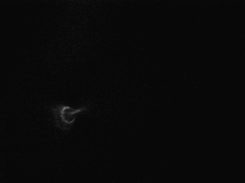
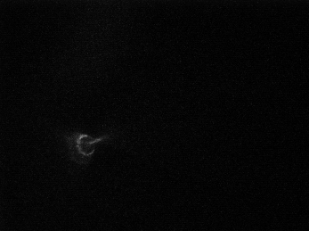
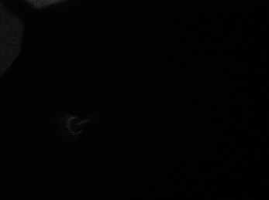
Results
1mA single bunch (injection 7; 2.1 GeV)
Beam lifetime slightly shorter than expected (approx. 2-3 min. vs. 10 min.)
Camera acquisition details: 12bit
camera exposure time 15 ms
camera gain 10
intensifier open
Intensifier gain 2V
2 mA 10 bunches (injection 8; 2.1 GeV)
SR
TR + DR

Slide 17
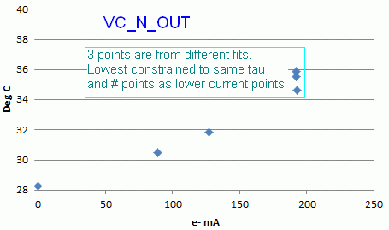
5.3 GeV High Current Operations
Tested at >200 mA in e+ & e- Beams with CHESS spacings
  Processed to these beam currents Friday Owl shift
Chamber Heating with Replacement Chamber Installed (Required for operation above 10 mA)
  Replacement chamber has internal thermal connection to cooling
  Beam pipe entrance ports do not have cooling
    Plan is to add cooling bands around the adjacent flanges
  At ~200 mA observed a several degree temperature rise on the TCs attached to the entrance ports (analyzed by DHR)
    Have a 5-10 minute thermal time
    constant
    After taking this time constant into
    consideration, the temperature rise
    appeared to linear – Synch Radiation
    - (although there may also be a very
    slight quadratic increase – HOML)
  Observed signals on B- & E-field probes in ODR housing
    1.3 V pk signal with ~150 nsec decay time for 5 mA single bunch (~ 1mW)

Slide 18
Future Plans
ODR Hardware
  Need final targets (available in Jan.) – survey to level
  Learn how to trigger the image intensifier for camera
ODR Chamber
  Repair damaged finger contacts – (removed chamber)
  Survey BPMs (& align nearby vacuum chambers)
CESR Operations
  Understand reason for shorter lifetime than expected
    Scattering from local pressure bump?
    Large off-momentum optical functions at Q48W?
    Scattering from transverse wake fields generated by target slit?
  Data acquisition
    Test of simultaneous t-b-t CBPM, xBSM & ODR camera data collection
    Possibly improve update rate for continuous CBPM readout

Slide 19
Conclusions & Plans
Installed & tested: ODR chamber, mechanisms, optics & controls
Able to align beam using, BPMs, BLMs & target imaging
Electron beam passed through 1 & 0.4 mm slits
Investigation of shorter beam lifetime ongoing
  xBSM not available in Dec – core size might be larger than expected
  Beam-gas scattering might be important
  Wakefields from slit are also being studied
  April 2013 Studies: Measure σ_{V} using SiC mask with polished Si target

Slide 20
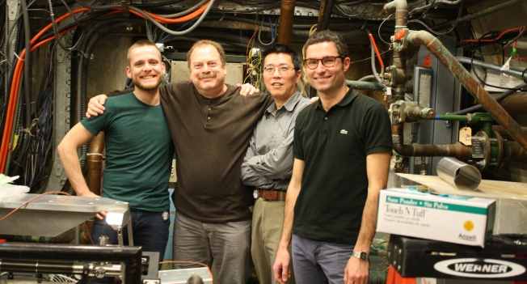
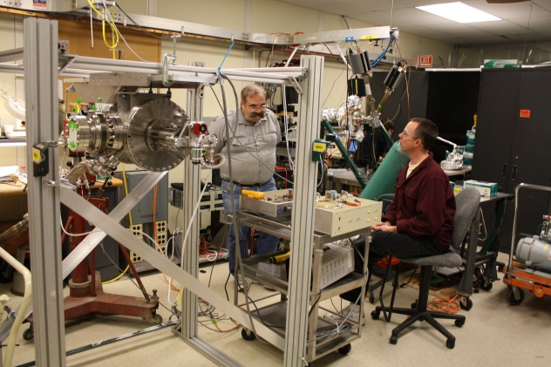
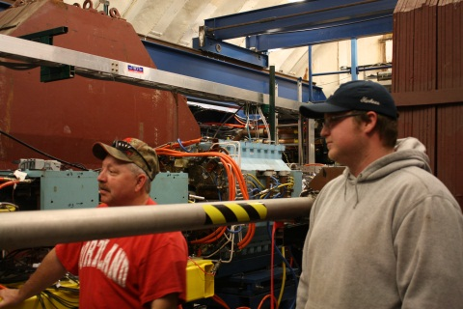
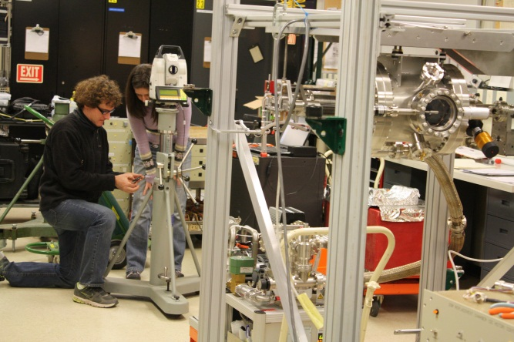
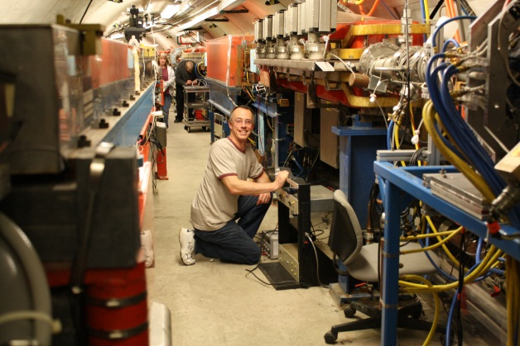
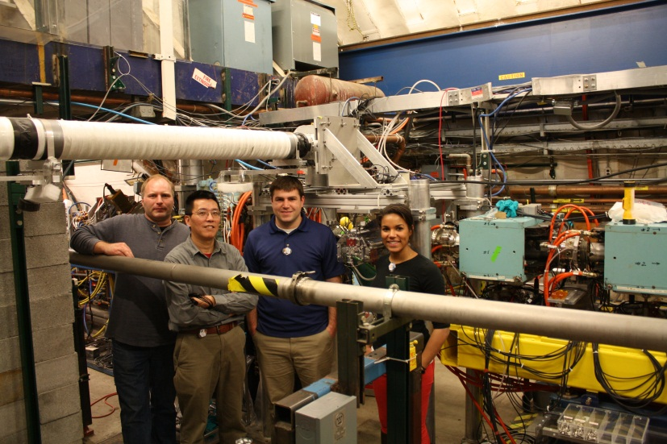
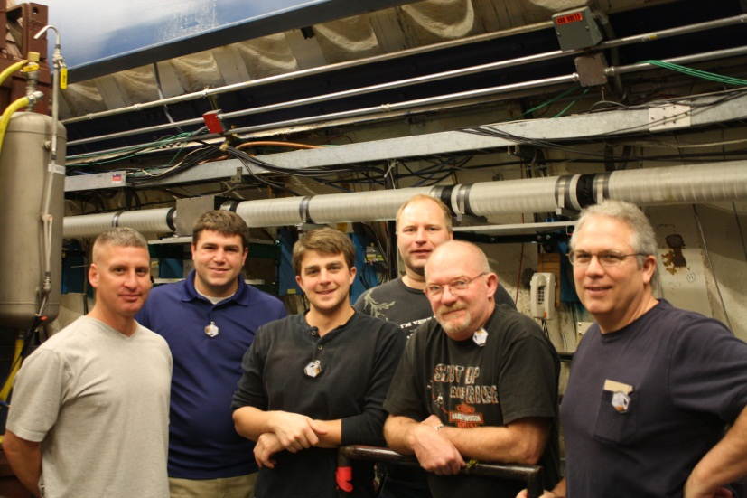
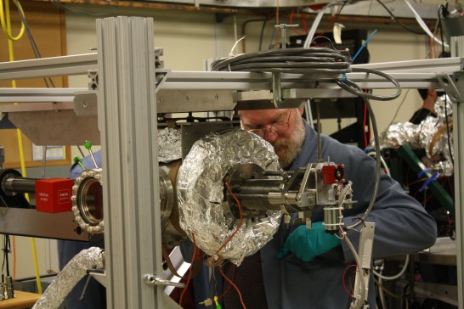
Acknowledgements
CERN:
A. Apyan, S. Burger, N. Chritin, A. Jeff, O.R. Jones, A. Nosych, H. Schmickler, S. Vulliez
Cornell:
J. Barley, J. Conway, J. Lanzoni, Y. Li, T. O'Connell, M. Palmer, D. Rice, D. Rubin, J. Sexton, C. Strohman, S. Wang
Members of CERN main workshop, BI workshop and CESR
BE-BI/PM

Slide 21
Extra slides

Slide 22
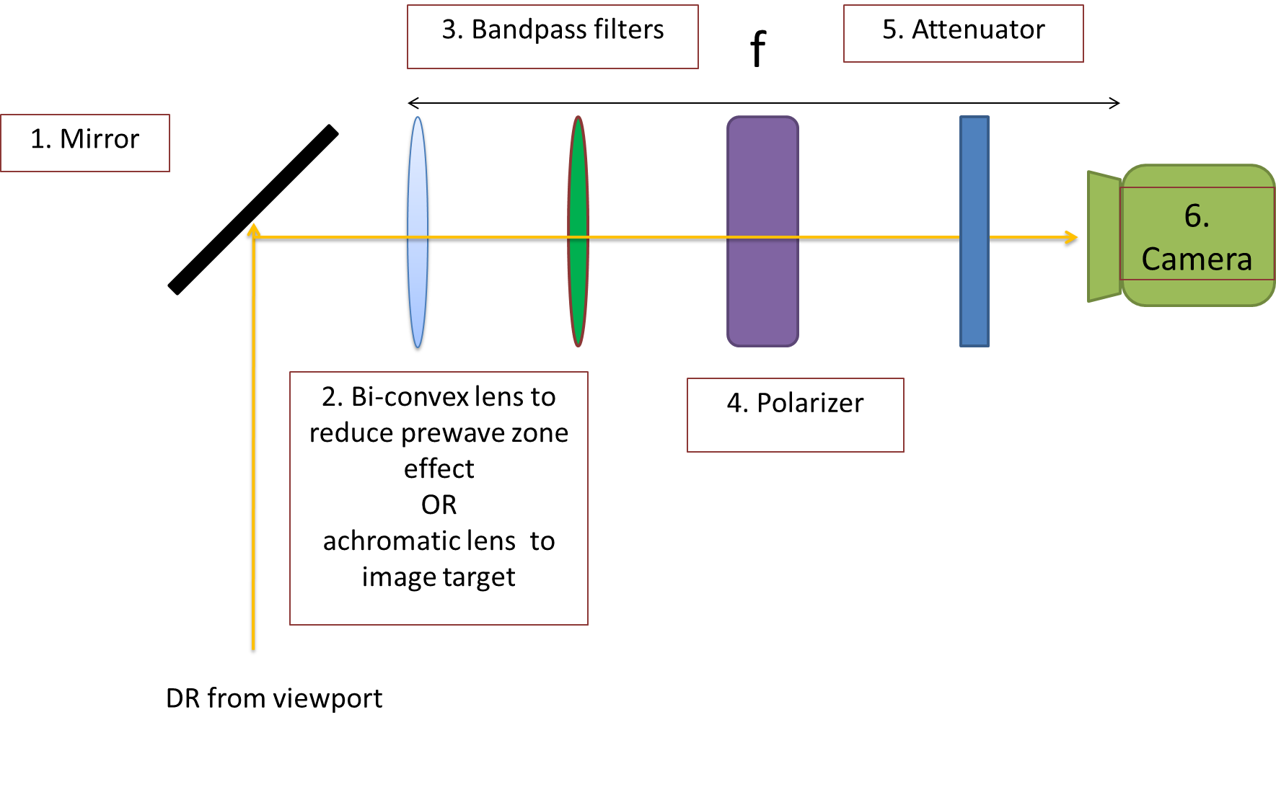

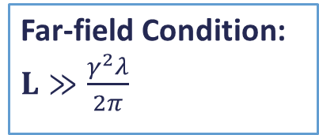
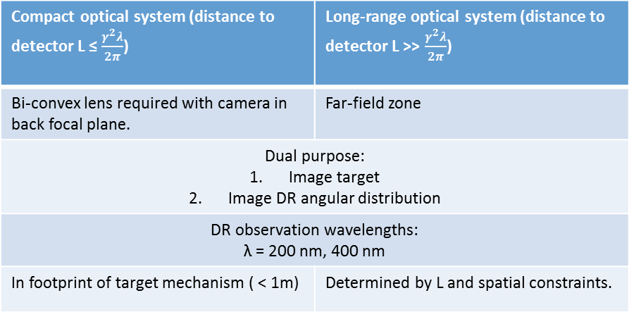
Optical System
Far-field Condition: $L≫\frac{γ^{2}λ}{2π}$
L = distance from source of DR to detector.
Compact optical system is in the pre-wave zone
(Pre-wave zone effect in transition and diffraction radiation: Problems and Solutions -P. V. Karataev).
Bi-convex lens required with camera in back focal plane. | Far-field zone
Dual purpose: Image target Image DR angular distribution
DR observation wavelengths: λ = 200 nm, 400 nm
In footprint of target mechanism ( < 1m) | Determined by L and spatial constraints.
 | 2.1 GeV | 5 GeV
200 nm | 0.54 m | 3.18 m
400 nm | 1.08m | 6.37 m

Slide 23
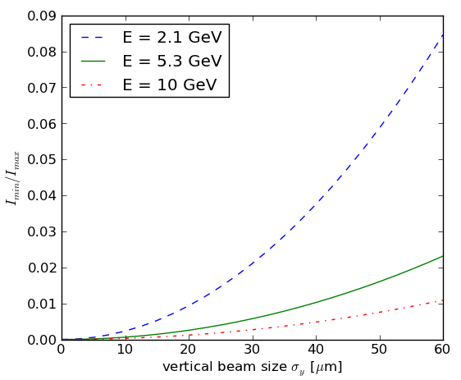
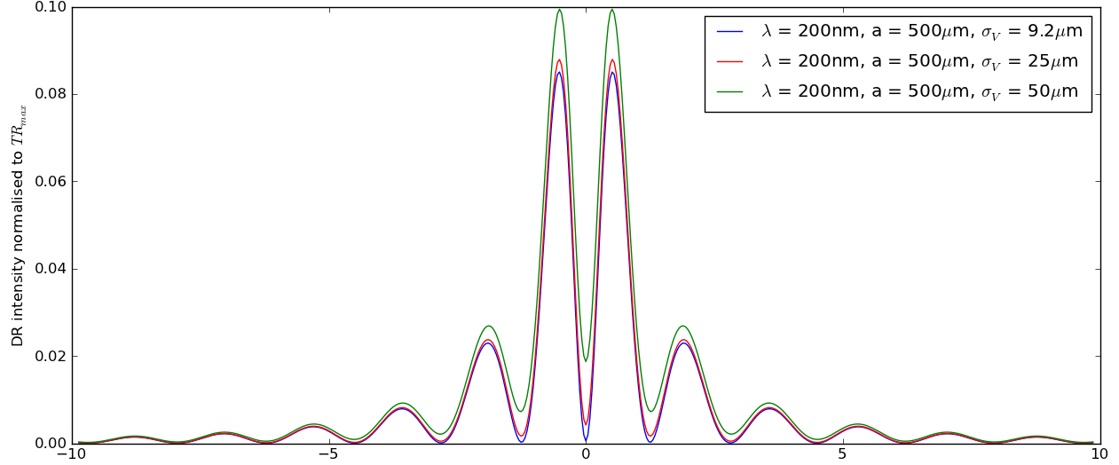


Phase 1 Experiment Simulations for CESRTA
Measureable visibility for initial test at parameters:
λ = 200 - 400 nm
a = 0.5, 1 mm
σ_{y} = 50 µm
To compare with TR intensities:
TR_{max} $=\frac{αγ^{2}}{2π}$
$$t_{y}=γθ_{y}$$

Slide 24
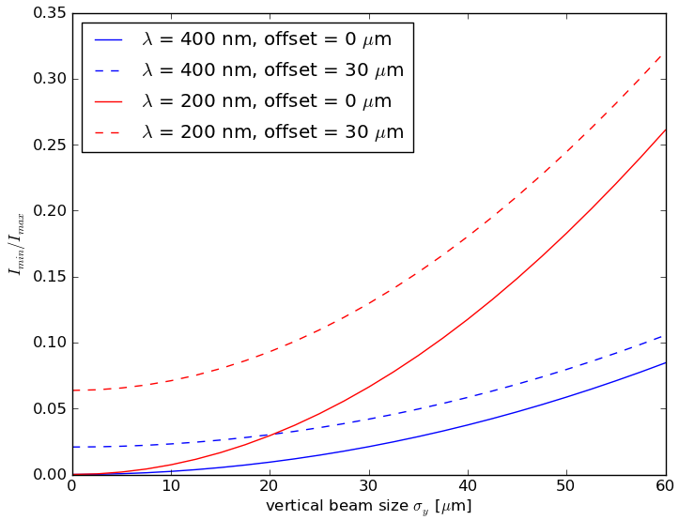
Beam Lifetime & Beam Jitter
M. Billing, "Introduction to Beam Diagnostics and Instrumentation for Circular Accelerators", AIP Conference Proc. 281, AIP 1993, pg.75 ff.
target slit size [mm] | vertical beam size [µm] | beam lifetime [min]
0.1 | 9.2 | 2.40
0.5 | 30 | 30 (max)
 | 50 | 2.22
1.0 | 50 | 30 (max)
a_{target} ≥ 5∙σ_{y,}
preferably a_{target} = 7-10∙σ_{y}
Large aperture = low DR intensity
Multiple turns of a single bunch through the target aperture
Errors due to beam jitter are reduced by including turn-by-turn vertical position measurements of the bunch in the target aperture.

Slide 25
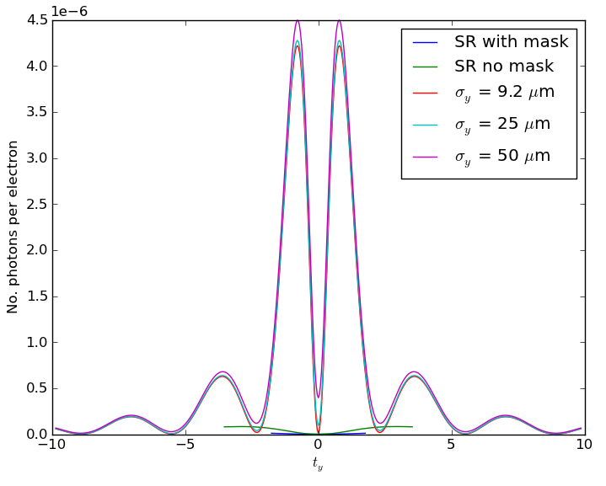


Synchrotron Radiation (SR)
Source of background | Contribution
SR from beamline optics | High
Camera noise | Low
Residual background
E = 2.1 GeV
λ = 400 nm
a = 0.5 mm
SR + DR interference
Use a mask upstream of target to suppress SR contribution.
Mask
OTR
ODR
θ_{y}
e⁻
θ₀
SR suppression
Target
P. Karataev et al., Proc. of EPAC 2004, THPLT067

Slide 26





Higher Order Modes (HOMs)
Fork OUT, Chamber IN
E-field + B-field magnitude of a single bunch pass in time domain (Gaussian bunch, length = [-4σ,4σ], σ = 10mm)
H-field surface tan. complex magnitude (Loss map)
1.017 GHz
1.26 GHz
1.19 GHz
1.017 GHz
P_{loss}_total = 0.6 W
1.19 GHz
Simulations by A. Nosych
1.26 GHz

Slide 27


Feasibility of a ring beam size monitor
LHC also has γ ≈ 4000 (@ E = 4000 GeV)
Using proton beam:
  Reduced SR background
  Larger beam size
Wavelengths in the infrared spectral range
Main requirement:
Non- invasive measurement
Must use large target aperture

