Slide 1
In-Situ Secondary Electron Yield Measurements for CesrTA: Update
W. Hartung, C. Dennett, V. Omanovic, Y. Li, T. Moore for the CESRTA Collaboration
CesrTA Collaboration Meeting ● 22 January 2013

Slide 2
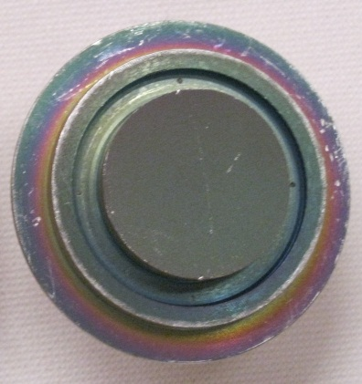
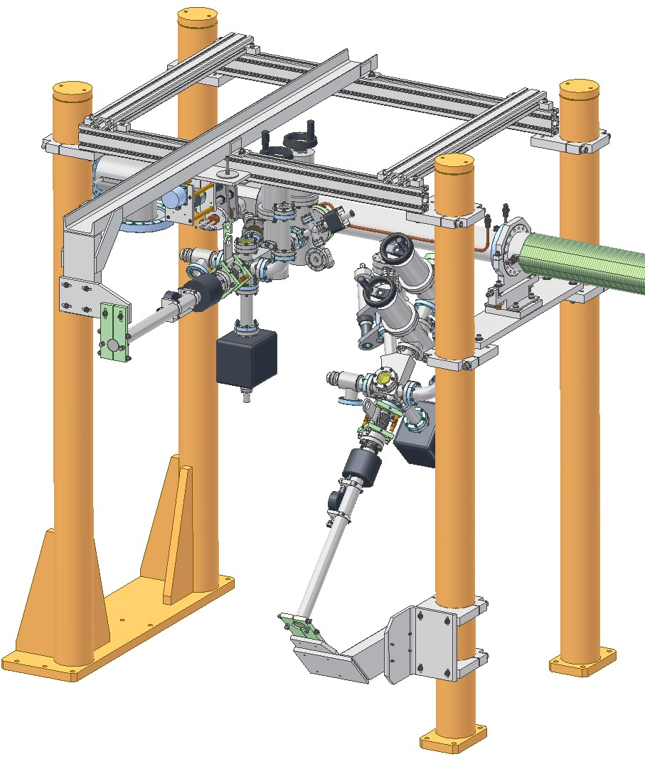
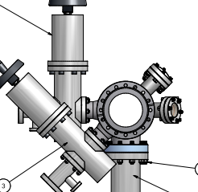
In-Situ Apparatus
Horizontal Station
Beam Pipe
TiN- coated
sample
45° Station
“Beam’s eye” view

Slide 3
SEY Samples
Material | Dates | Comments
TiN 1st pair | Jan 2010-Aug 2010 | Samples from SLAC
Al | Aug 2010-Nov 2010 | 6061-T6 alloy
Amorphous C | Nov 2010-Jan 2011 | Coating by CERN
Diamond-like C | Sep 2011-Nov 2011 | Coating by KEK
TiN 2nd pair | Nov 2011-Mar 2012 | Samples from SLAC
Cu | Mar 2012-Jul 2012 | OFC 101
Stainless steel | Aug 2012-Oct 2012 | 316-series
TiN 2nd pair | Oct 2012-Jan 2013 | Recondition after air exposure
Al | Jan 2013- | 6063 alloy

Slide 4
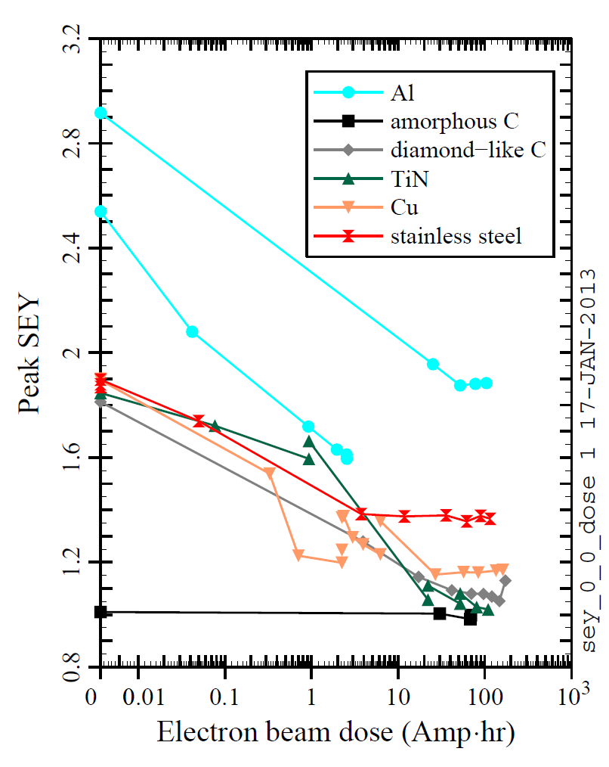
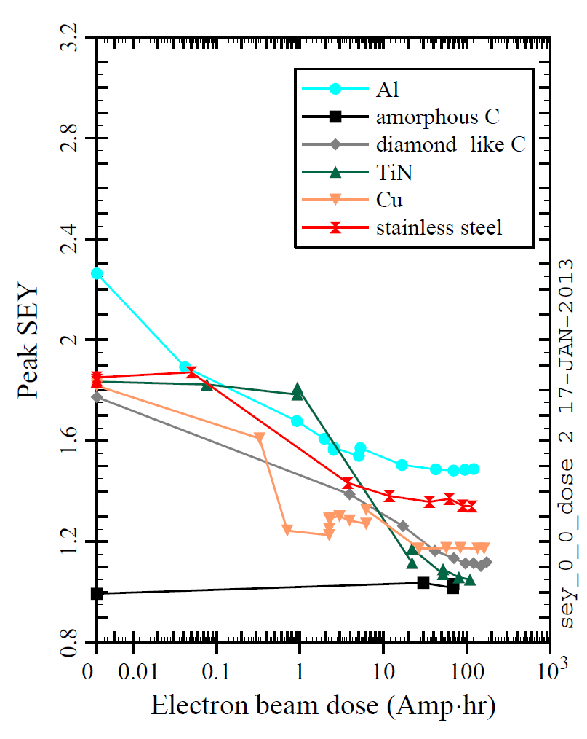
Beam conditioning: Peak SEY
Horiz.
45°
Beam conditioning of SEY samples (center, inc. angle = 25°)

Slide 5
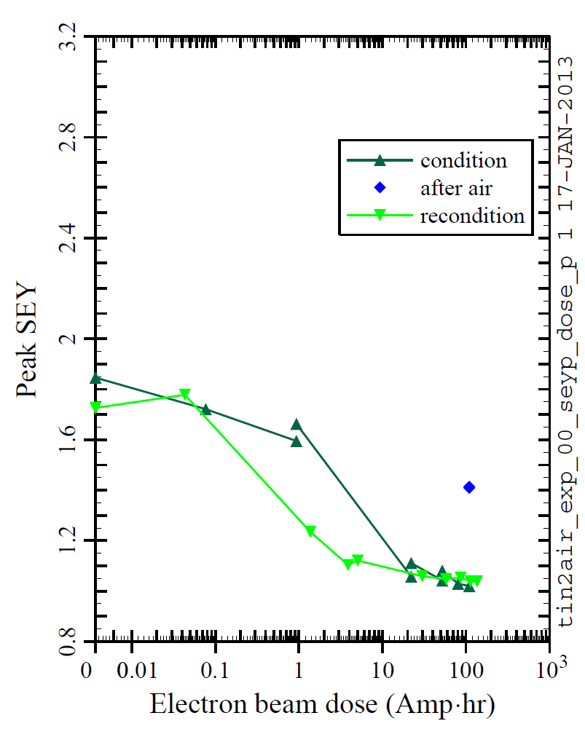
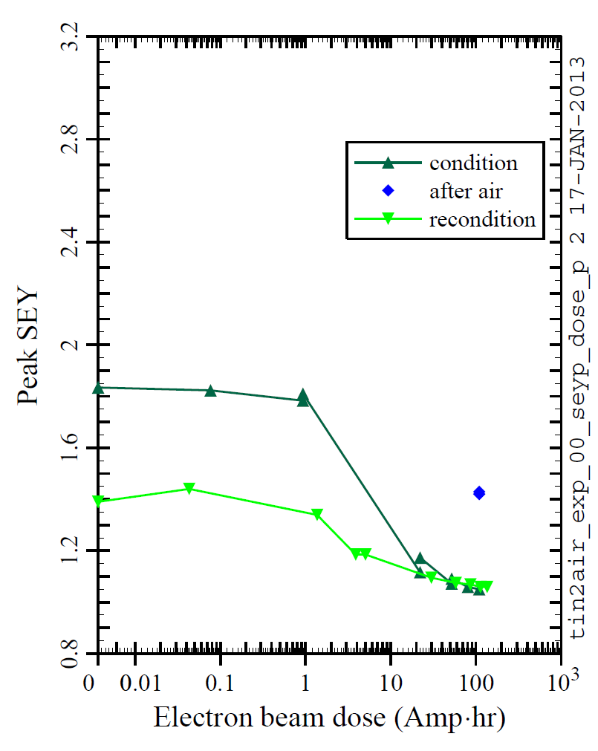
Beam conditioning: Peak SEY
Horiz.
45°
Conditioning vs reconditioning: TiN (center, inc. angle = 25°)

Slide 6
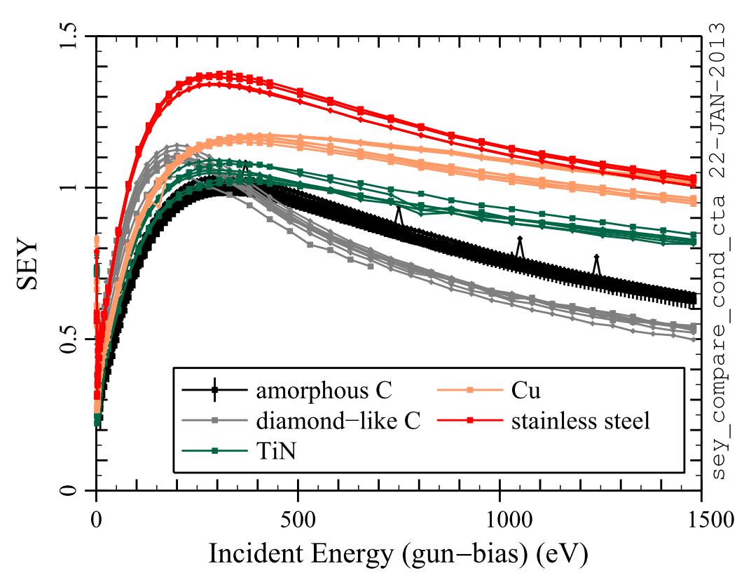
Conditioned Samples
SEY vs energy after conditioning (center, inc. angle = 25°)

Slide 7
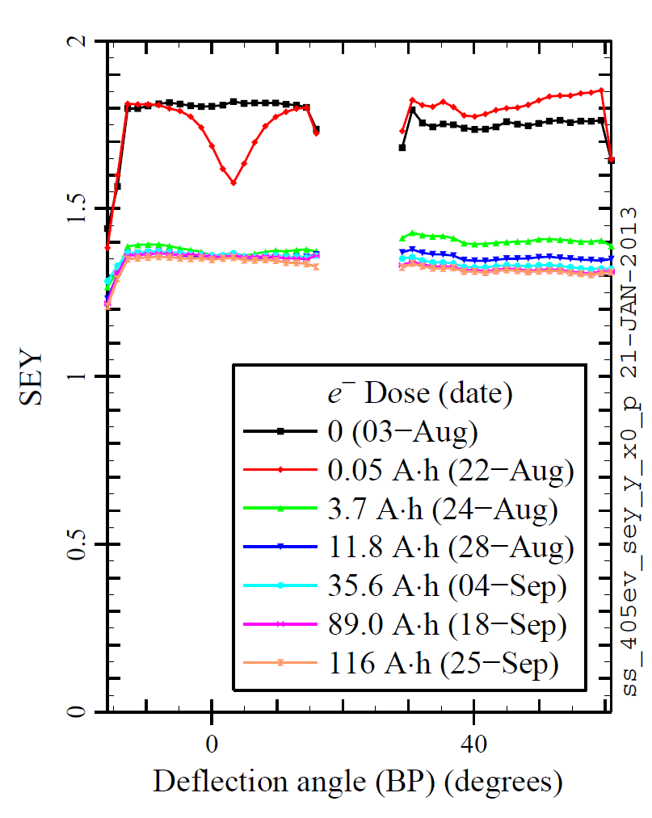
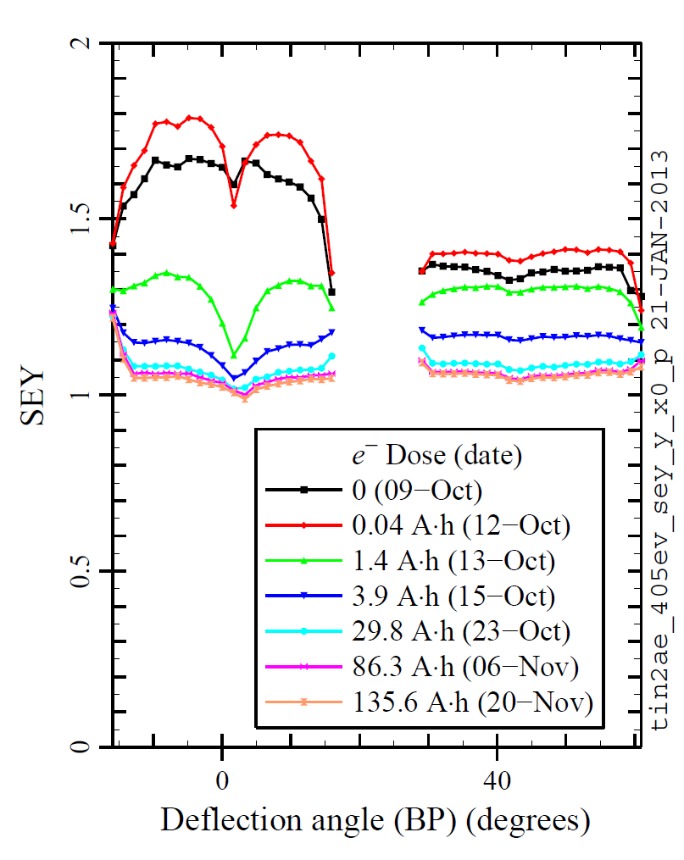
Beam conditioning: SEY vs position
TiN after air exp.
Stainless steel
Beam conditioning vs azimuth (inc. beam = 405 eV, 25°)

Slide 8
Conclusion
Work in progress/plans
Monitor SEY vs time after conditioning, with samples in vacuum (done for Cu and reconditioned TiN)
Remeasure SEY in Blue Room after exposure to air
Interpret results so far; correct for systematic effects and connect measurements to SEY models, including SEY vs incident angle and SEY at low energy
Near term: measure Al-6063, then new amorphous carbon samples

