Slide 1
BPM System Design Update / Proposal
  Streamline / organize
    Improve readability of code
    Decrease code volume/line count
    Simplify mechanisms
    Improve maintainability & clarity
    Decrease development overhead
    Leverage object-oriented design principles
  Lay groundwork for required features
    Improved documentation (automatic doc generation)
    Greater flexibility in adding/refining powerful features
    Better automated testing and logging
    Real-time status
    Integrated plotting/GUI/graphical support

Slide 2
Design Changes
Using appropriate tools in the right places
  C Language
    For low-level logic on devices with no OS (BPMs)
      Communications data structures are the contact surface between instrument and control system code. They remain unchanged.
    To leverage existing library functionality
      cbi_net – ethernet communication
      mpmnet – XBUS/MPM communication
      cbpmfio – Data file I/O
    Can be used for anything performance-related
      Reality is that BPM system is I/O limited, not CPU limited
      I/O is already handled by compact, fast C implementations

Slide 3
Design Changes
Using appropriate tools in the right places
  Python Language
    Allows rapid development with concise expression
    Fully object-oriented
      Strong encapsulation of data and methods, data hiding
      Class inheritance and introspection
    Excellent for tying existing components together
      Built-in support for accessing C library functions and data structures [ctypes] (Akin to how MATLAB does this, only less complicated.)
    Robust and mature exception/error handling system
    Excellent standard library support
      String/math/advanced data structure types and operations
      GUI toolkit
      Networking
      Automatic documentation generation
    Easily installed 3rd-party module support
      Remote objects, distributed computing and control [Pyro4]
      Plotting [matplotlib]

Slide 4
Design Features
  Design principles borrowed from high performance control system software frameworks used elsewhere
    Modular design similar to:
      EPICS
      DOOCS
  Modular components talk to each other via objects registered with a nameserver process [Pyro4]
    Completely transparent communication
      Removes the need to spend lots of time on the error-prone topics of sockets, buffering, & handshaking
    Everything is an object, even remote code and data
      Simply call methods on remote objects as if they were local
      Treat it all like it’s on a single machine. It doesn’t have to be.

Slide 5
Design Features

Slide 6
Progress
Functional and tested implementation of core BPM system functionality
  Instruments can be brought online and polled for status
  Test data buffers command
  Time-scans w/ delay corrections & plotting of waveforms
    Plotting is far more flexible with built-in saving, and multi-plotting capabilities
  TBT/raw data acquisition & file output
  Traditional “server mode” requests honored
Other improvements
  Greatly simplified master configuration files
    Removed redundant / obsolete value fields
    Uses built-in module for configuration file parsing, zero development overhead.
  High-level threading and parallelization
    [Threading] module makes development easy and safe with high level abstractions
    Thread lock objects prevent resource contention problems

Slide 7
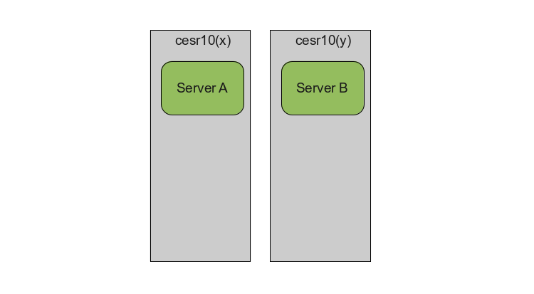
Progress
Present Server Architecture
  Completely decoupled, duplicated effort to control

Slide 8
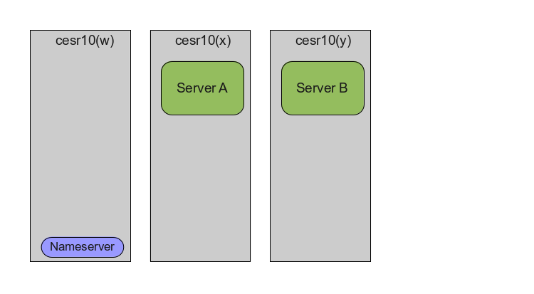
Progress - New Features
New unified server architecture
  Modular with centralized control interface

Slide 9
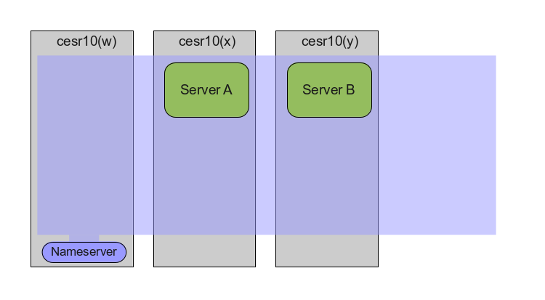
Progress - New Features
New unified server architecture
  Modular with centralized control interface

Slide 10
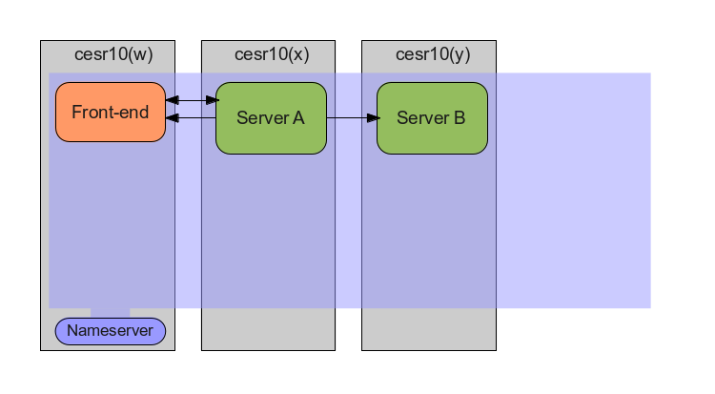
Progress - New Features
New unified server architecture
  Modular with centralized control interface

Slide 11
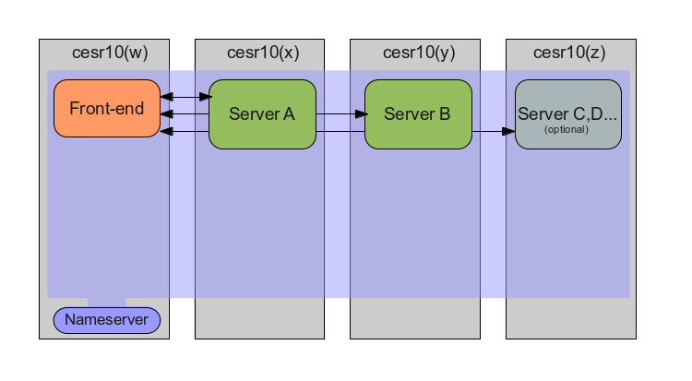
Progress - New Features
New unified server architecture
  Modular with centralized control interface

Slide 12
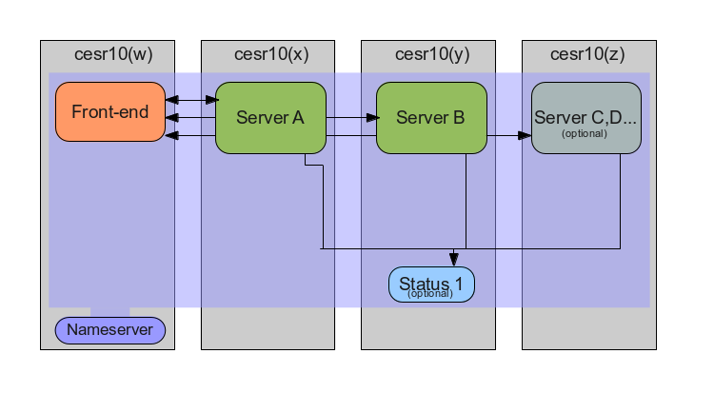
Progress - New Features
New unified server architecture
  Modular with centralized control interface

Slide 13
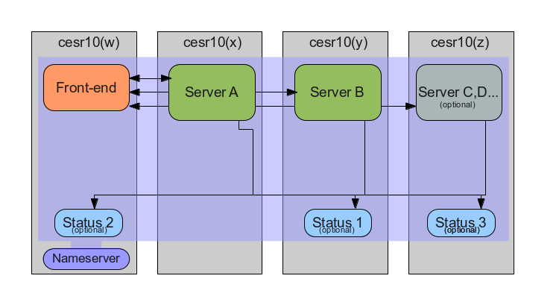
Progress - New Features
New unified server architecture
  Modular with centralized control interface

Slide 14
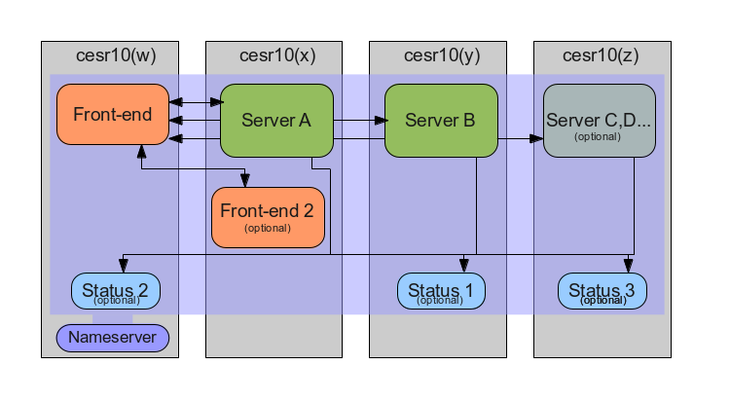
Progress - New Features
New unified server architecture
  Modular with centralized control interface

Slide 15

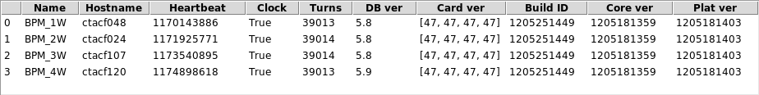
Progress - New Features
  Graphical real-time polling of vital information
    Displays can be spawned in multiple locations simultaneously as an operational and diagnostic aid
  Single point of control
    Front-end / back-end operation allows for operation as a true system, instead of a pile of servers.
  Automatic mode-switching
    Servers interleave honoring of local commands and remote data requests seamlessly

Slide 16
Progress - New Features
  Automatic documentation generation
    Core communication structures
    Instrument-specific communiction structures
    Command base class
    System commands
    Etc… every module gets its own documentation
  A working implementation is available for perusal

