Slide 1
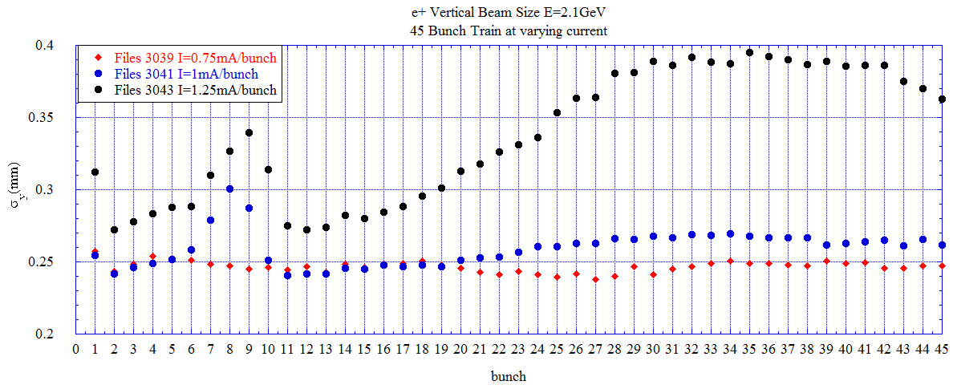
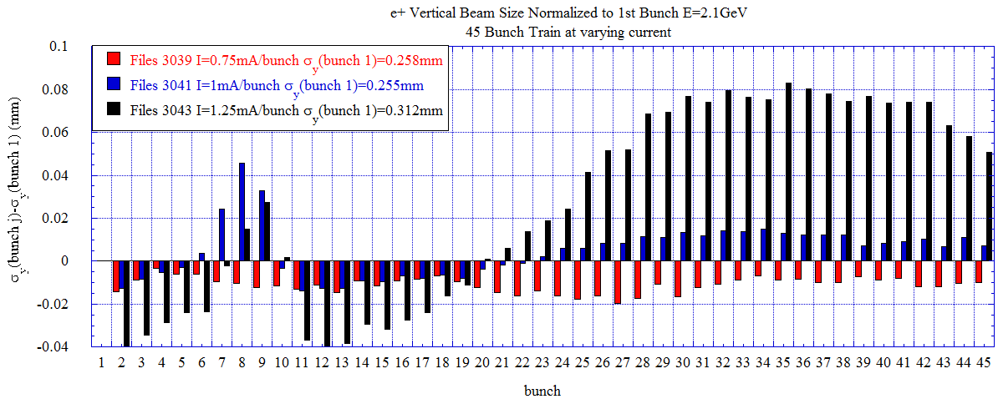
PMT vertical beam size for 45 bunch train at various bunch current.
Measurements made on 11/9/2008.
Resolution correction of 170μm included in results.

Slide 2
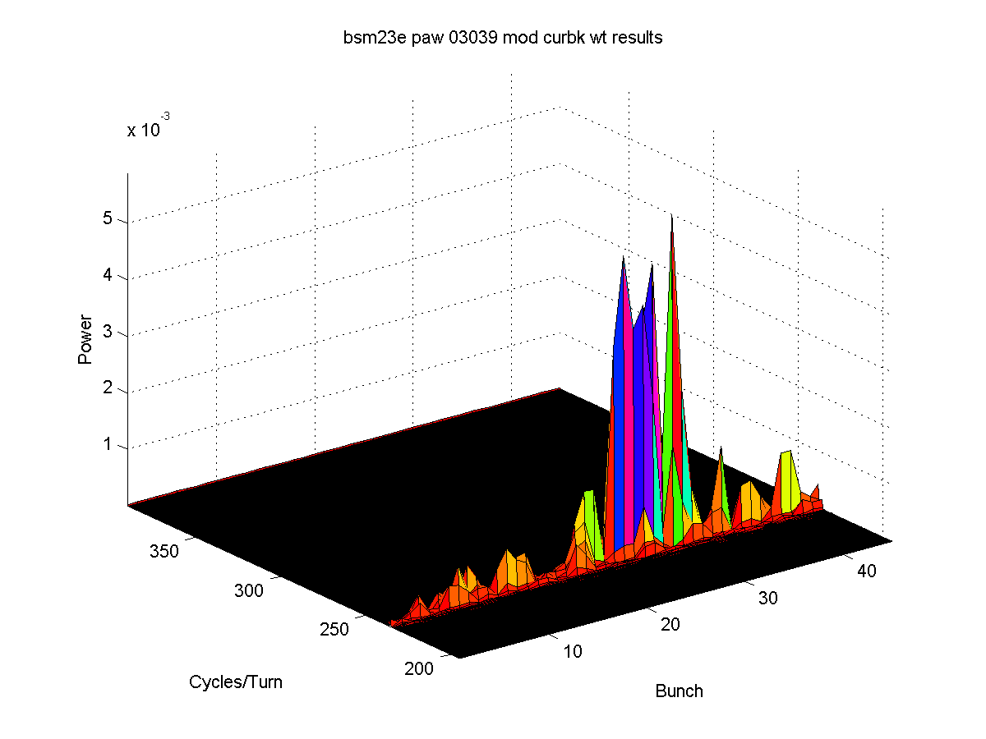
File 3039 I=0.75mA/bunch
Turn-by-turn results for 5k turns
Mean position (movie-double click to start)
Beam Size (movie)
FFT mean position
Unstable bunch (bunch27-movie)
Stable bunch (bunch 4-movie)

Slide 3
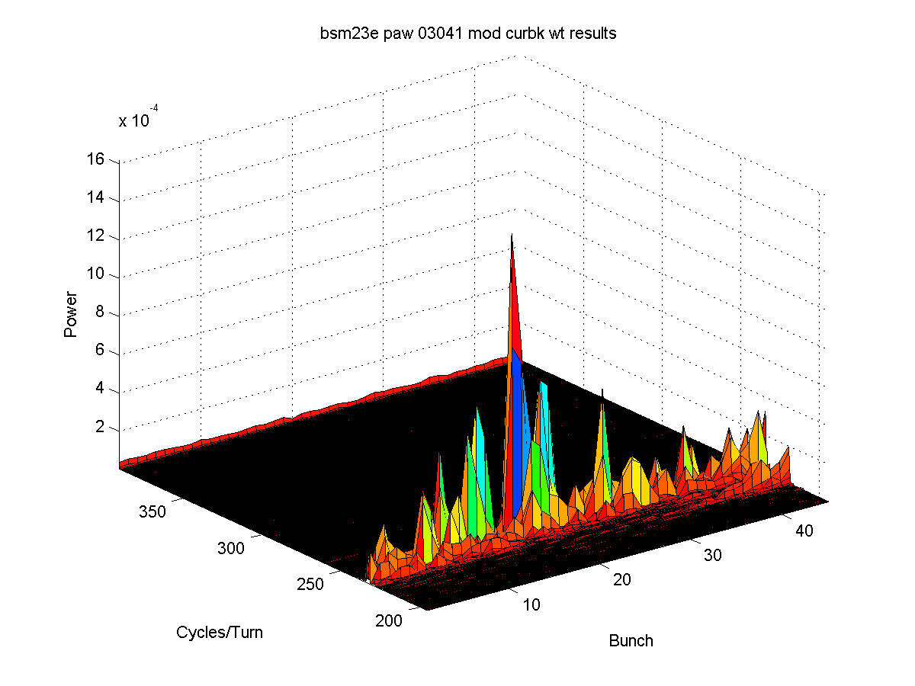
File 3041 I=1mA/bunch
Turn-by-turn results for 5k turns
Mean position (movie)
Beam Size (movie)
FFT mean position

Slide 4
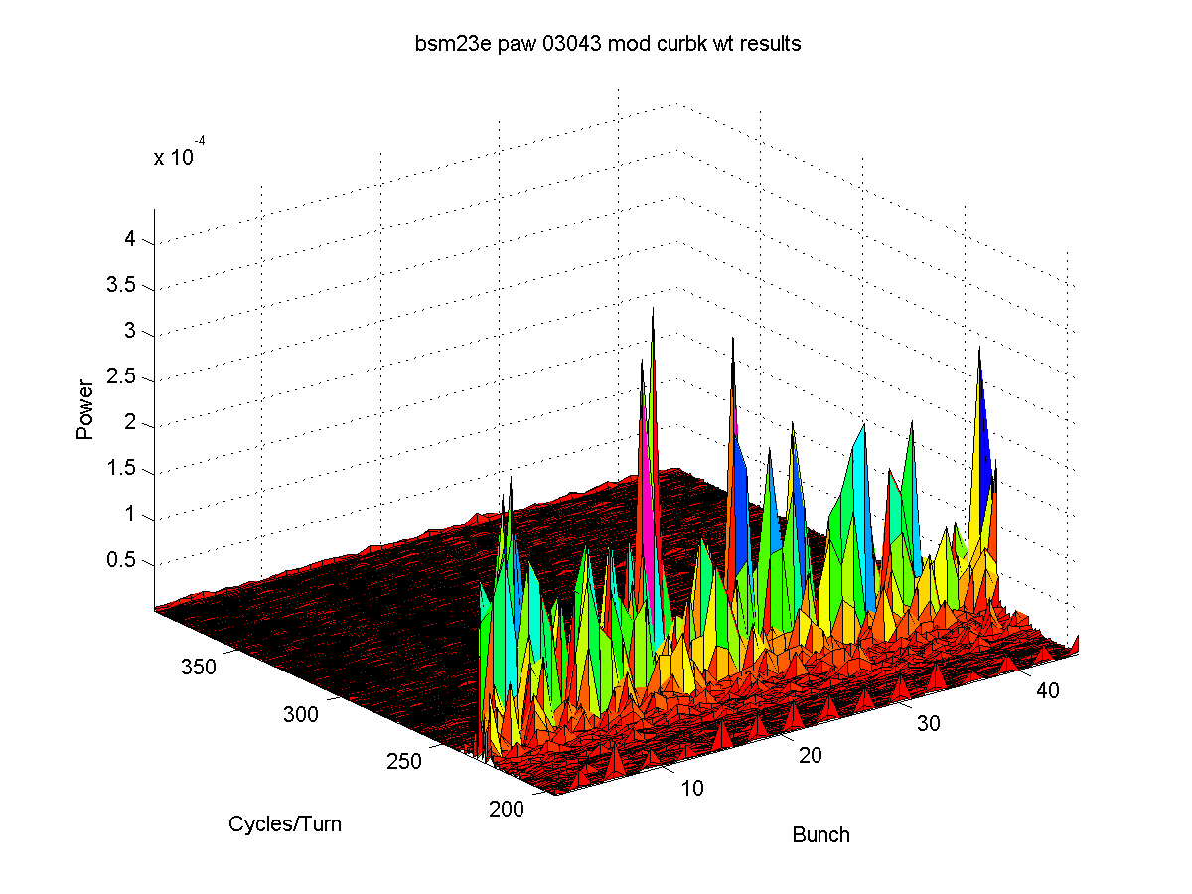
File 3043 I=1.25mA/bunch
Turn-by-turn results for 5k turns
Mean position (movie)
Beam Size (movie)
FFT mean position

Slide 5
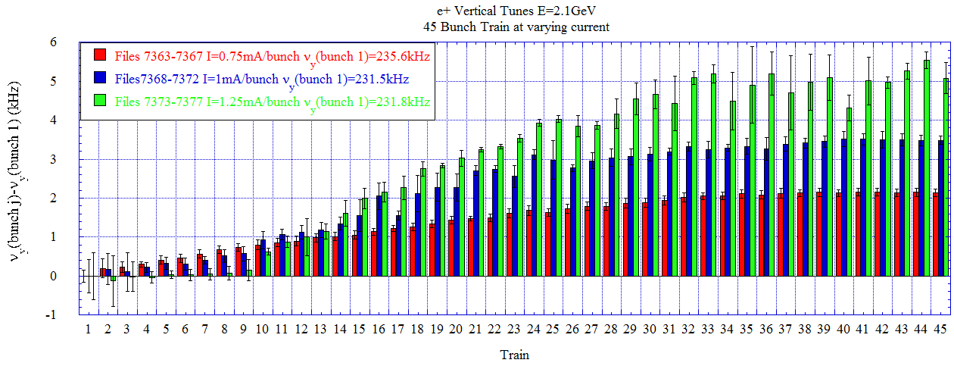
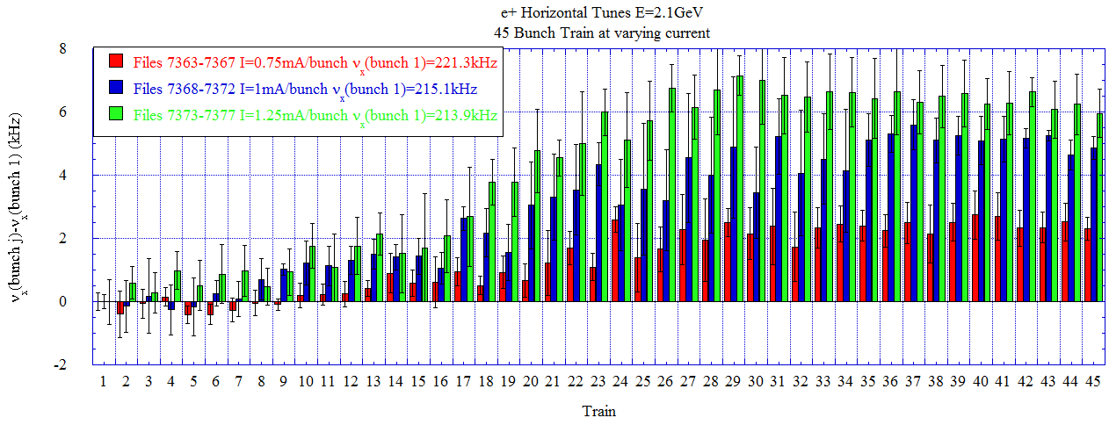
Vertical/horizontal tunes for 45 bunch train at various bunch current.
Measurements made on 11/9/2008.
Shown here is the mean tune shift from bunch 1 along the 45 bunch train

Slide 6
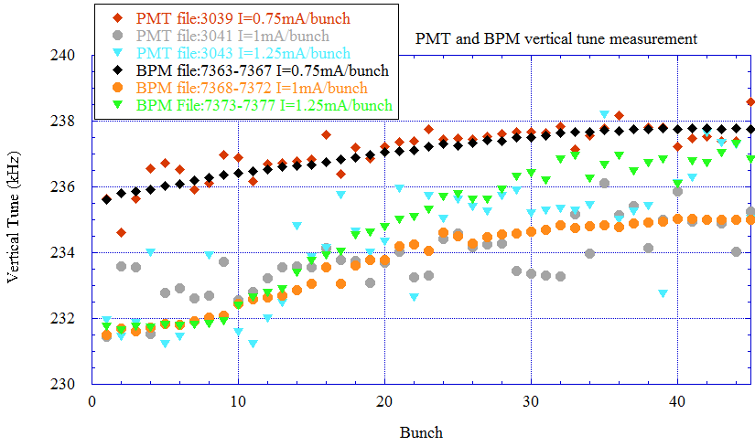
Comparison between PMT and BPM vertical tunes

