Slide 1
Electron cloud tune shift measurements-systematic studies, and studies of tune shift vs. current in long trains
Systematic studies: 45 bunch positron train with 14ns spaced bunches at 0.5mA/bunch. Measured the horizontal and vertical tunes at various vertical/horizontal pinger amplitude settings. Horizontal feedback is off and vertical feedback is set to -250CU for these measurements.
Tune Shift versus current: Measured the tune shift for 10 and 20 bunch positron trains with 14ns bunch spacing at 0.5, 0.75,1.0, 1,25, and 1.50mA/bunch.
These results are from measurements made by M. Billing, G. Dugan, and R. Holtzapple on 1/23/2009.

Slide 2
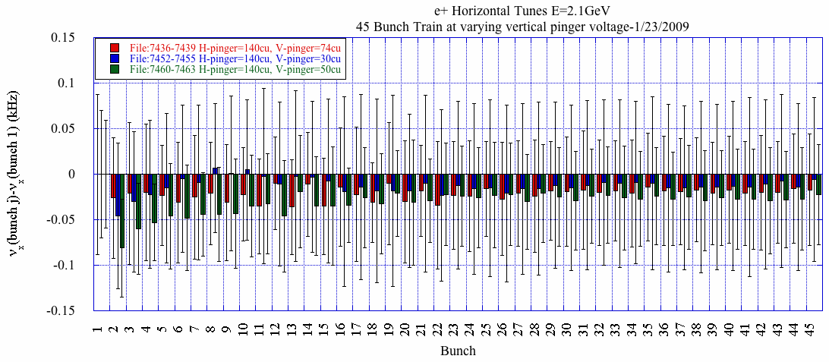
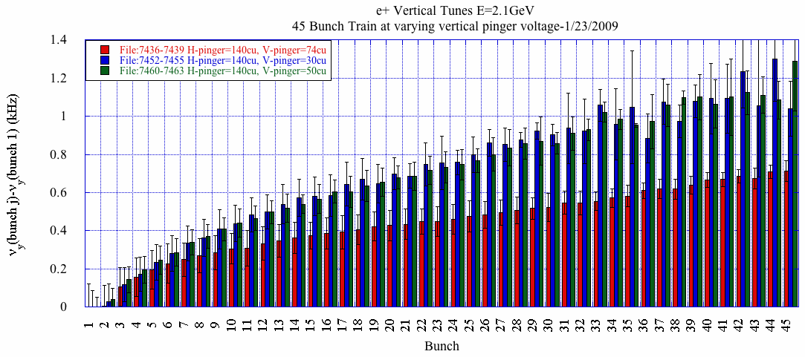
Systematic studies
e+ I=0.5mA/bunch
-Varied the vertical pinger from 30-74cu.
-Measured the vertical/horizontal orbit for all 45 bunches over 1024 turns at each pinger setting. Orbit is measured 4 times at each current setting.
-FFT orbit to determine the single bunch tune for all 45 bunches in the train.
No horizontal tune shift along the train.
Strong vertical tune shift along train that increases at lower vertical pinger amplitude!

Slide 3
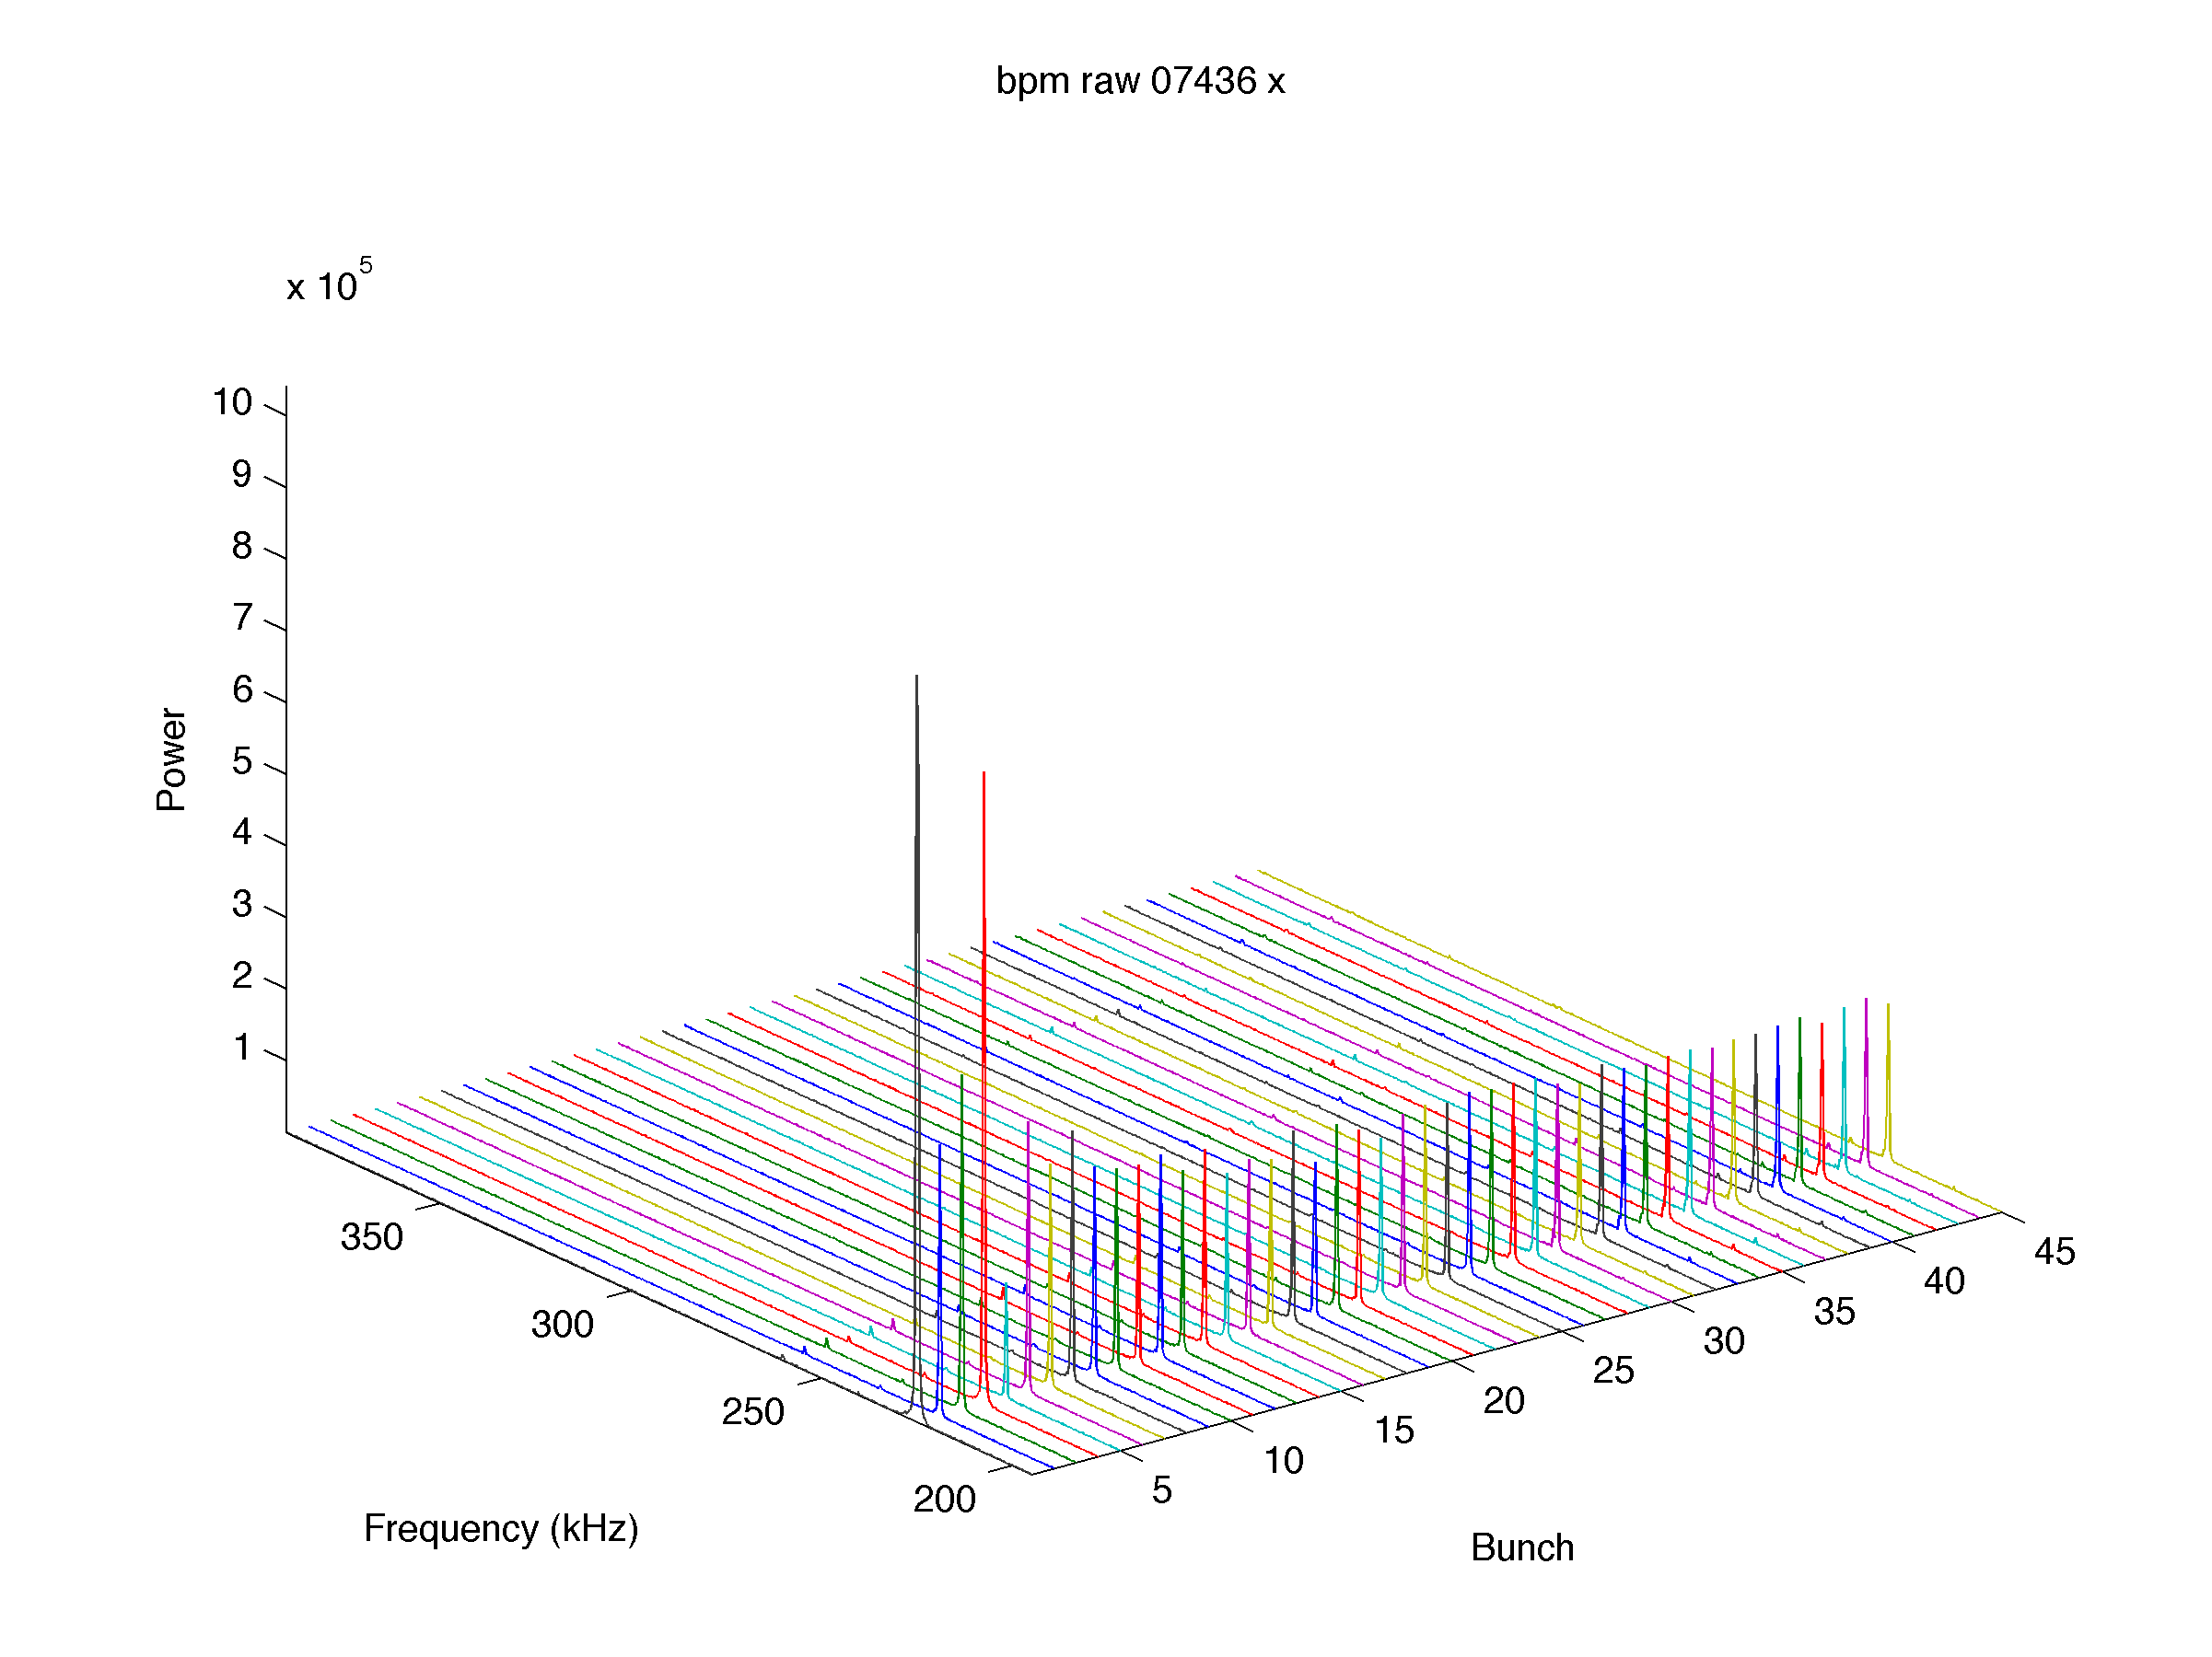
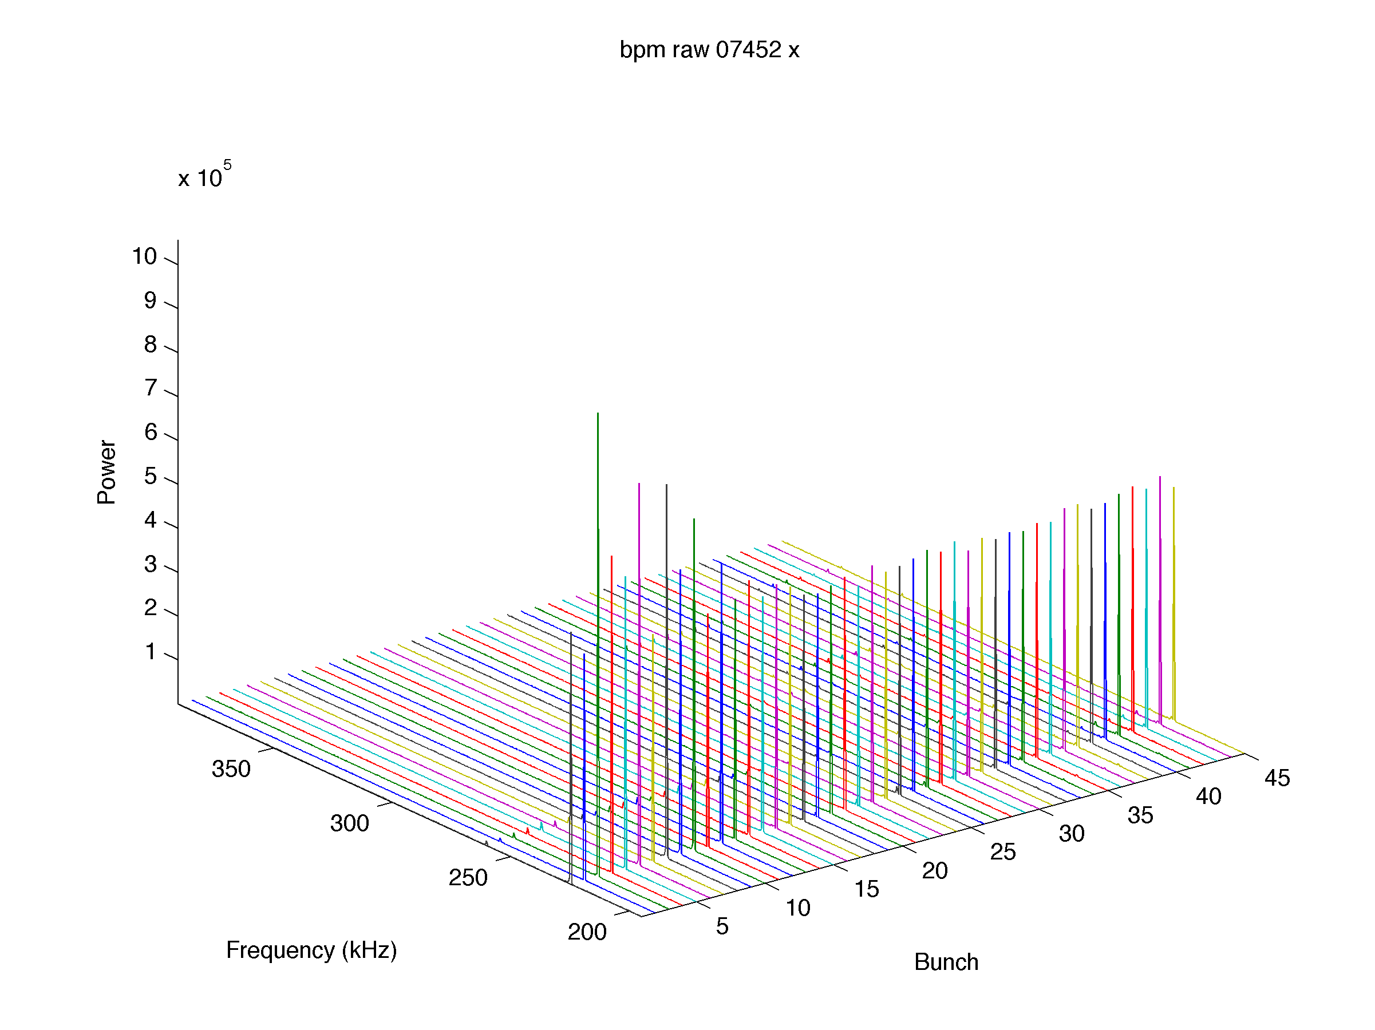
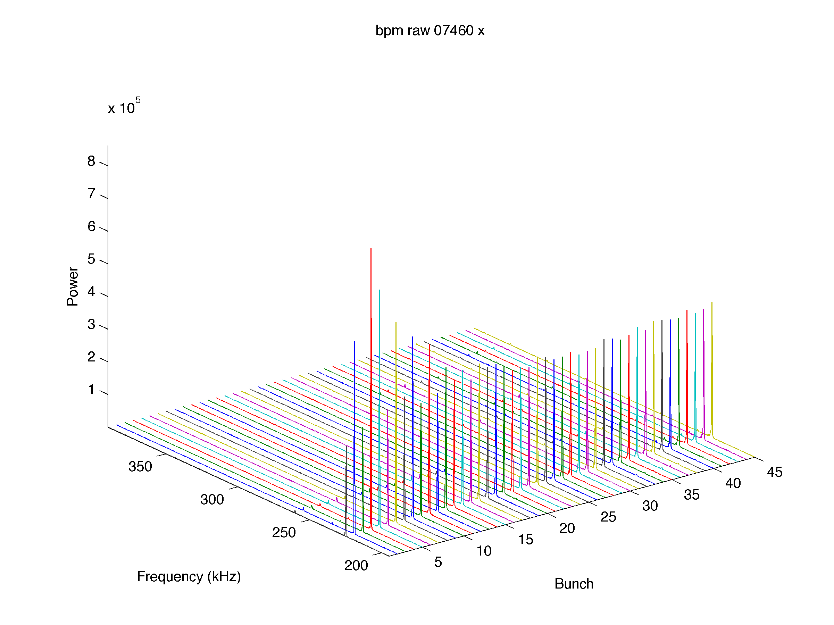
Horizontal Orbit/Tune at different vertical pinger settings.
Horizontal Orbit (Movie)
Horizontal Tune (Movie)
Horizontal Spectrum for 45 bunch train
V-pinger=74cu
V-pinger=30cu
V-pinger=50cu

Slide 4
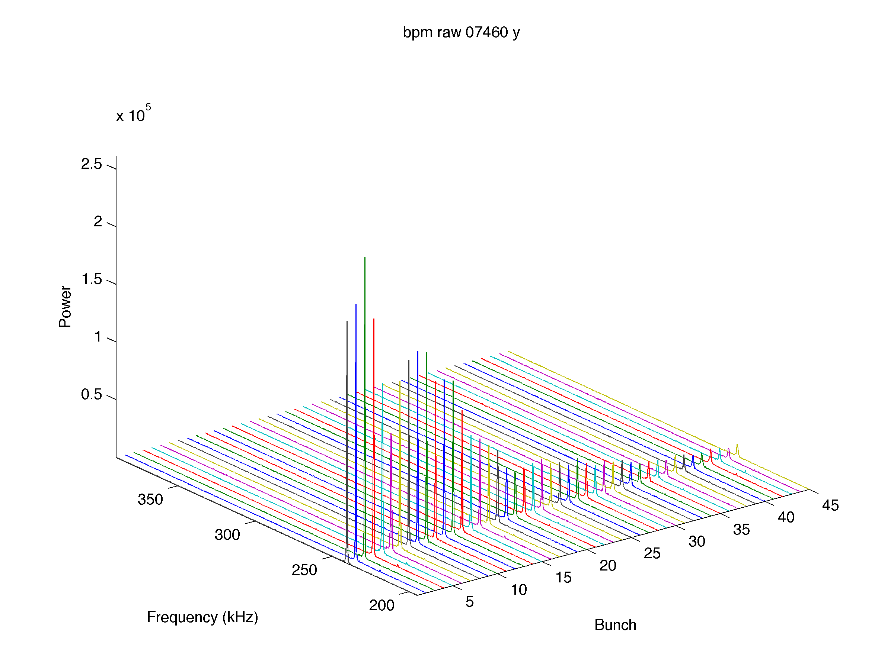
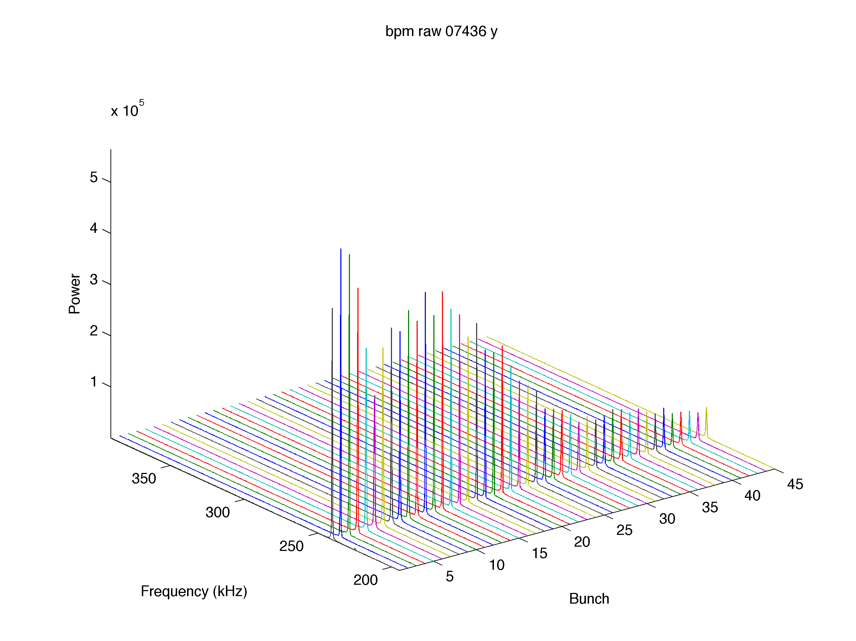
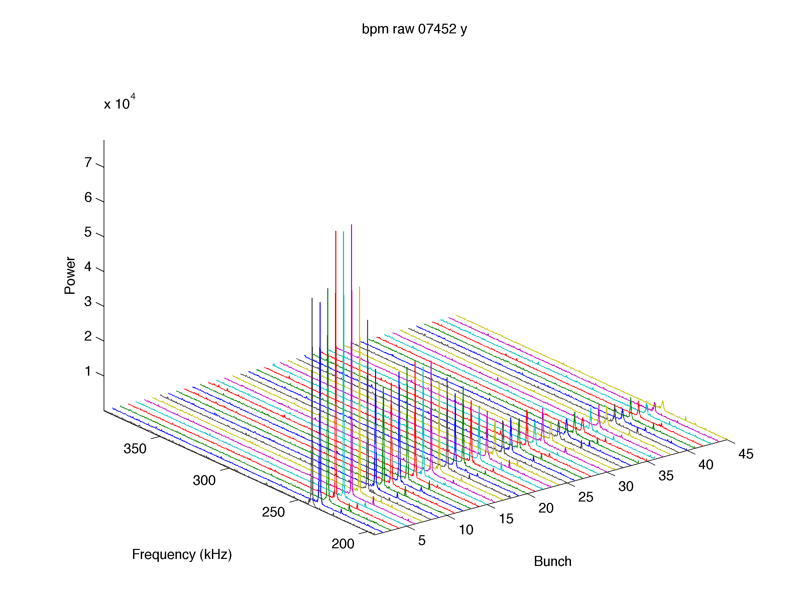
Vertical Orbit/Tune at different vertical pinger settings.
Vertical Orbit (Movie)
Vertical Tune (Movie)
Strong Vertical damping is present towards the end of the train
Vertical Spectrum for 45 bunch train
V-pinger=74cu
V-pinger=30cu
V-pinger=50cu

Slide 5
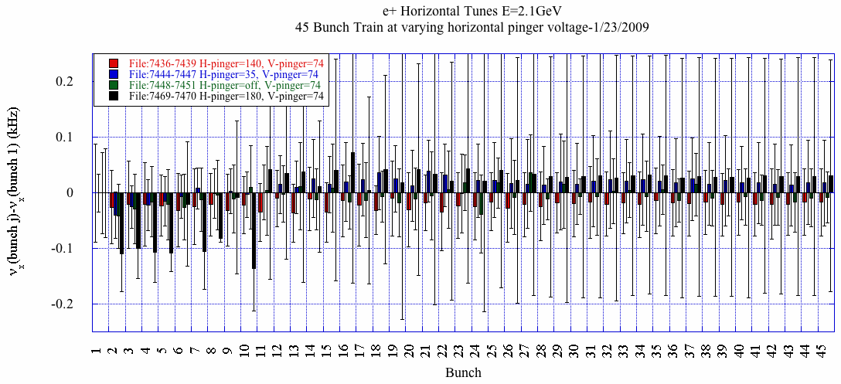
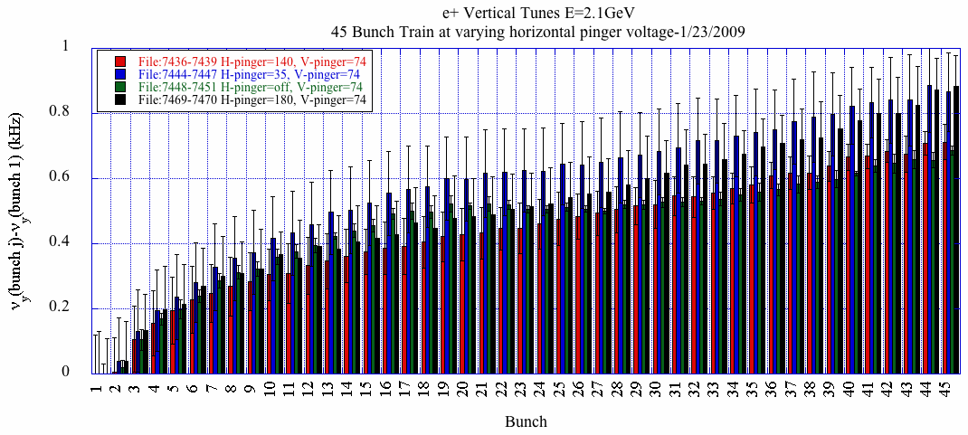
Systematic studies
e+ I=0.5mA/bunch
-Varied the vertical pinger from 0-140cu.
-Measured the vertical/horizontal orbit for all 45 bunches over 1024 turns at each pinger setting. Orbit is measured 4 times at each current setting.
-FFT orbit to determine the single bunch tune for all 45 bunches in the train.
No horizontal tune shift along the train.
Strong vertical tune shift along train that does not vary much due to the horizontal pinger setting.

Slide 6
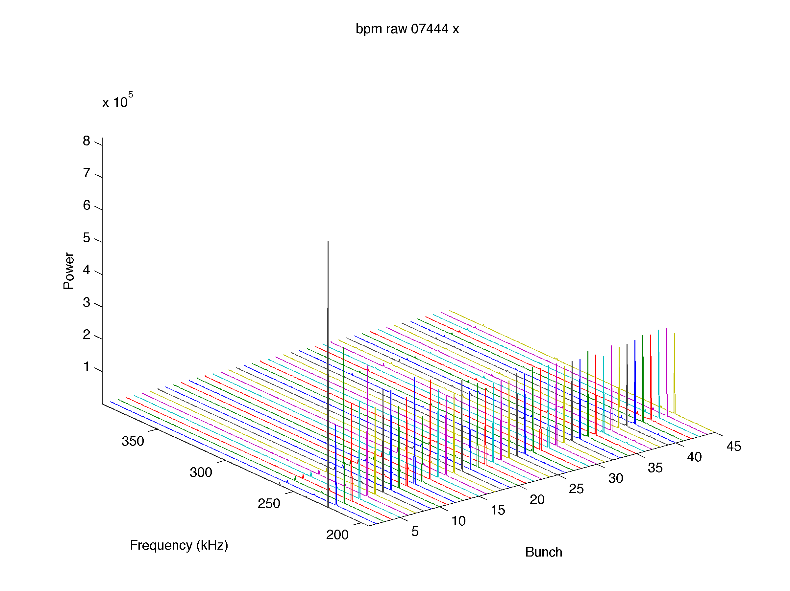
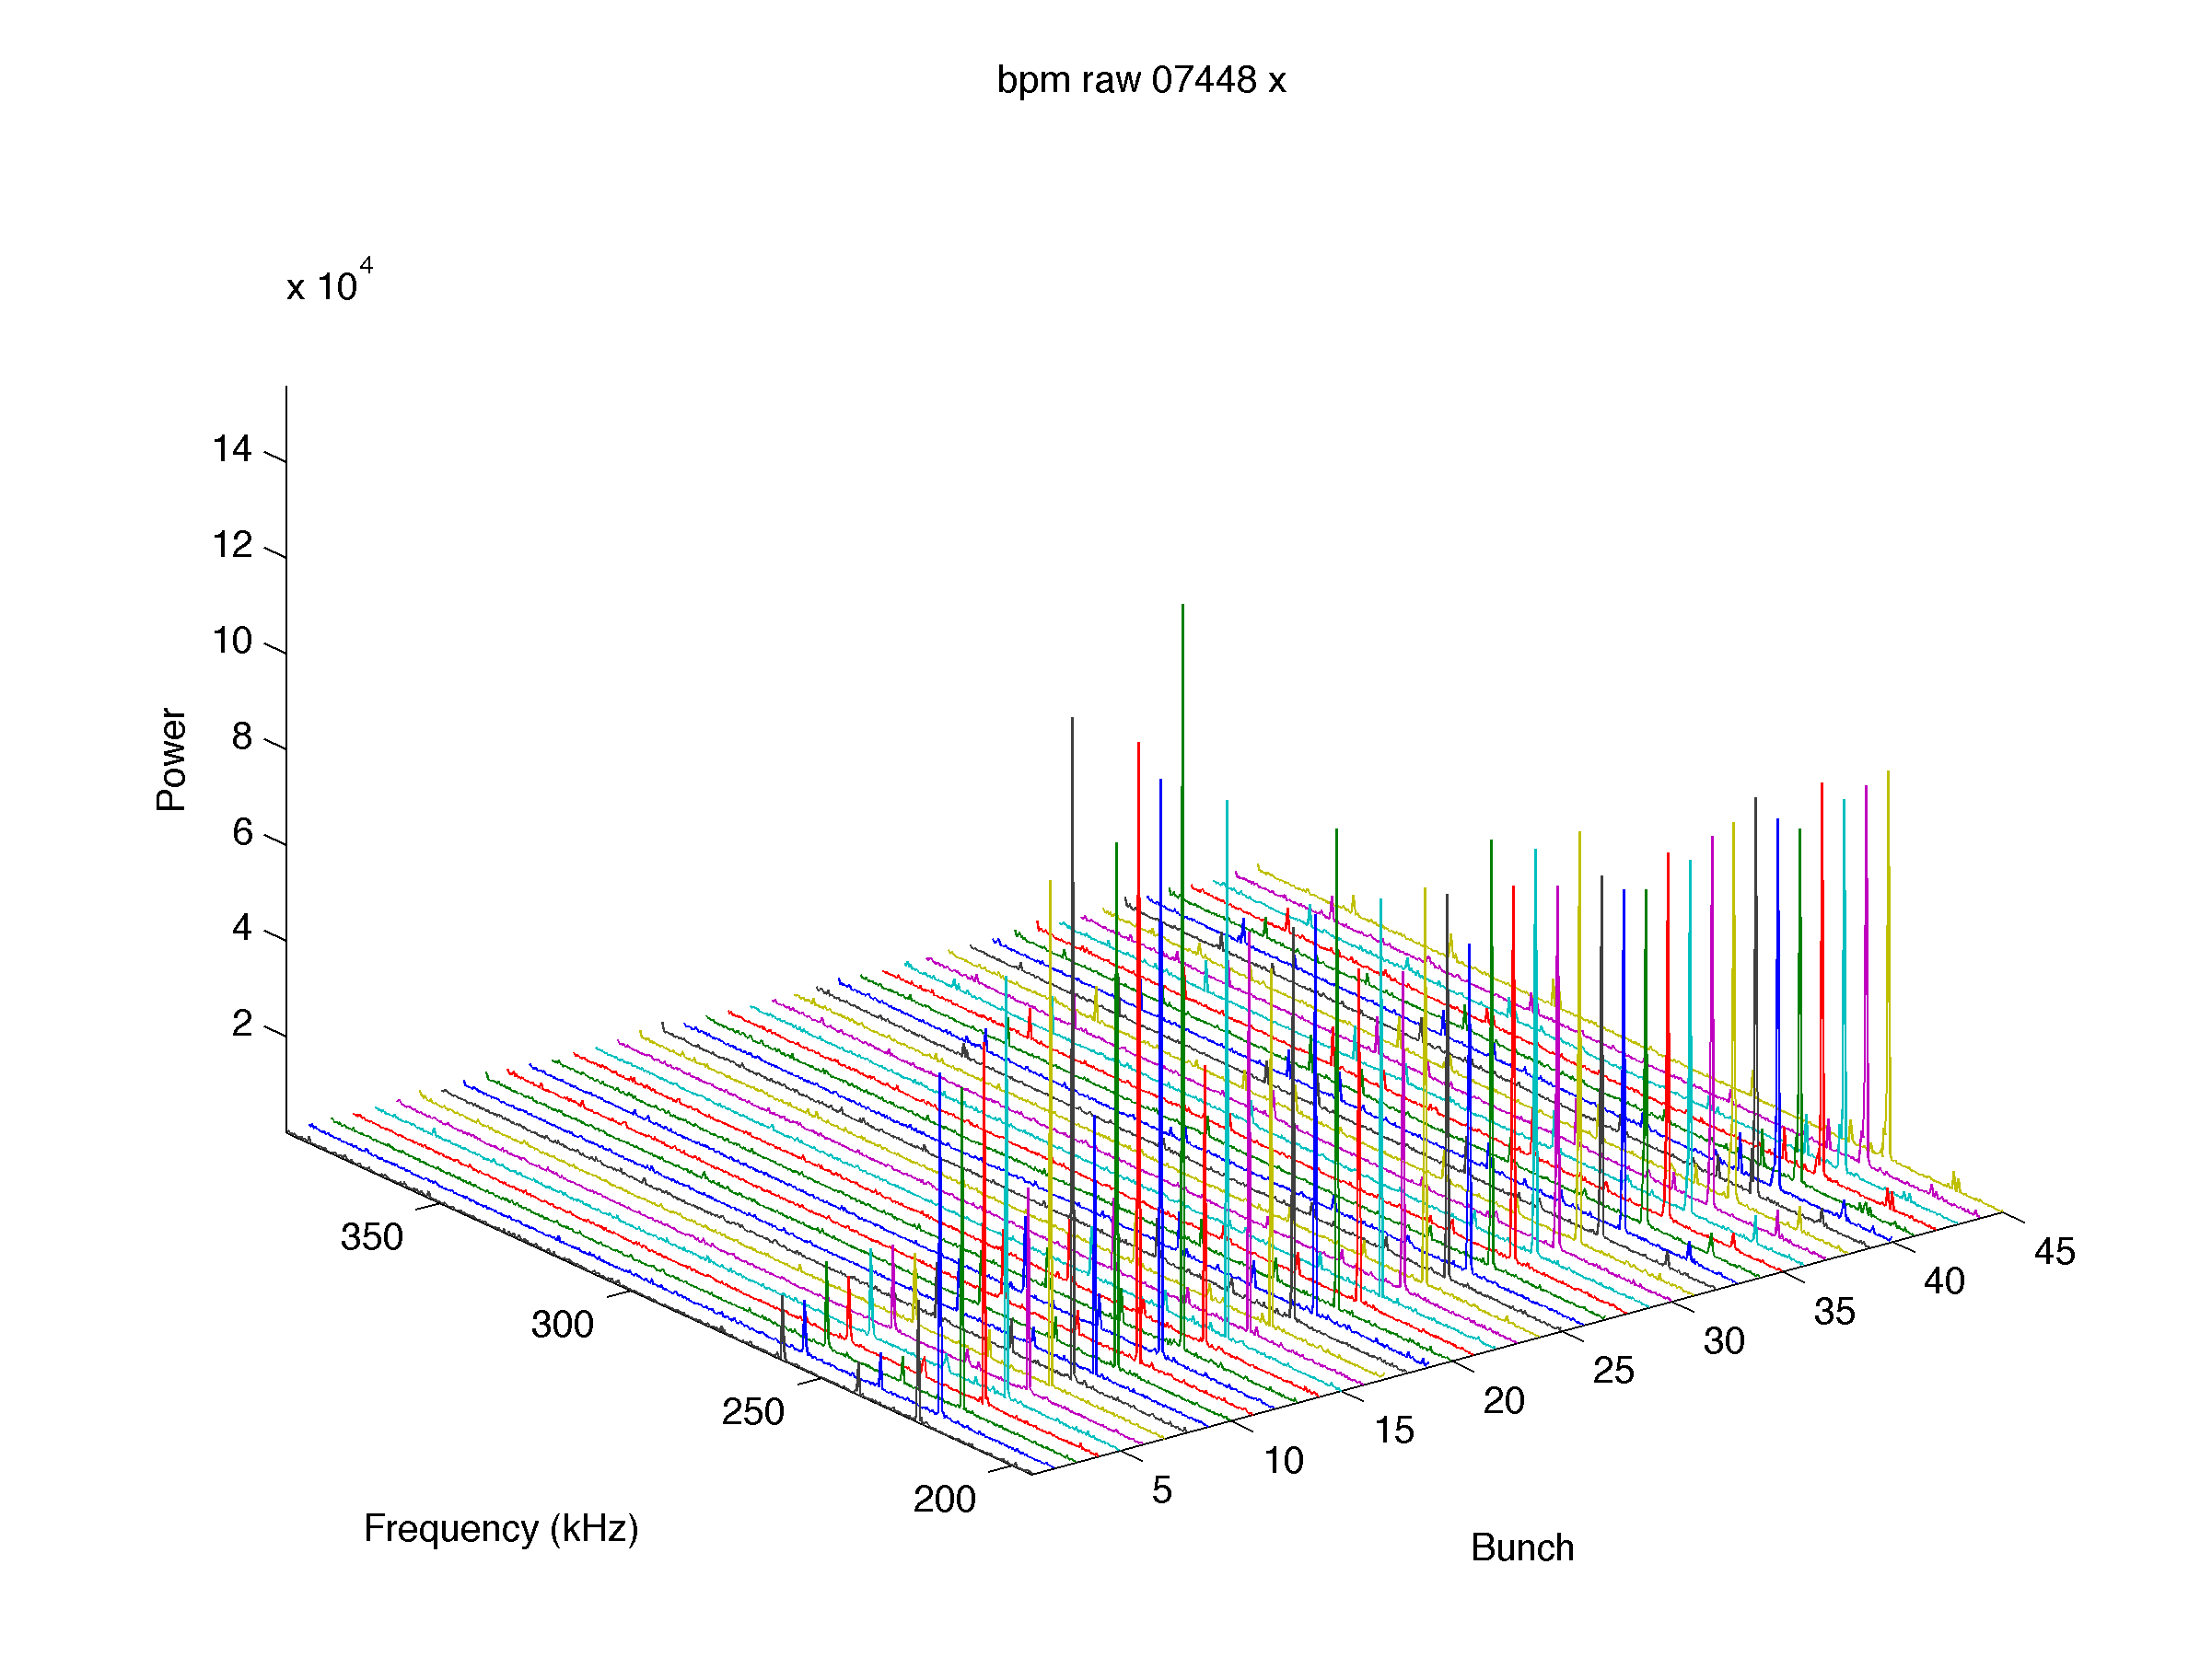
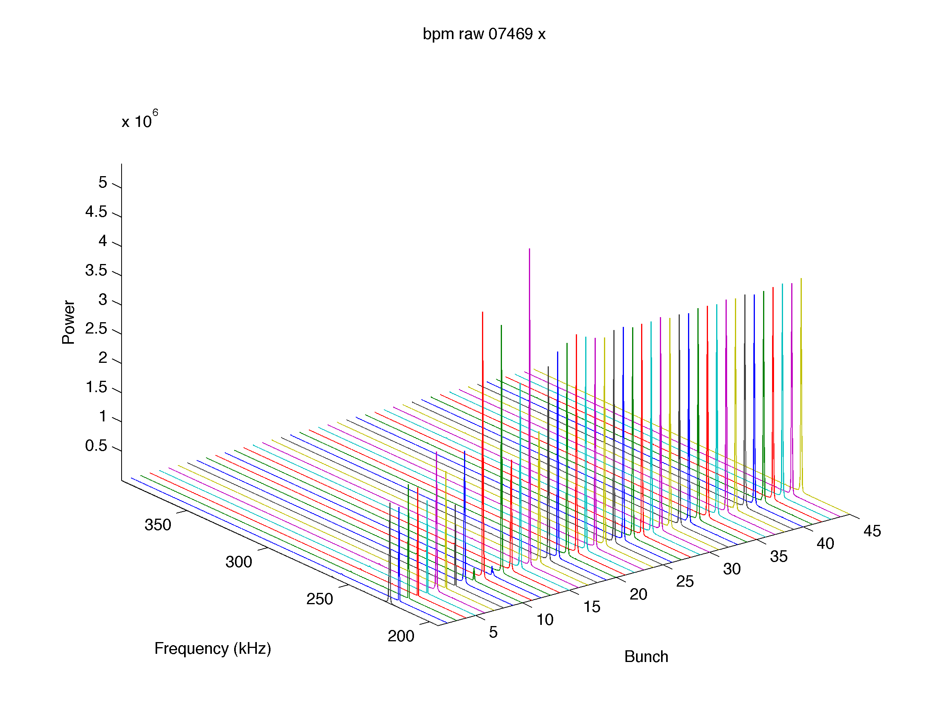
Horizontal Orbit/Tune at different horizontal pinger settings.
Horizontal Orbit (Movie)
Horizontal Tune (Movie)
Horizontal Spectrum for 45 bunch train
H-pinger=off
H-pinger=180cu
H-pinger=140cu
H-pinger=35cu

Slide 7
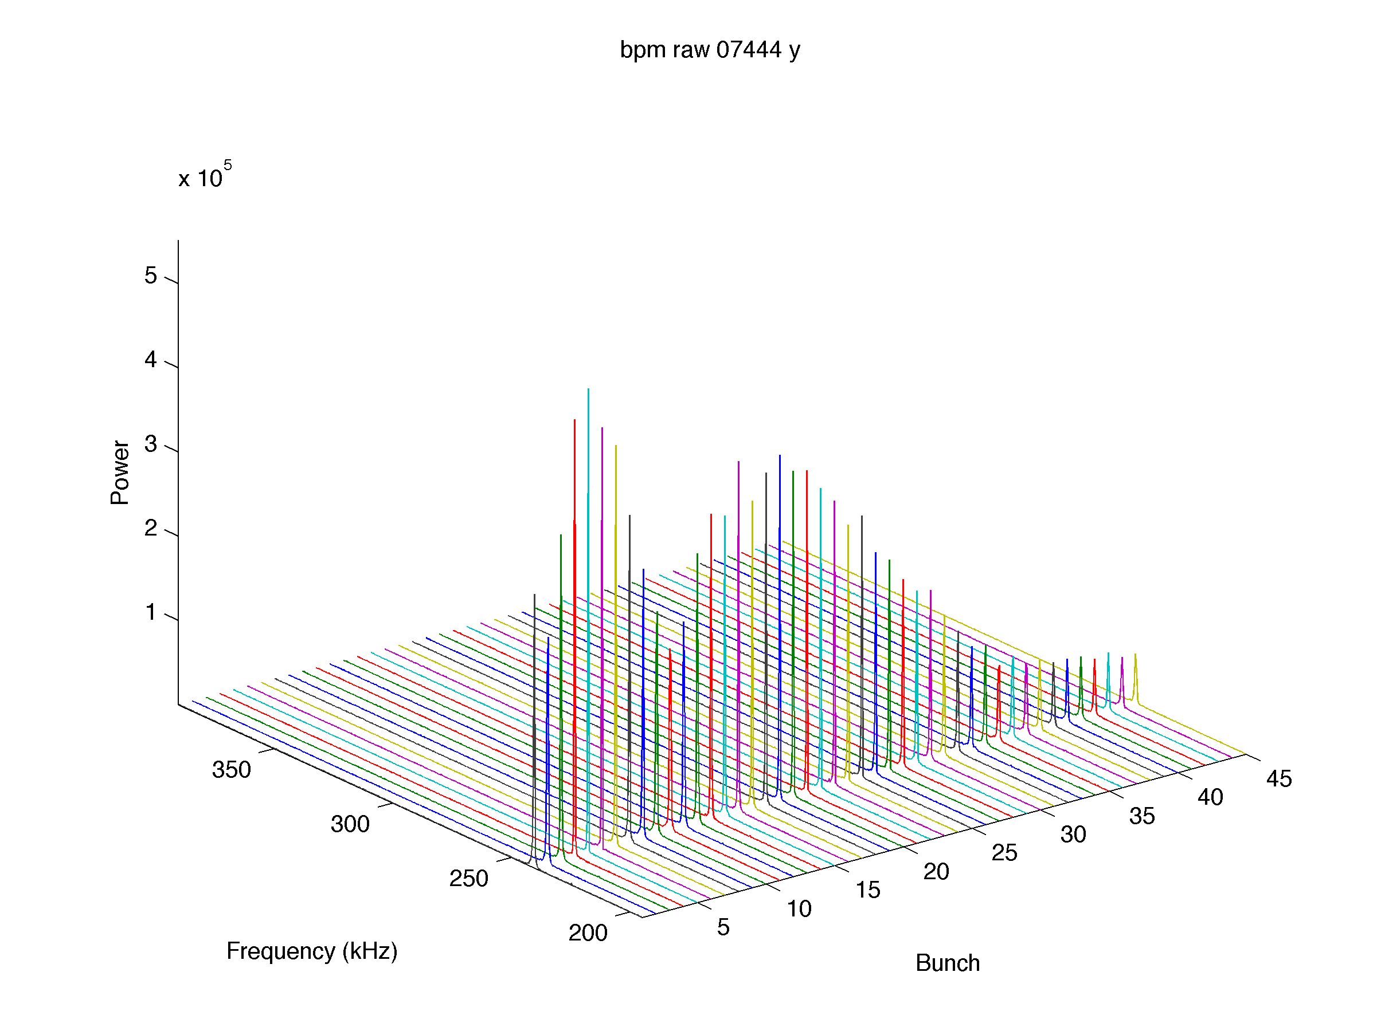
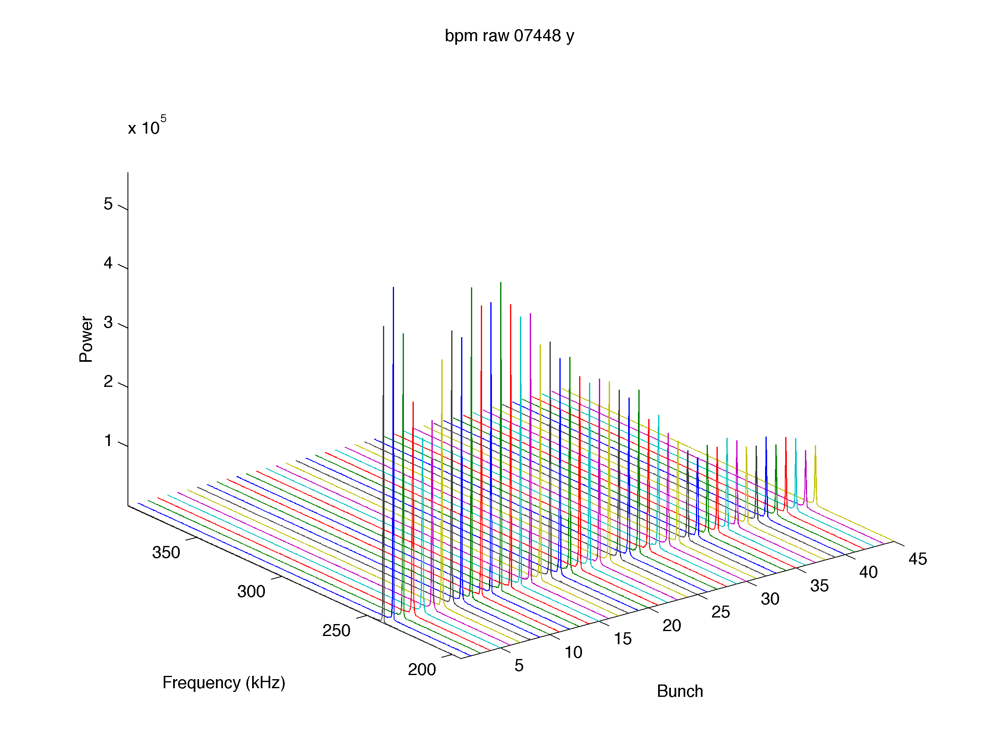
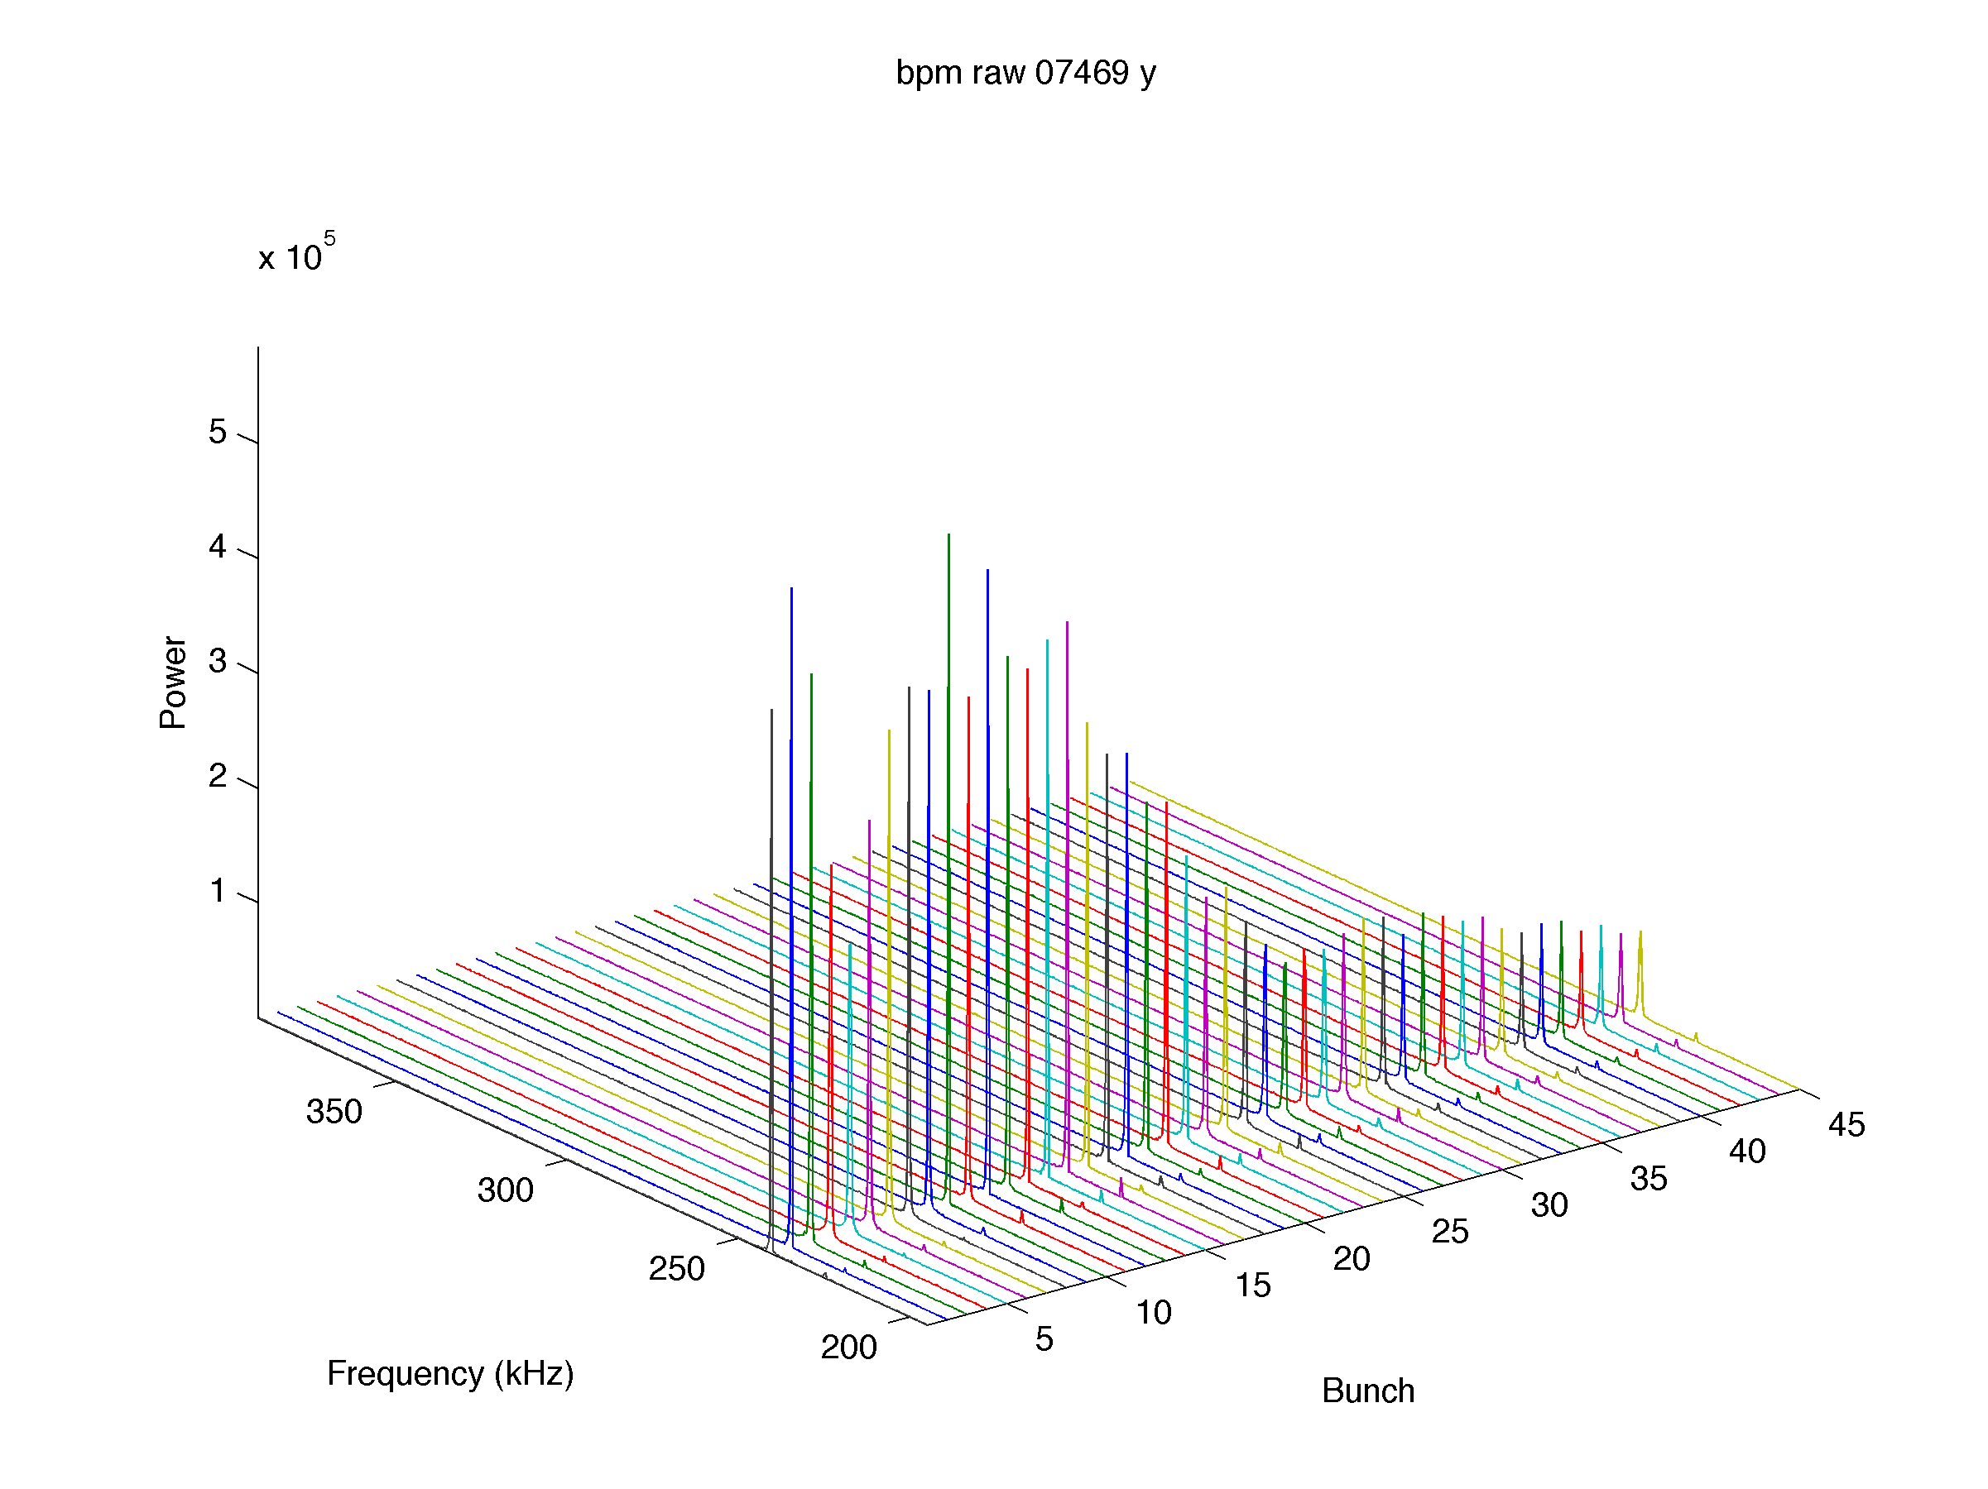
Vertical Orbit/Tune at different horizontal pinger settings.
Vertical Orbit (Movie)
Vertical Tune (Movie)
Strong Vertical damping is present towards the end of the train
Vertical Spectrum for 45 bunch train
H-pinger=off
H-pinger=180cu
H-pinger=140cu
H-pinger=35cu

Slide 8
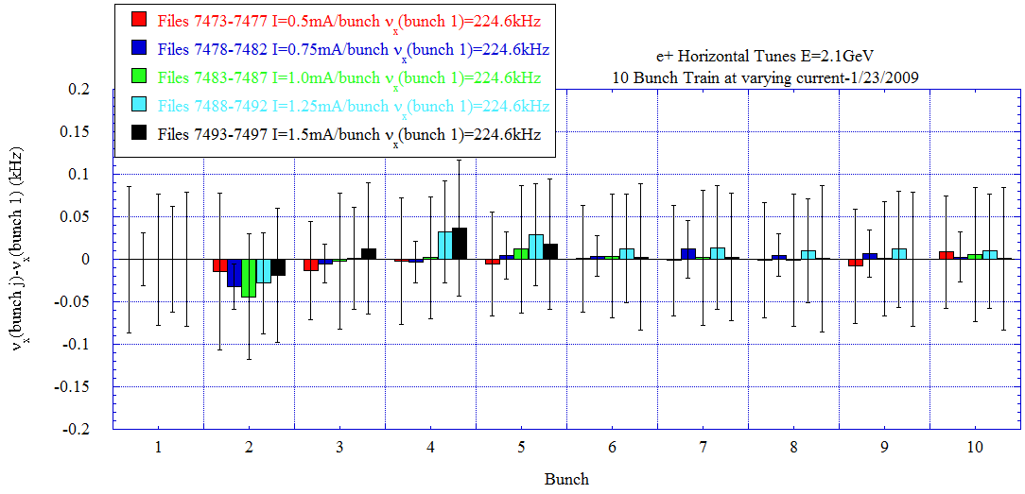
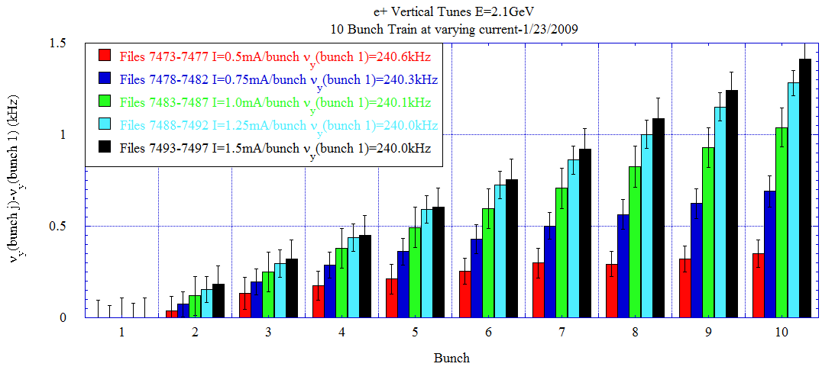
Tune versus I for 10 bunch e+ train
-Varied the current from 0.5 to 1.5mA/bunch.
-Measured the vertical/horizontal orbit for all 10 bunches over 1024 turns at each current setting. Orbit is measured 5 times at each current setting.
-FFT orbit to determine the single bunch tune for all 10 bunches in the train.
No horizontal tune shift along the train.
Strong vertical tune shift along train that increases with current.

Slide 9
Current dependent Vertical damping is present towards the end of the train
Orbit/Tune at different current settings.
Horizontal orbit/tune (Movie)
Vertical orbit/tune (Movie)

Slide 10
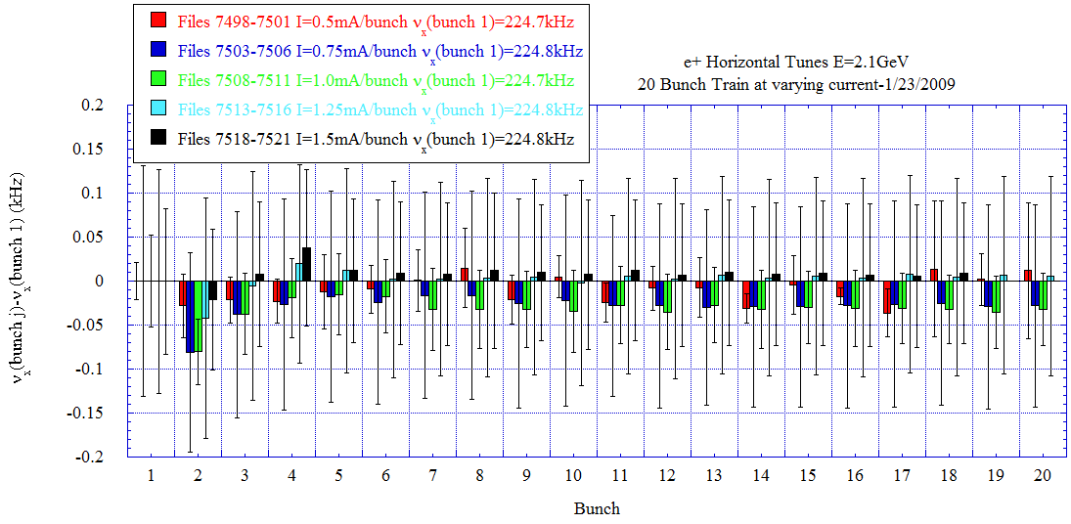
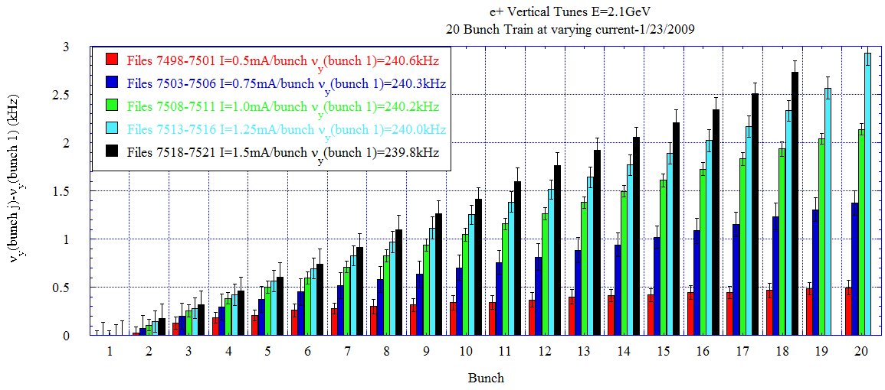
Tune versus I for 20 bunch e+ train
-Varied the current from 0.5 to 1.5mA/bunch.
-Measured the vertical/horizontal orbit for all 20 bunches over 1024 turns at each current setting. Orbit is measured 5 times at each current setting.
-FFT orbit to determine the single bunch tune for all 20 bunches in the train.
No horizontal tune shift along the train.
Strong vertical tune shift along train that increases with current. Bunches 19-20 at 1.5mA/bunch were lost.

Slide 11
Current dependent Vertical damping is present towards the end of the train
Orbit/Tune at different current settings.
Horizontal orbit/tune (Movie)
Vertical orbit/tune (Movie)

