Slide 1
Electron cloud tune shift measurements for long trains
Tune Shift versus current: Measured the tune shift for 45 and 115 bunch positron trains with 14ns bunch spacing at various bunch currents.
These results are from measurements made by M. Billing, M. Palmer, G. Dugan, and R. Holtzapple on 1/27/2009.

Slide 2
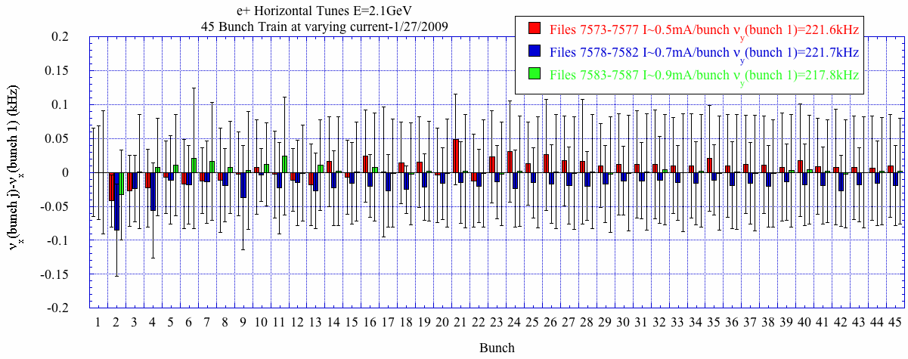
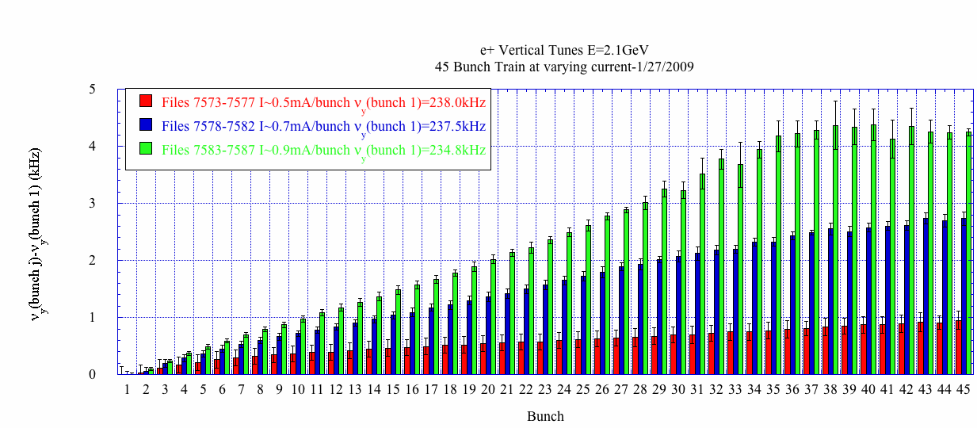
Tune versus I for 45 bunch e+ train
-Varied the current from 0.5 to 0.9mA/bunch.
-Measured the vertical/horizontal orbit 5 times for all 45 bunches over 1024 turns at each current setting.
-FFT orbit to determine the single bunch tune for all 45 bunches in the train.
No horizontal tune shift along the train.
Linear vertical tune shift along train at 0.5 and 0.7mA/bunch. At 0.9mA/bunch, the tune growth levels off after ~35 bunches.

Slide 3
Current dependent Vertical damping is present towards the end of the train
Orbit/Tune at different current settings.
Horizontal orbit/tune (Movie)
Vertical orbit/tune (Movie)
Width of vertical tune signal increase along the bunch train.

Slide 4
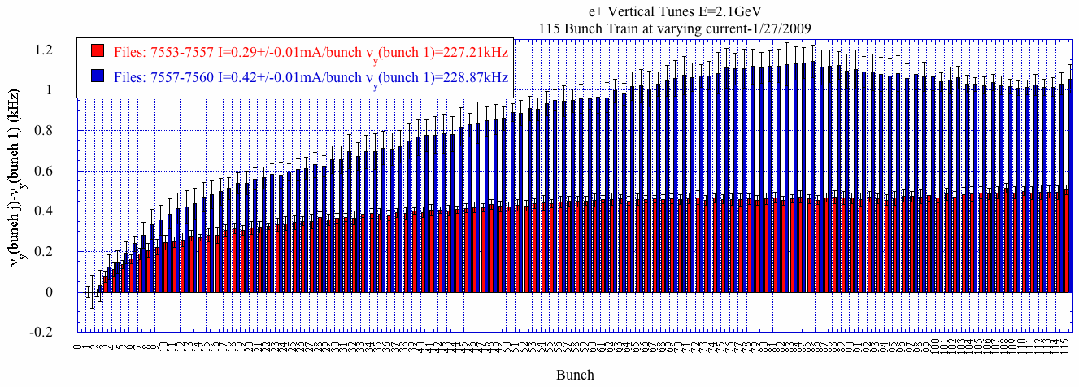
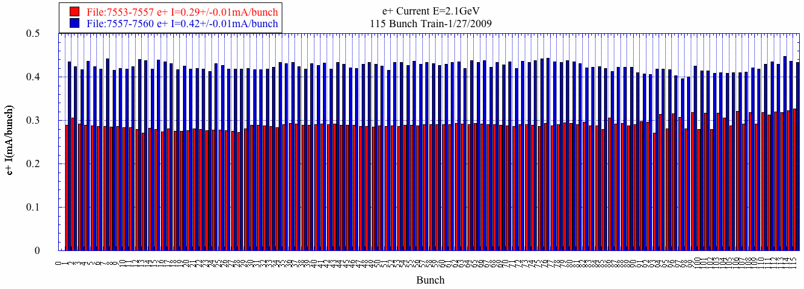
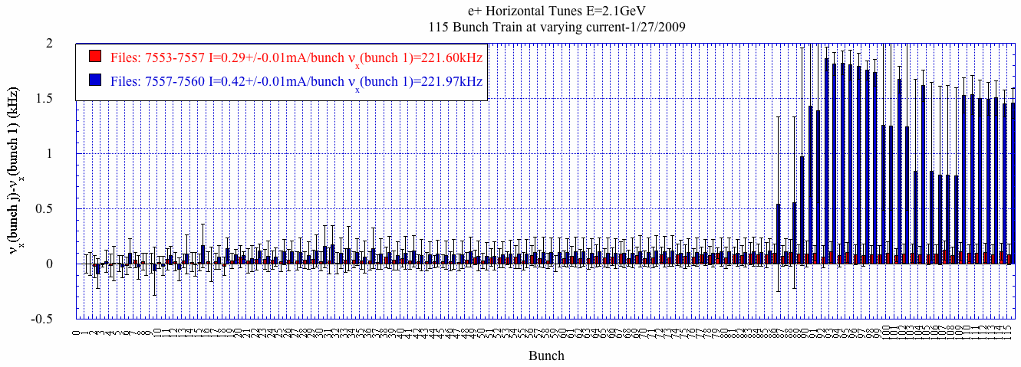
Tune versus I for 115 bunch e+ train
-Measured the tunes at two currents, 0.29 to 0.42mA/bunch with first bunch tunes set at:
A jump in the horizontal tune is detected in the beam spectrum at ~bunch 90 when I=0.42mA/bunch.
Strong vertical tune shift is detected at the front of the train that changes slope after the initial 10 bunches. At I=0.29mA/bunch, the tune gradually increases along train. At I=0.42mA/bunch, the tune shift has a steeper slope until ~bunch 80 where it levels out.

Slide 5
A horizontal instability is present near the end of the train when I=0.42mA/bunch.
Orbit/Tune at different current settings.
Horizontal orbit/tune (Movie)
Vertical orbit/tune (Movie)
A strong signal is detected near the horizontal tune at ~bunch 50 when I=0.42mA/bunch.

Slide 6
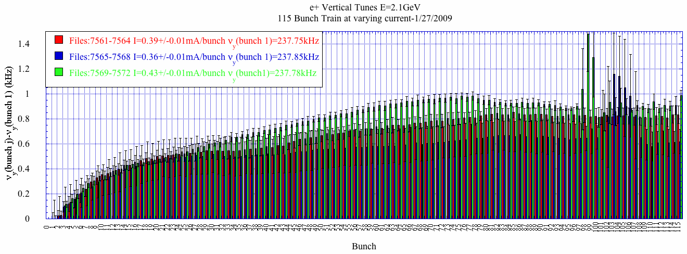
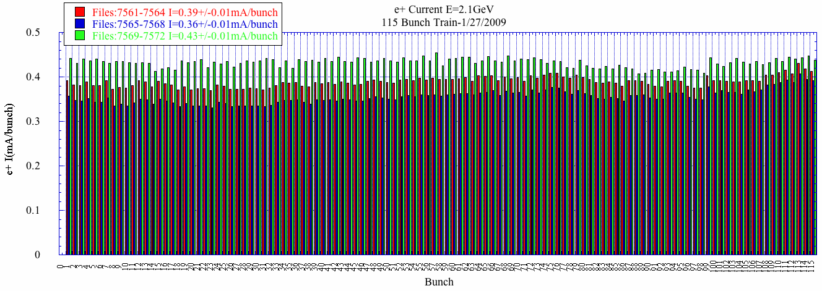
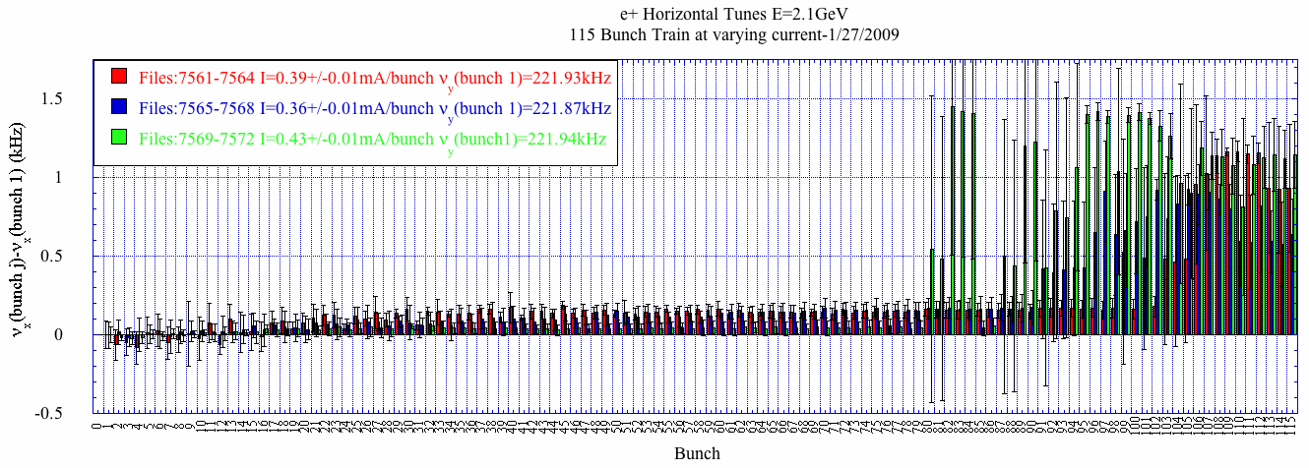
Tune versus I for 115 bunch e+ train
-Measured the tunes at three currents, 0.36, 0.39, and 0.43mA/bunch at the first bunch tune setting of:
A jump in the horizontal tune is detected in the beam spectrum at all three currents.
A current dependent vertical tune shift is evident. A jump in the vertical tune is noted late in the train.

Slide 7
A horizontal instability is present near the end of the train at all currents.
Orbit/Tune at different current settings.
Horizontal orbit/tune (Movie)
Vertical orbit/tune (Movie)
A strong signal in the horizontal spectrum is detected near the horizontal tune near the end of the train.
Width of vertical tune signal increases when tune jumps.

