Slide 1
CBETA Bunch Pattern Generator Trigger Output Driver U12 Modification to Prevent Inadvertent Assertion of Laser Trigger
R. Michnoff, R. Hulsart, J. Renta
May 1, 2019

Slide 2
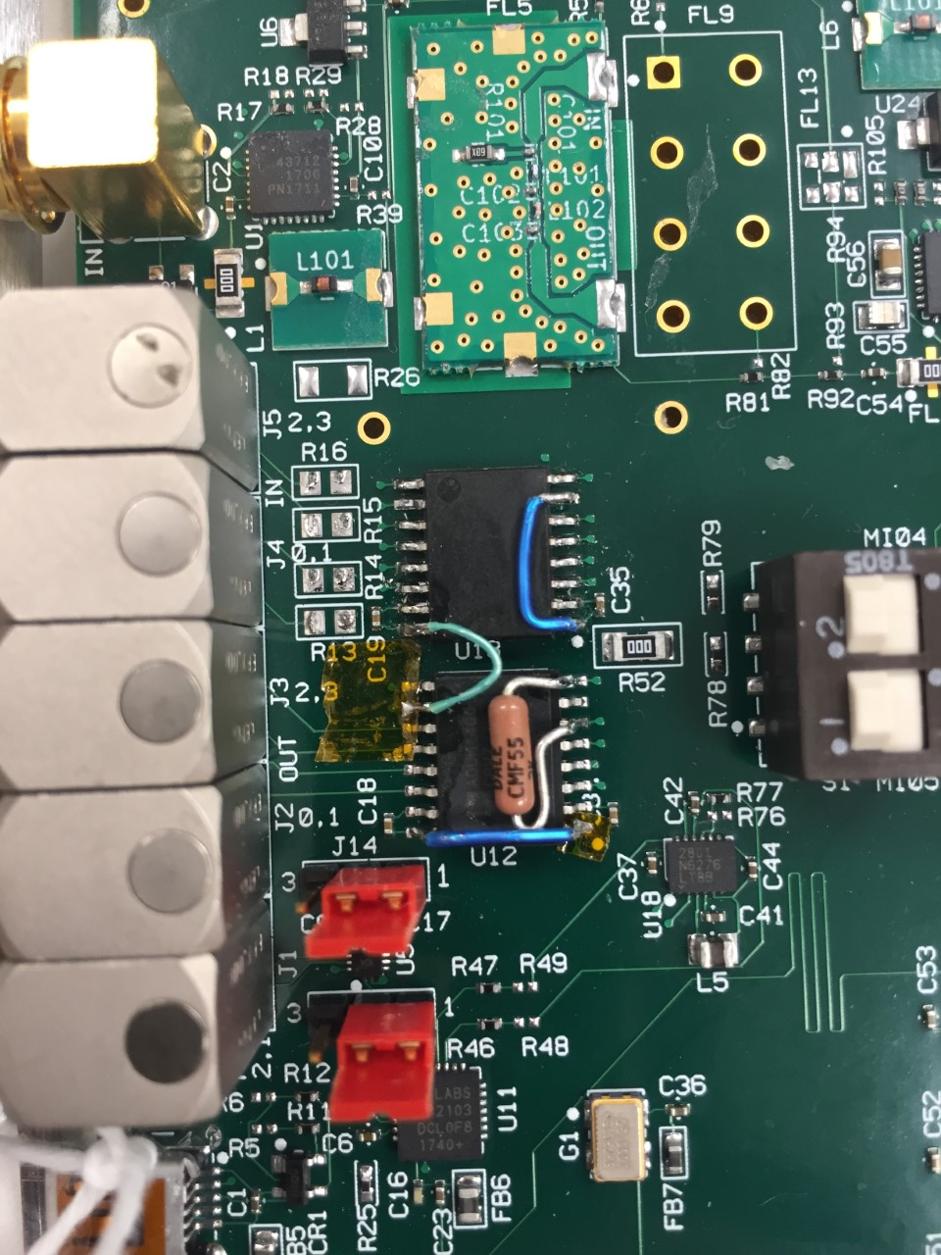
U12 ADUM1400 trigger driver modifications
Add 2k resistor across U12 pins 6 & 8
Lift pin 1 of U12 off pad (VDD1, +2.5V)
Solder jumper wire from U12 pin 16 (VDD2, +5V) to pin 1 (VDD1)
Lift U12 pin 10 of U12 off pad (VE2)
Solder jumper wire as shown to connect U12 pin 10 (VE2, output enable) to +2.5V.

Slide 3
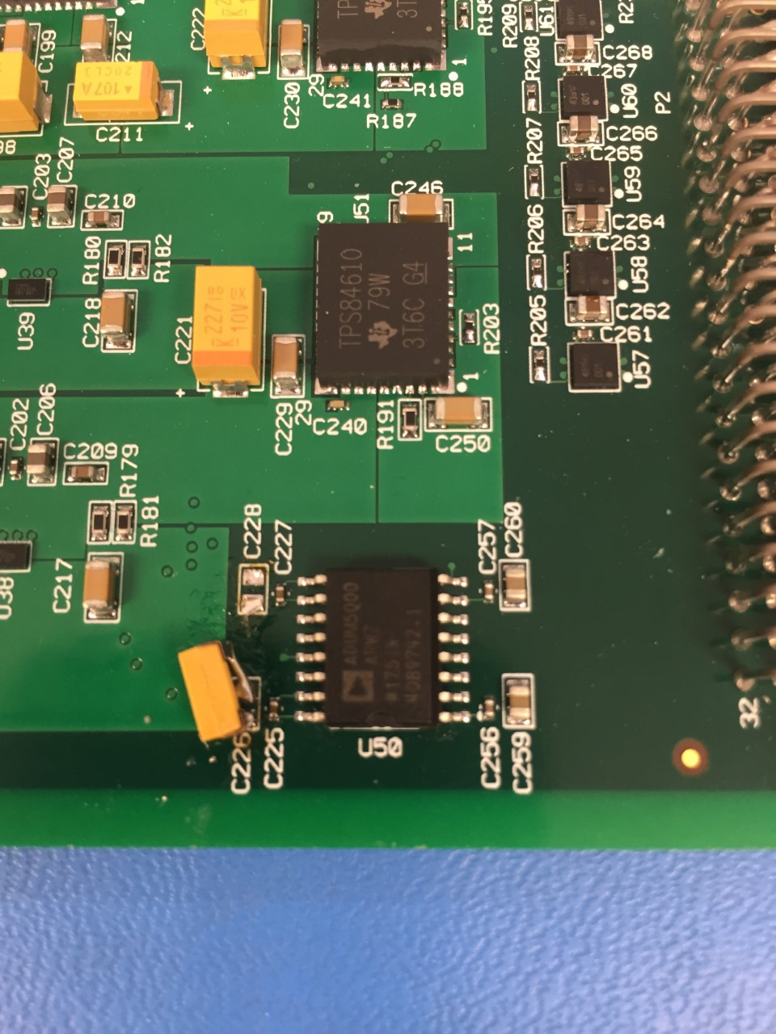
U12 Modifications (5V regulator output)
Remove C226 and C228
Install 100 uF, 10V tantalum cap in place of C226 (+ is toward edge of board).
A 6.3V 0603 100 uF cap like this from digikey may be acceptable:
https://www.digikey.com/product-detail/en/avx-corporation/F980J107MMAAXE/478-9836-2-ND/5957626

Slide 4
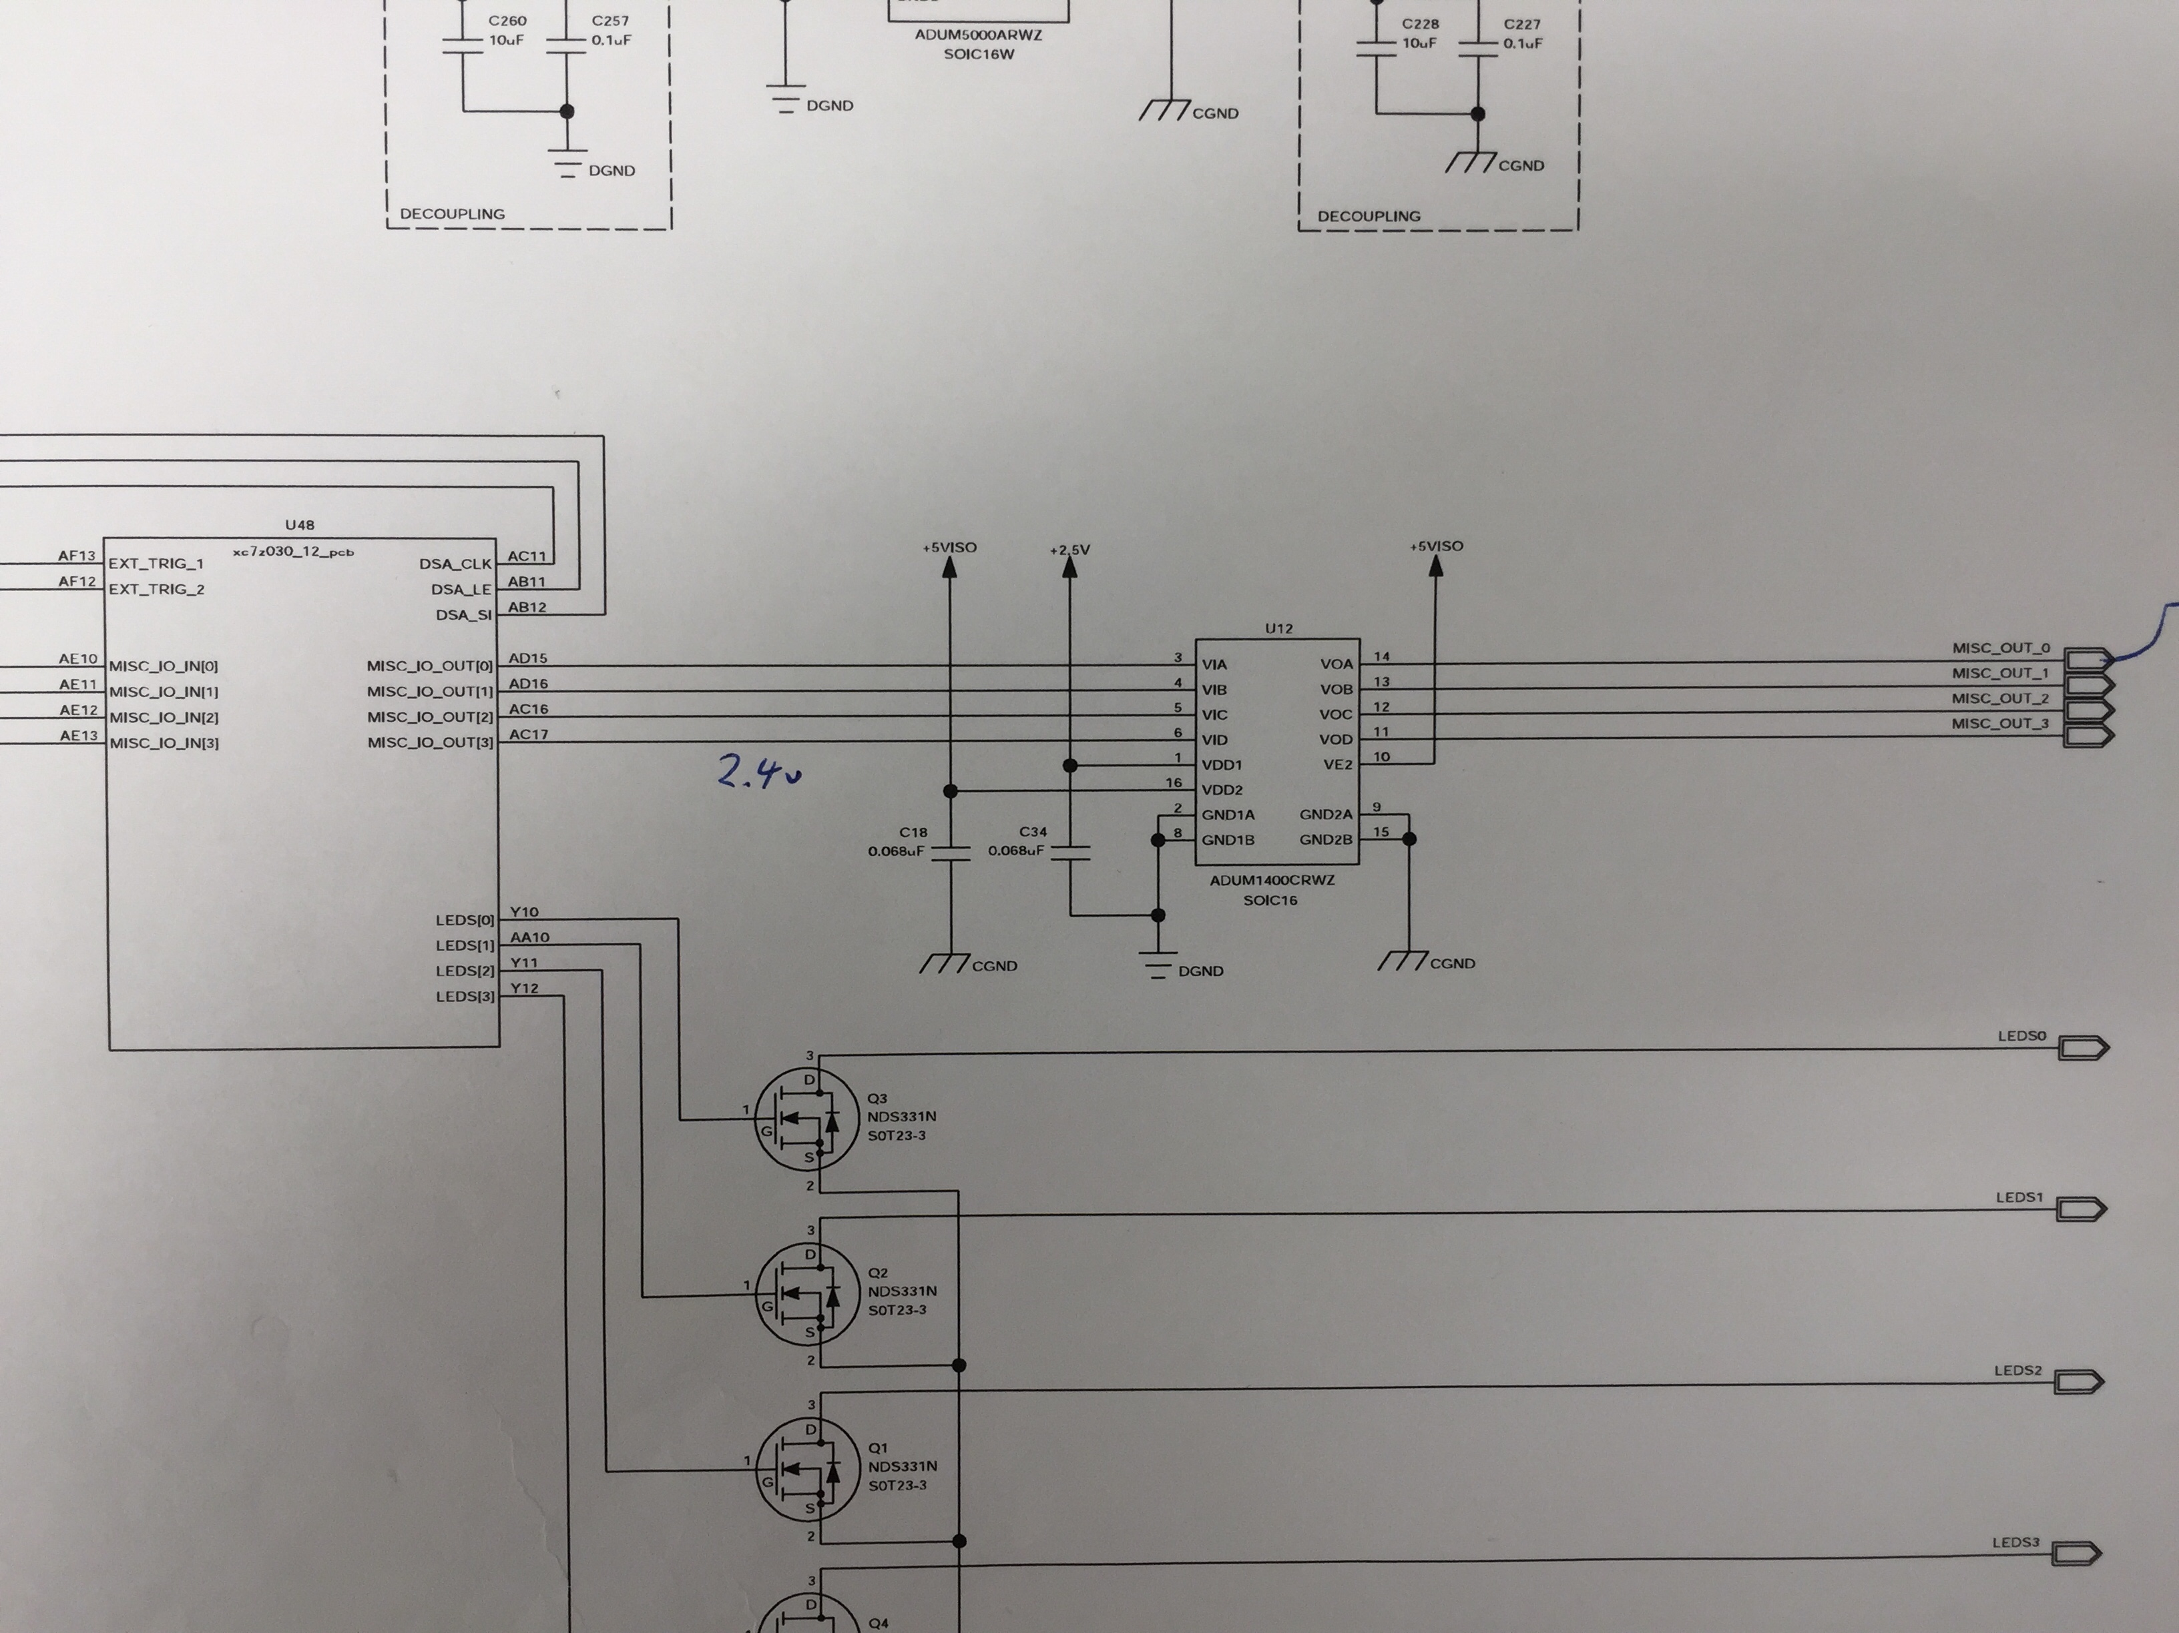
Schematic representation of modifications
Yellow x is disconnect
Red markings are additions
2k

Slide 5
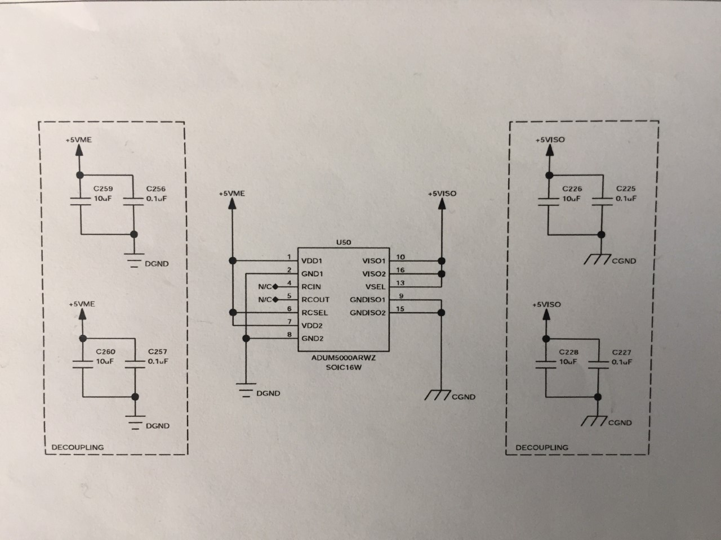
Schematic representation of modifications
Yellow x is disconnect
Red markings are additions
100uF

Slide 6
Reason for changes to U12 ADUM1400CRWZ
U12 is a quad-channel digital isolator used as an off-board driver for the bunch pattern generator laser trigger, bpm trigger and other triggers
On VME power cycles the laser trigger and other outputs were found to go high for more than 1 sec
On soft reboot of the bunch pattern generator firmware, the laser trigger and other outputs were found to go high for 0.5 sec

Slide 7
Explanation of problems and solutions
Problem 1:
On power up and gate array code loading, the zynq gate array outputs to the ADUM1400 are in an un-programmed state and were found to float high (due to an external hardware connection that enables an internal soft-pullup)
Solution:
This problem was resolved by installing the external 2k pull-down resistor, which forces the outputs to a logic low during the un-programmed state.

Slide 8
Explanation of problems and solutions
Problem 2:
Even with the pull-down resistor installed per the problem 1 solution, the outputs were still found to go high for up to several ms when the VME chassis power is turned on or turned off.
The V301 uses separate input and output power to the ADUM1400 to provide isolation. These 2 power supplies were found to have rise and fall times separated by several ms. The ADUM1400 outputs are incorrectly set to a logic high during this period where both supplies are not on or not off.
Solution:
Instead of using separate supplies, the 5V power is supplied to both inputs and outputs on the ADUM1400. This avoids the condition where one supply is on or partially on when the other supply is off or partially off.

Slide 9
Explanation of problems and solutions
Problem 3:
Even with both problem 1 and problem 2 solutions installed, the laser trigger output was found to sometimes go high for up to a few hundred microseconds when the VME chassis power is turned on or turned off.
The output was found to go high while the 5V power is ramping-up. This does not happen all the time.
2 different boards were modified. One of the boards has this few hundred microsecond high output and the other seems to have the output high with only a level of 0.5V and for only ~40 microseconds. The 5V ramp-up time is for some reason different on both boards.
Solution:
The ADUM1400 enable pin is now tied to +2.5V instead of +5V, and the input power and output power are both now tied to +5V, instead of 2.5V for input and 5V for output.
The capacitance on the output of the isolated 5V is changed from 20 uF (2 10 uF caps, C228, C226) to 100 uF.
Before any modifications, the 2.5V supply rises later than the 5V supply. By tying the enable to +2.5 V, the 5V power is fully applied to the chip before the enable is asserted. This prevents glitches on power-up.
The 100 uF cap across the +5V isolated power slows down the 5V ramp down when VME power is turned off. The +2.5V now turns off first, thereby de-asserting the enable while 5V power to the chip is still applied. This prevents glitches on power down.

Slide 10
Summary
These modifications seem to now prevent inadvertent assertion of the laser trigger output when:
VME power is turned on
VME power is turned off
A soft reboot is issued to the board
Gate array code is reloaded to the board

Slide 11
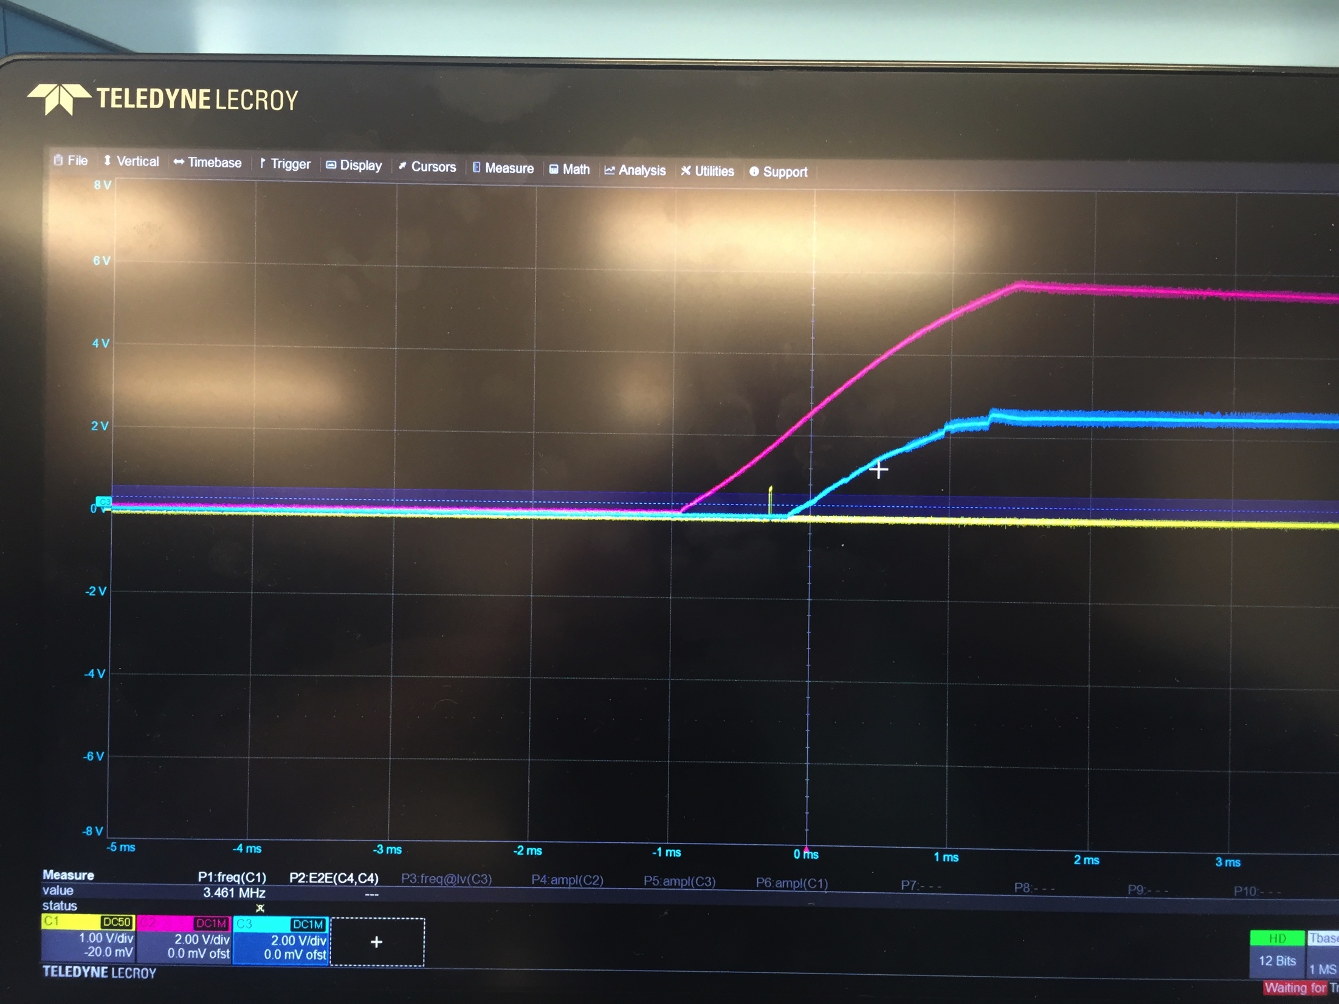
V301 power up
Blue: +2.5V
Pink: +5V
Yellow: laser trigger output
This is with:
100 uF cap installed at C226.
input and output power supplies both tied to +5V
ADUM1400 enable pin is open so the outputs are always enabled.
Note small glitch (with amplitude = ~0.5V) on laser trigger output when +5V goes above about 1.5V. This glitch is not present when +2.5V is applied to the enable pin because the outputs are enabled after the +5V increases is above a reasonable level (> ~1.5V).

Slide 12
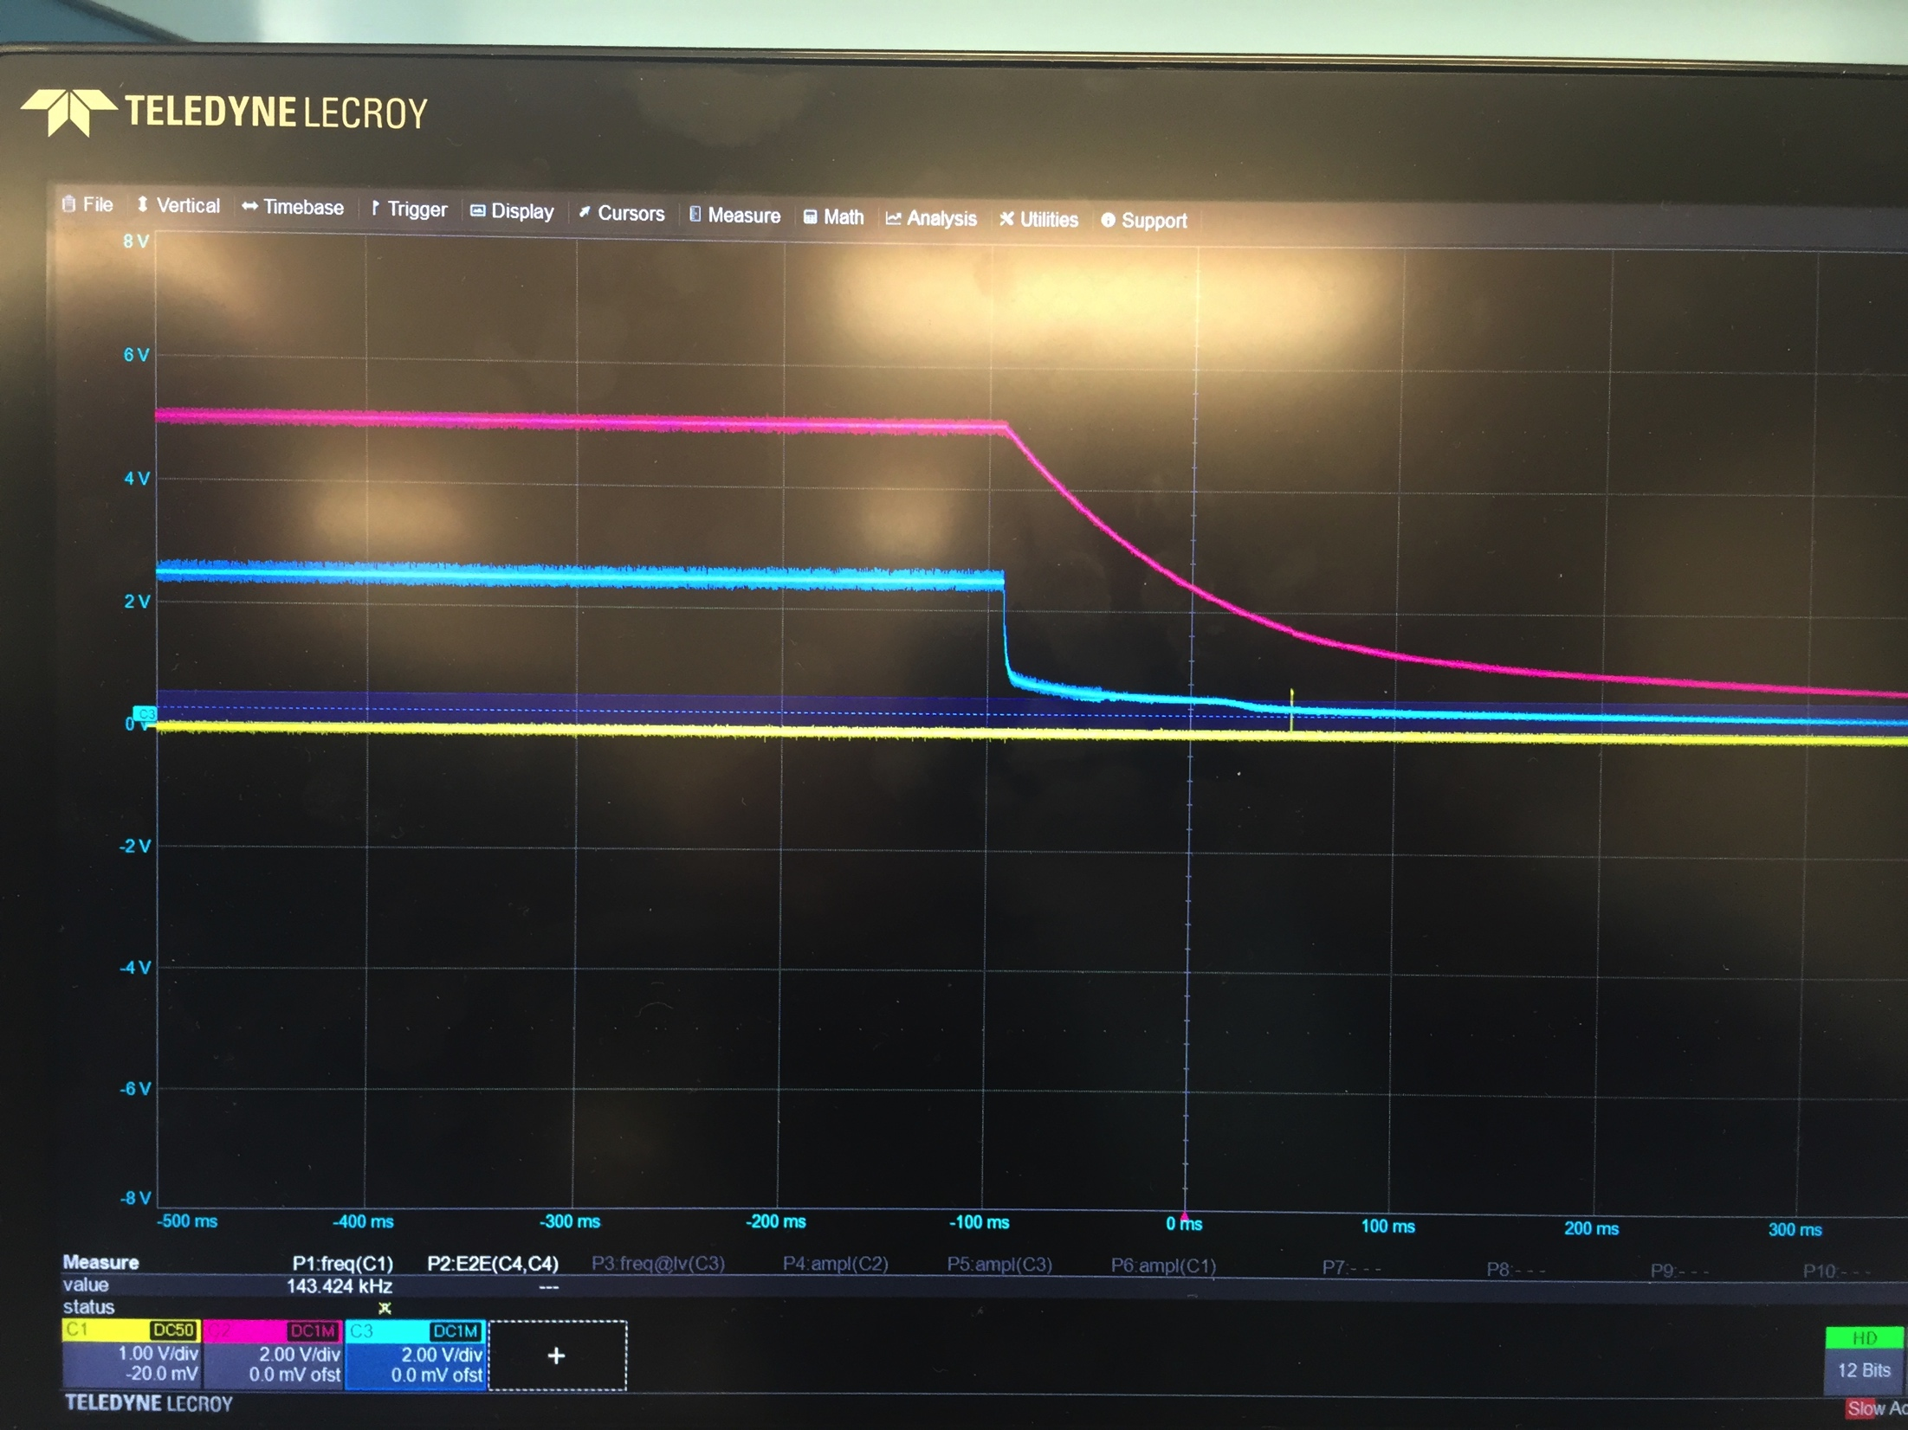
V301 power down
Blue: +2.5V
Pink: +5V
Yellow: laser trigger output
This is with:
100 uF cap installed at C226.
input and output power supplies both tied to +5V
ADUM1400 enable pin is open so the outputs are always enabled.
Note small glitch (with amplitude = ~0.5V) on laser trigger output when +5V goes below about 1.5V. This glitch is not present when +2.5V is applied to the enable pin because the outputs are disabled before the +5V decreases too signficantly.

