Slide 1
Milestones and Schedule
Technical Meeting September 18, 2017
Rob Michnoff

Slide 2
Milestone dates per the schedule
Present version of the schedule (which is now being used to status the project) shows activities completing too late, which will cause us to miss the contract milestone dates.

Slide 3
Some of the milestone date issues
Milestone | Date per schedule | Required date per NYSERDA contract
System integration complete | 10/1/2019 | 2/28/2019
Fractional arc test commissioning w/ beam | 4/20/2018 – 7/16/2018 | Complete by 4/30/2018
Single pass energy scan | 5/9/2019 – 9/16/2019 | Complete by 6/30/2019
Single pass energy recovery | 9/17/2019 – 1/28/2020 | Complete by 10/31/2019
Four pass energy recovery | 1/29/2020 – 4/28/20 | Complete by 12/31/2019
* Time to reconfigure machine from single pass energy recovery to four pass energy recovery is not presently provided in the schedule

Slide 4
Milestone list per the schedule
Although the milestone dates need to be modified, the list itself is very comprehensive and is a very valuable tool for tracking progress

Slide 5
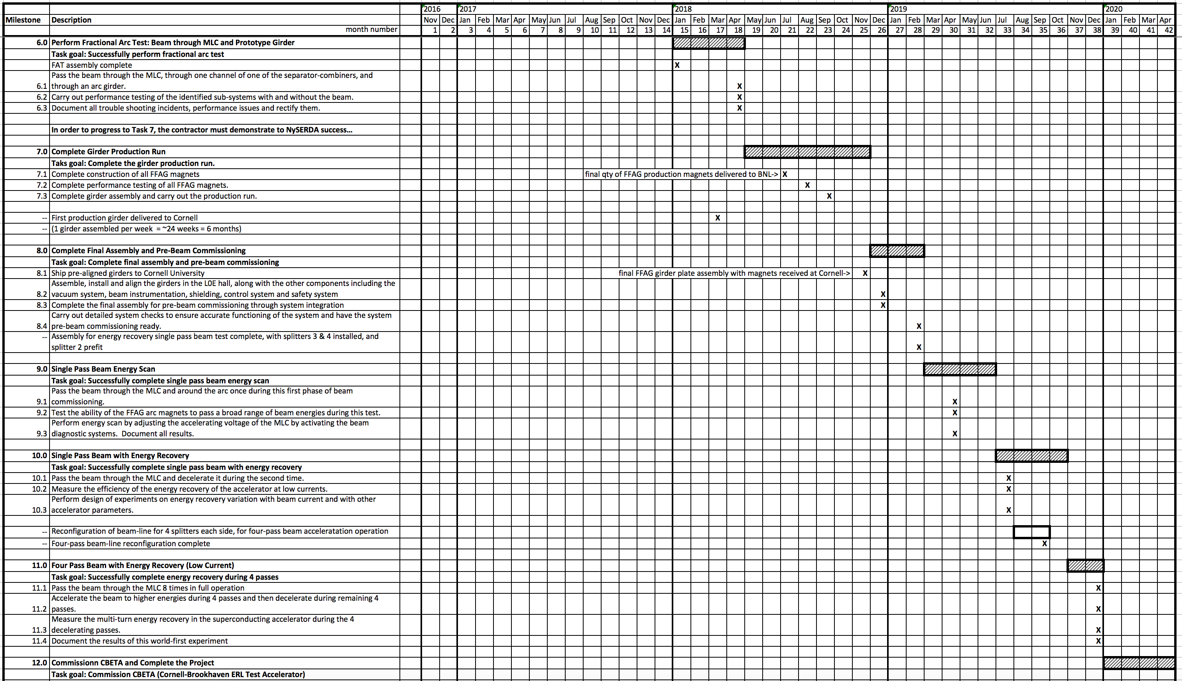
Schedule – Milestones 6-12

Slide 6
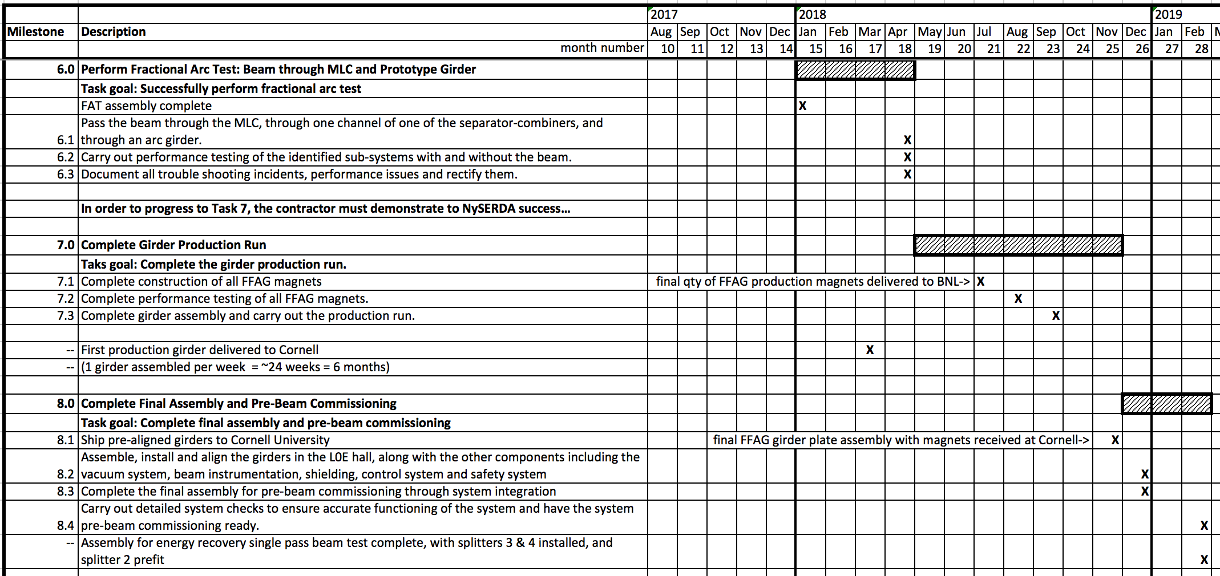
Schedule – Milestones 6-8
Fractional arc test assembly and pre-beam tests should be completed as early as possible – late Jan / early Feb. – to provide sufficient time for beam commissioning.
* First production girder (with vendor supplied magnets) should be shipped to Cornell mid-March 2018. Assuming one week to complete each girder plate assembly, about 6 months will be required.
Goal is to complete full assembly by 12/31/2018 to allow sufficient time for pre-beam testing.

Slide 7
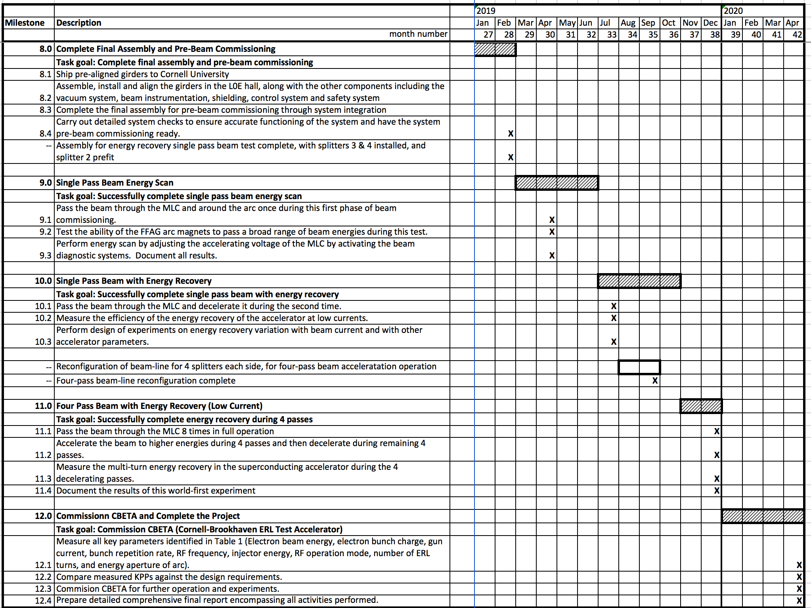
Schedule – Milestones 9-12
We might consider eliminating the beam energy scan tests to allow single pass energy recovery beam tests to begin early and provide sufficient time to reconfigure to four pass configuration and commission four pass energy recovery by 12/2019.
Single pass beam tests must begin March 1, 2019.

Slide 8
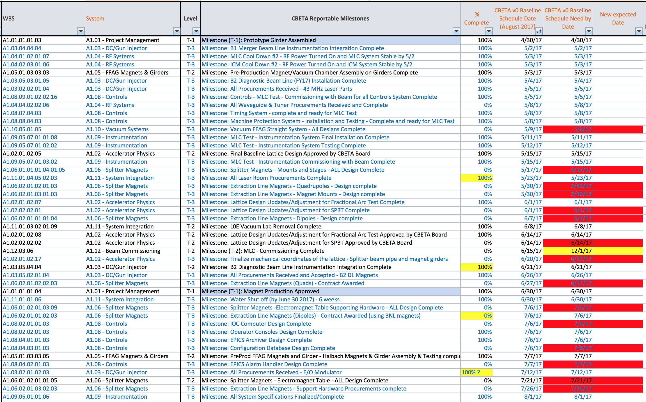
Milestone list
Yellow – Change to milestone date
Red – Overdue milestone
Blue background – Contract milestone

Slide 9
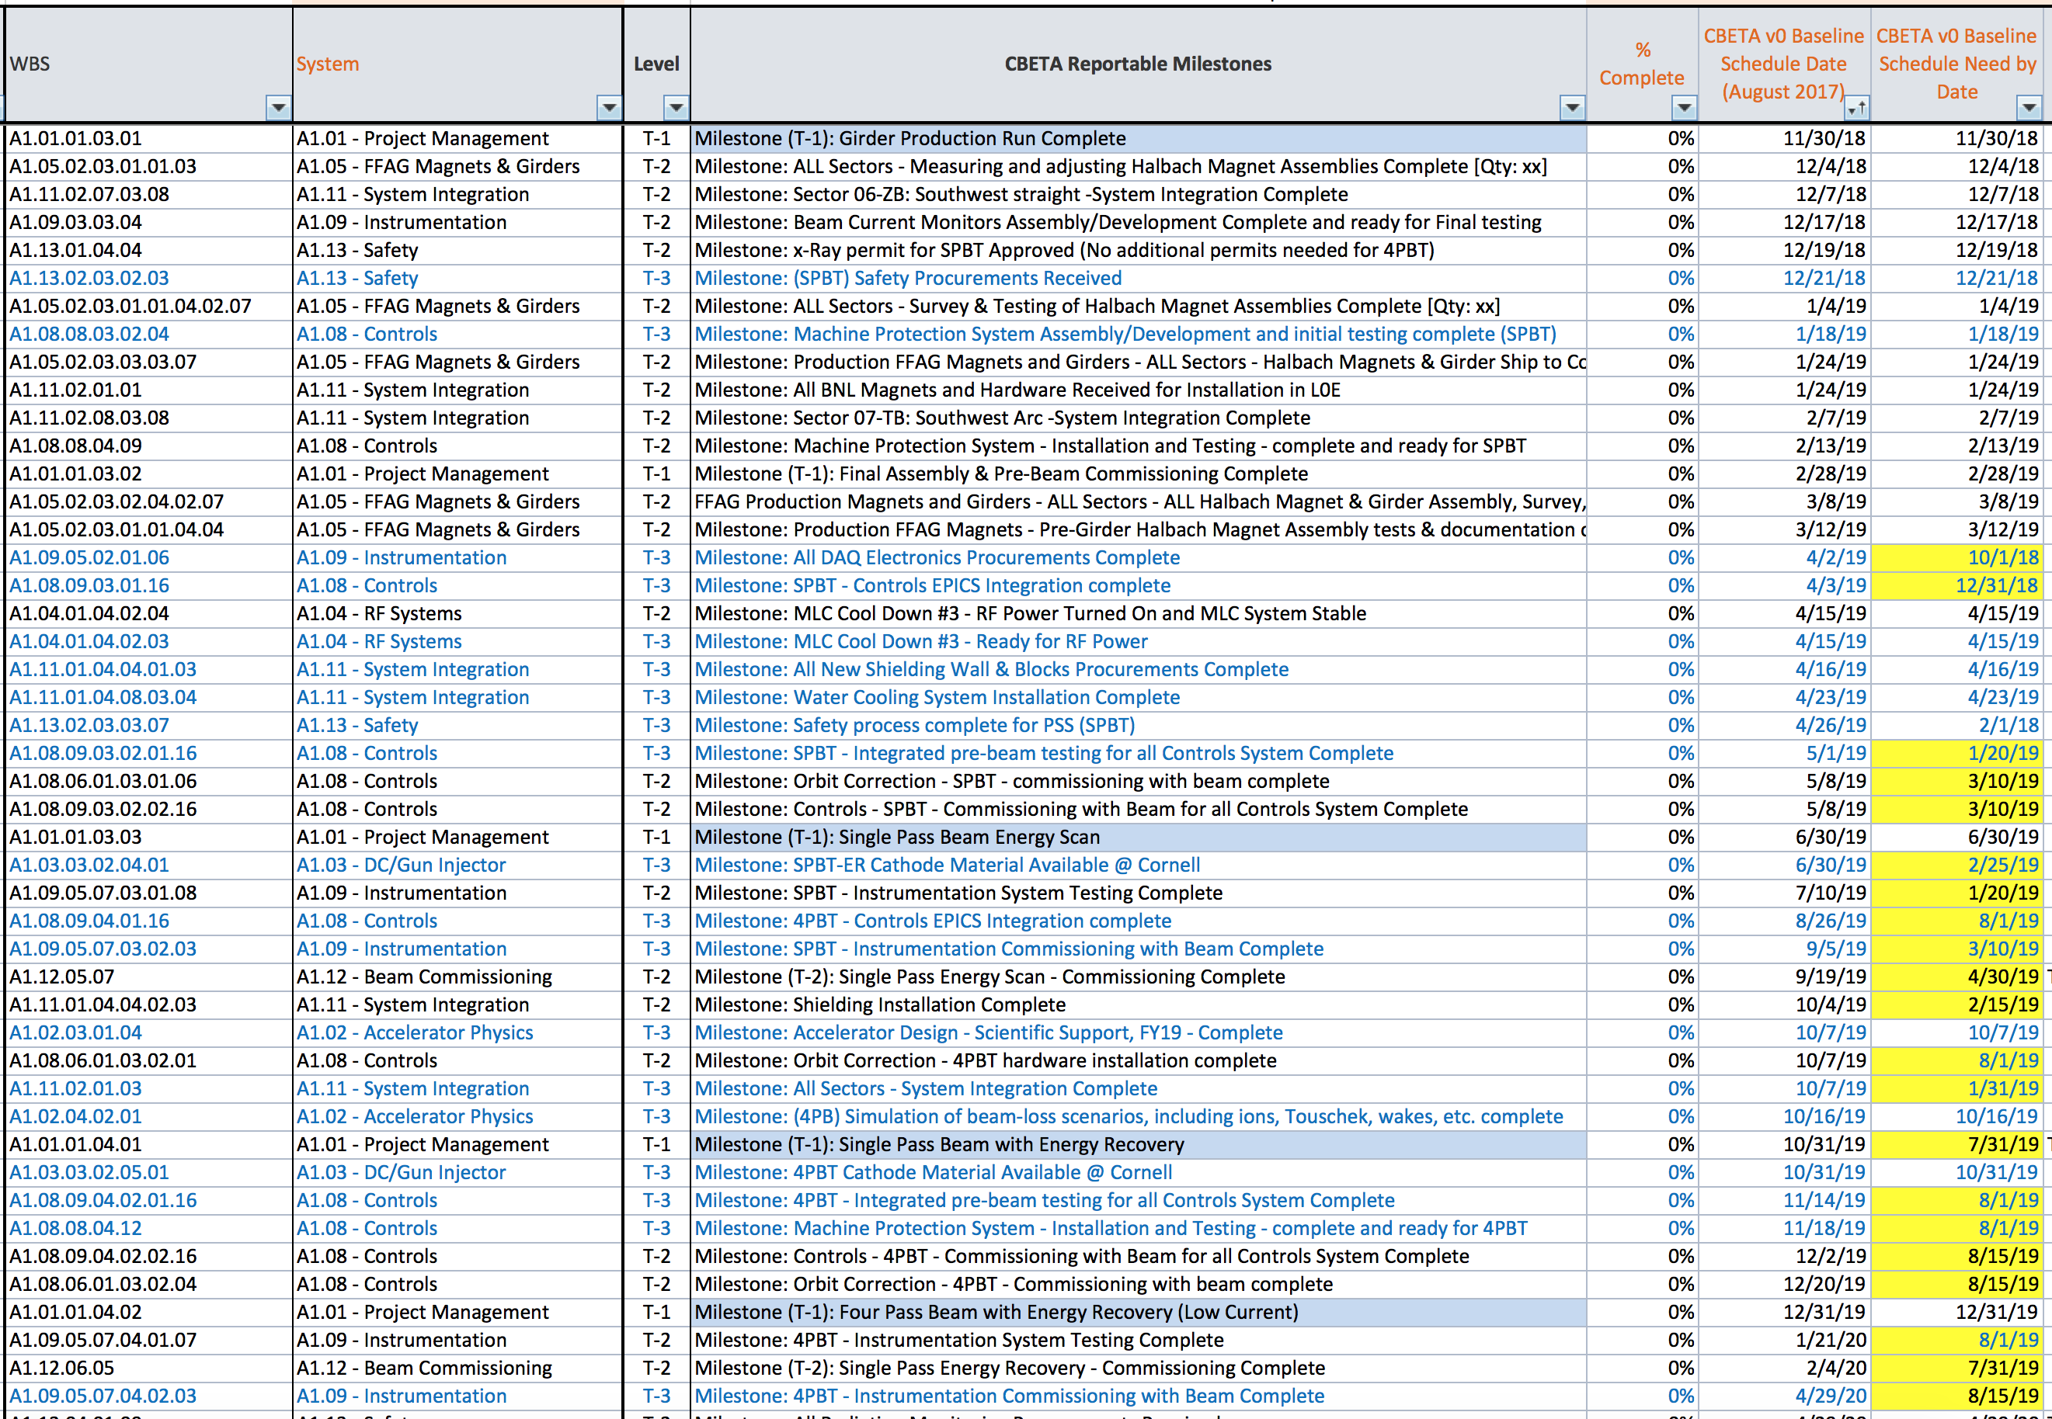
Milestone list
Yellow – Change to milestone date
Red – Overdue milestone
Blue background – Contract milestone

Slide 10
High priority items to complete
Finalize lattice
Complete drawings of entire machine (FAT dwgs by Sept. 30, 2017)
Vacuum layout, including location all devices – instrumentation, vacuum ports, bellows, etc.
FFAG magnet assembly procurements
Halbach assembly, corrector fabrication, girder components and assembly
Concrete wall cutouts
MLC beam tests – test 36 MeV acceleration
BPM beam tests, design finalization, procurement
Septa magnet – Halbach/electromagnet hybrid
Vacuum cross piece
View screen and insertable beam stop design, procurement
Common magnets

