Slide 1
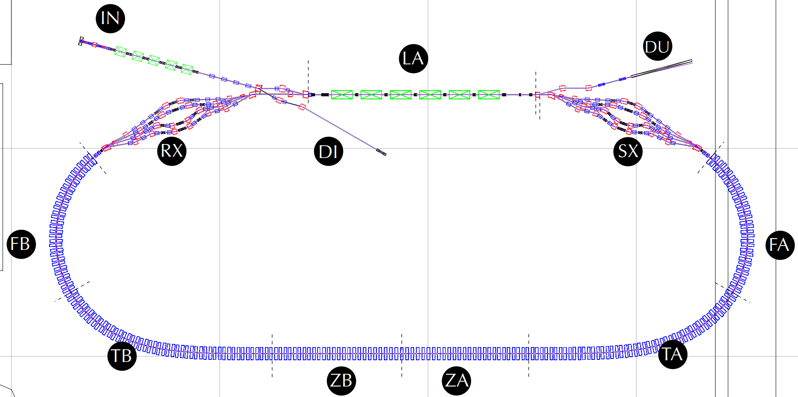
GV
GV
GA
IP
GV
GA
NT
CT
GA
IP
IP
NT
CT
IP
IP
CT
CT
CT X4
GV
GV
NT
GV
NT X4
GV
GV
GV
NT X4
CT
NT
GA
GA
CT
CT X4
CT
CT X4
CT X4
CT
GA
GA
(0,10m)
GV
(10,10m)
NT
(20,10m)
GV
FB-GD04
CT
FA-GD01
SJ
Gate Valves (11) 10 RF shielded 2 New to CBETA
SJ
NT
GV
NT
NexTorr Pump (13+9)
NT
FB-GD03
GV
2x
2x
CT
CapaciTorr Pump (40)
FLG
FA-GD02
CT
FLG
GA
CT
SJ
SJ
FFAG SJD JT (14)
IP
Ion Pump (5)
SJ
CT
FLG
FFAG Flanges (40)
GA
Ion and Pirani Gauges (10)
FB-GD02
GA
FFAG BPMs (108)
CT
FA-GD03
2x
2x
FLG
FLG
FFAG Instr Ports (46)
CT
NT
FB-GD01
SJ
SJ
FA-GD04
2x
NT
FLG
2x
ZM-GD01
FLG
CT
TB-GD06
CT
2x
CT
TA-GD01
SJ
2x
FLG
FLG
2x
FLG
2x
2x
FLG
FLG
2x
2x
FLG
SJ
CT
NT
SJ
FLG
SJ
SJ
SJ
SJ
NT
CT
CT
CT
CT
CT
NT
NT
CT
CT
NT
CT
SJ
TB-GD05
TA-GD02
(0,0)
TB-GD04
TB-GD03
TB-GD02
TB-GD01
TA-GD06
TA-GD05
TA-GD04
TA-GD03
ZB-GD03
ZB-GD02
ZB-GD01
ZA-GD03
ZA-GD02
ZA-GD01

