Slide 1
Scientific Computing @ CLASSE
First Steps
2023-06-09
Notes:
Purpose:
more programming projects than usual this year
so effort is not wasted, these projects must be documented & maintainable
show students how to do that at CLASSE so they can start the fun, scientific part of their projects ASAP
also: plug Sci Comp office hours on Wednesdays at 9AM

Slide 2
Overview
The CLASSE Linux system
  Logging in
  Where to work
Developing python code
  Managing environments
  https://jupyter01.classe.cornell.edu
  Best practices
Version control (git)
Notes:
Demonstrations will be interspersed throughout this presentation:
Practice using some tools for developing more sustainable code
Leave this session with a hospitable environment for working on your project

Slide 3
Using the CLASSE Linux system

Slide 4
The CLASSE Linux system
Logging in
ssh — secure shell
On Linux & mac terminals:
  ssh <CLASSEID>@<host>
  For example:
  ssh kls286@lnx201.classe.cornell.edu
On Windows: use PuTTY
  https://wiki.classe.cornell.edu/Computing/WinTunnelVncSSH
NoMachine — full desktop interface
On any computer, open an web browser and visit:
https://nomachine.classe.cornell.edu
Be prepared for issues with speed, copy/paste, and dropped connections
Another option, although not standard: https://jupyter01.classe.cornell.edu

Slide 5
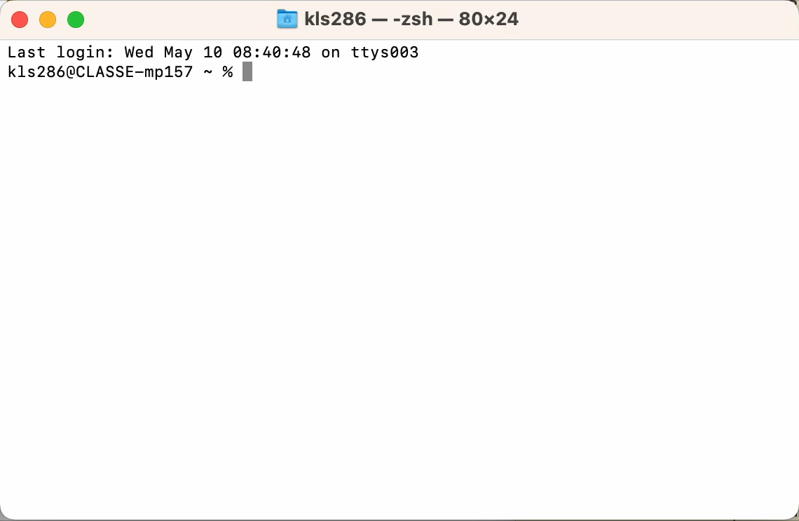
The CLASSE Linux system
Logging in
<demonstration>

Slide 6
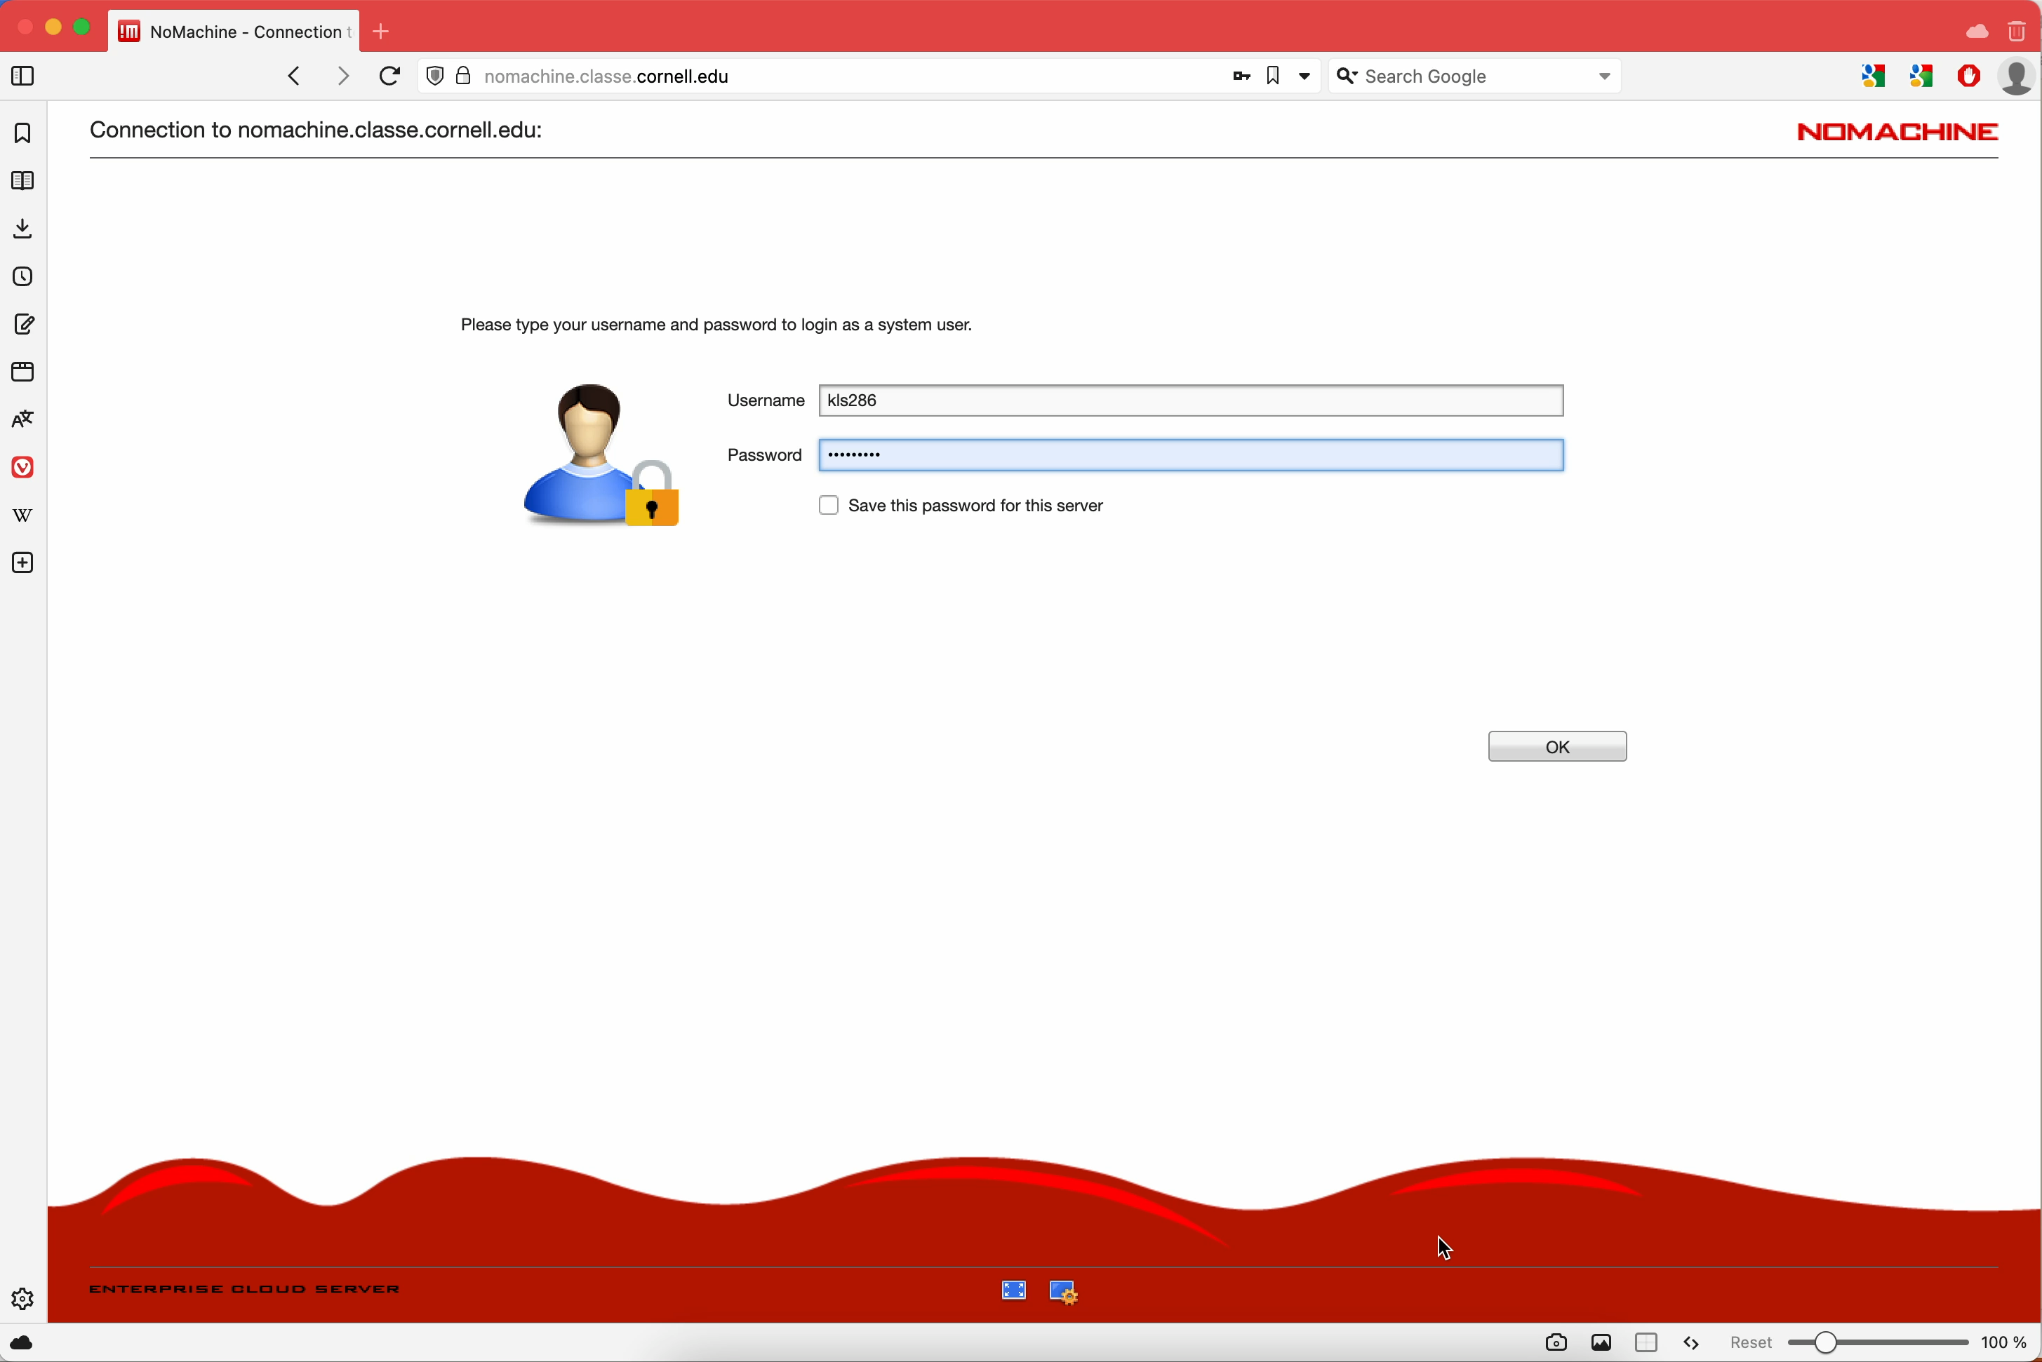
The CLASSE Linux system
Logging in
<demonstration>

Slide 7
The CLASSE Linux system
Where to work
lnx201 is a good option for most day-to-day tasks
  Accessible through ssh or NoMachine
  Do not run heavy computing jobs here! lnx201 is a shared resource — please do not hog it
Some tasks may require a specific machine, for example:
  Station hardware can only be controlled from the station computer
  The CHESS controls system can only be accessed on a certain network
Heavy computing jobs should be run on the ComputeFarm

Slide 8
The CLASSE Linux system
Where to work
HomeDisk (/home/<CLASSE-ID>) is limited to 1GB
  This is the landing point when you open a new terminal or log in with ssh
  Do not make a habit of working here!
Recommended working space: /nfs/…
  For CHESS students:/nfs/chess/user/<CLASSE-ID>/
  For other students: ask your project mentor
  nfs stands for Network File System — if something’s in /nfs on lnx201, it’s also there on the CLASSE Compute Farm nodes, the station computers, the computers in the CESR and CHESS operations areas, etc.

Slide 9
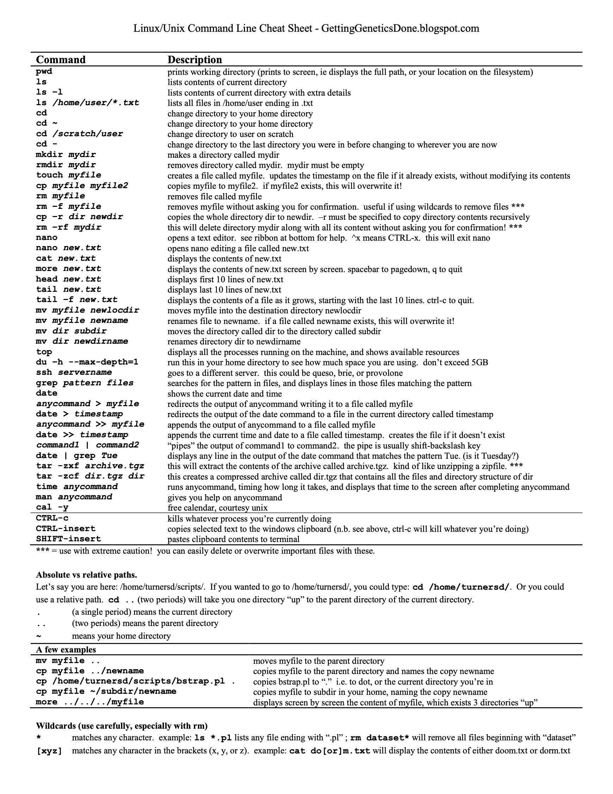
The CLASSE Linux System
Getting comfortable in the terminal
Use tab completion so you don’t have to type out long file names or commands
A nice cheat sheet of Linux commands —>
DO make liberal use of your favorite search engine…but DO NOT copy / paste commands you find on the internet without understanding what they do and how they work.
nano, emacs, and vi are good options for editing files in the terminal

Slide 10
The CLASSE Linux system
Summary
Terminal access — ssh
Full graphical desktop — NoMachine
Working directory for CHESS students— /nfs/chess/user/<CLASSE-ID>/
Everyday tasks — lnx201
Resource-intensive jobs — CLASSE Compute Farm
Hardware control & other specialty tasks — ask your project mentor
https://wiki.classe.cornell.edu/Computing/SummerStudentOrientation

Slide 11
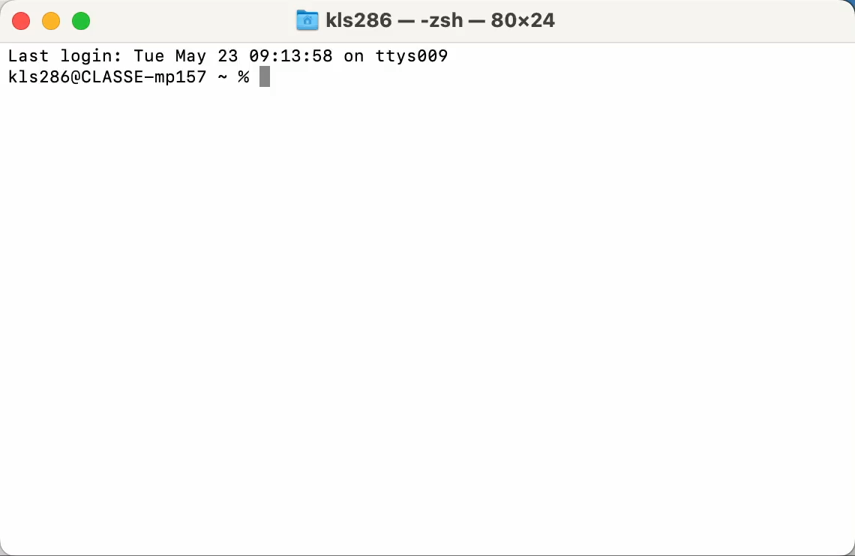
The CLASSE Linux system
Demonstration
Log on to lnx201
  ssh kls286@lnx201.classe.cornell.edu
Change to a working directory
  cd /nfs/chess/user/kls286/demo
Use emacs to write a “helloworld” script
Change the file mode of the script to be executable by the user who owns it
  chmod u+x helloworld.sh
Hop to an a compute farm node for interactive jobs
  qrsh -q interactive.q
Change directories
  cd /nfs/chess/user/kls286/demo
Run the script
  ./helloworld.sh
Log out of the compute farm
  exit
Log out of lnx201
  exit

Slide 12
Developing python code at CLASSE

Slide 13
Developing python code
Managing environments
System-wide default python
No version options
No permission to install packages like numpy, scipy, matplotlib, etc.
Can’t track the minimum needs for your project
Your own python environment
Use any version of python
Permission to install any packages your project needs
Track the minimum needs for your project

Slide 14
Developing python code
Managing environments
conda
Choose any python version
Install packages, system libraries
Install packages published for conda or pip
Can be slow
venv
Must use the system default python version
Install only packages published for only pip
Usually faster

Slide 15

Developing python code
Managing environments — installing miniconda
1. Download and run the miniconda installer with the following commands:
  ssh <CLASSE-ID>@lnx201.classe.cornell.edu
  CHESS students: cd /nfs/chess/user/<CLASSE-ID>/
  Others: cd /cdat/tem/<CLASSE-ID>/
  wget https://repo.anaconda.com/miniconda/Miniconda3-latest-Linux-x86_64.sh
  chmod u+x Miniconda3-latest-Linux-x86_64.sh
  ./Miniconda3-latest-Linux-x86_64.sh
2. Accept the miniconda license agreement
3. Specify the installation location:
    CHESS students: /nfs/chess/user/<CLASSE-ID>/miniconda3
    Others: /cdat/tem/<CLASSE-ID>/miniconda3
4. DO NOT allow the installer to run conda init
5. (optional) Add an alias for activating your new base conda environment:
  echo ‘alias conda_activate=“source /nfs/chess/user/<CLASSE-ID>/miniconda3/bin/activate”’ >> ~/.bashrc

Slide 16
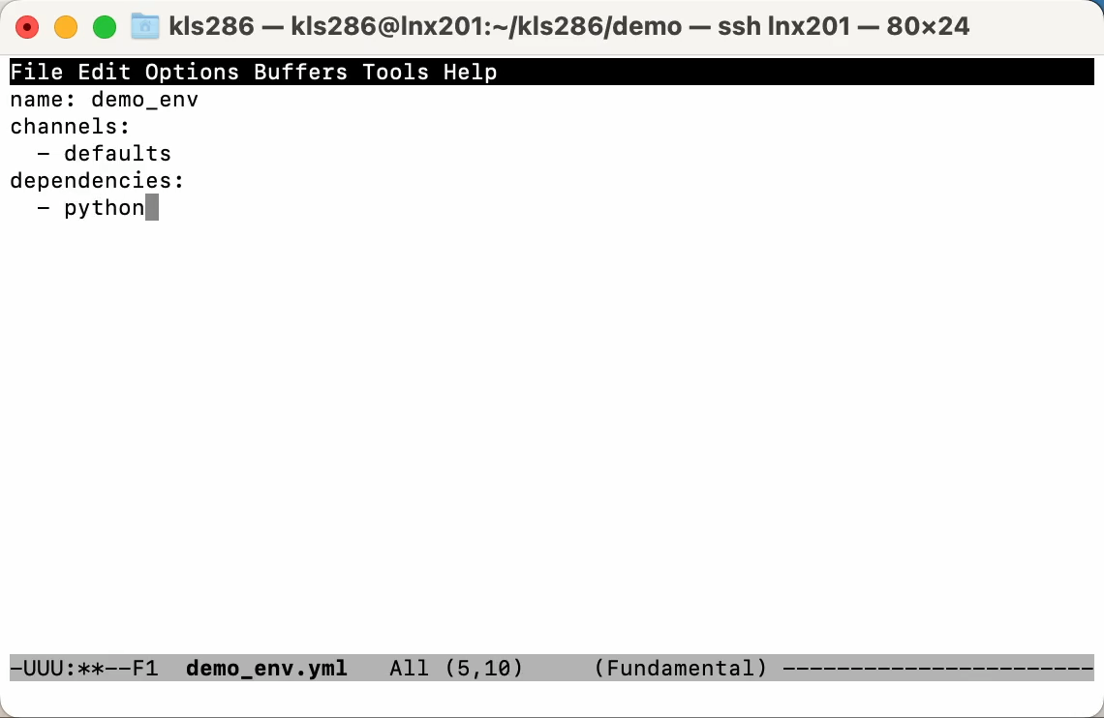
Developing python code
Managing environments — conda env create
Create a conda environment configuration file from scratch (use your preferred text editor)
Activate the base environment of your new miniconda installation
source miniconda3/bin/activate
Create a new environment from the environment configuration file written previously
conda env create -f demo_env.yml
Activate the new environment
conda activate demo_env

Slide 17
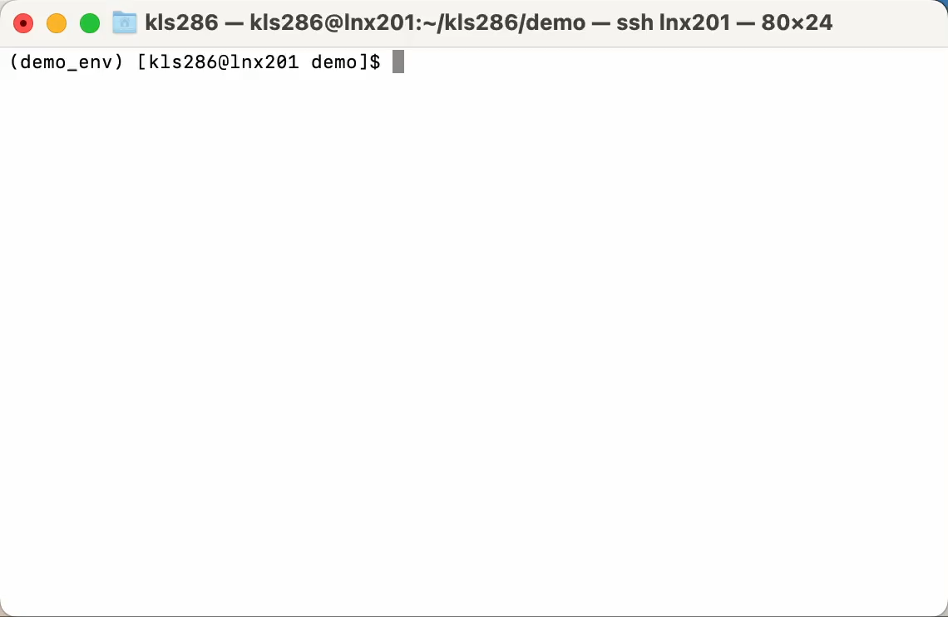
Developing python code
Managing environments — conda install
Write a script which attempts to import a package that is not built-in to python (use your preferred text editor)
Attempt to run the script using the demo_env environment
    ./demo.py
Install the third party package to the activated conda environment
    conda install -y numpy
Run the script
    ./demo.py
Add numpy to demo_env.yml (use your preferred text editor)
Notes:
Pause at the end of this demo for questions about environments. Next up: jupyter

Slide 18
Developing python code
https://jupyter01.classe.cornell.edu
Another way to interact with the CLASSE filesystem
Open a terminal, create / edit files, or use jupyter notebooks
Notebooks can be a friendly option for developing python code if you’re not comfortable using the terminal, but…
There’s a time and place for notebooks. Your project mentor can tell you if a jupyter notebook is an acceptable form for the final version of your code
https://wiki.classe.cornell.edu/Computing/JupyterHub

Slide 19
Developing python code
https://jupyter01.classe.cornell.edu
jupyter01’s file browser provides access to your /home/<CLASSE-ID> directory
Recall: your work belongs somewhere in /nfs/…, NOT
/home/<CLASSE-ID>
Solution: create a link to your working directory inside your home directory:
    ln -s /nfs/chess/user/<CLASSE-ID> ~/<CLASSE-ID>

Slide 20
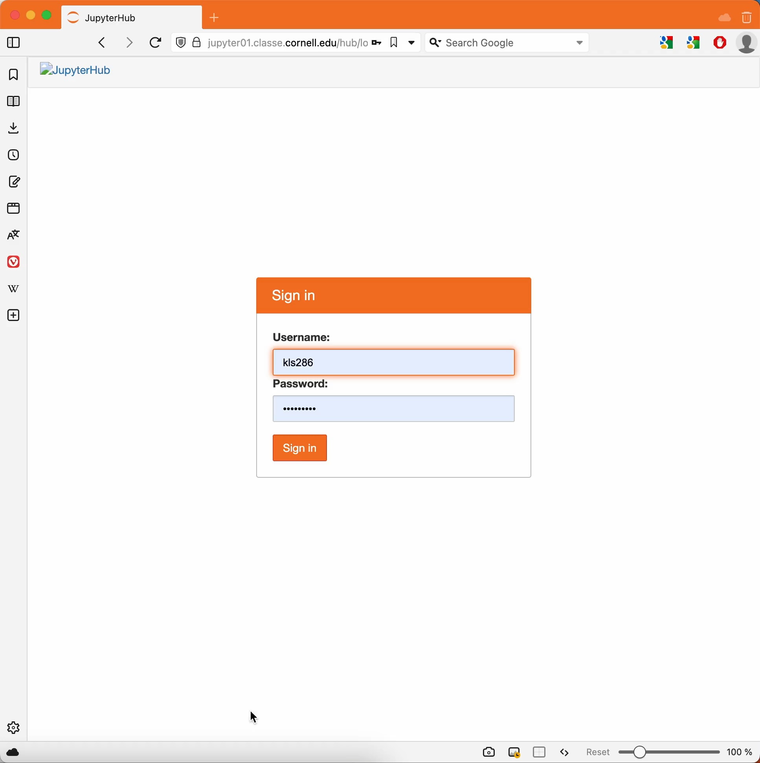
Demonstration
jupyter01.classe.cornell.edu
Log in to jupyter01.classe.cornell.edu
Navigate to the working directory
Write some code in a cell
Run the cell

Slide 21
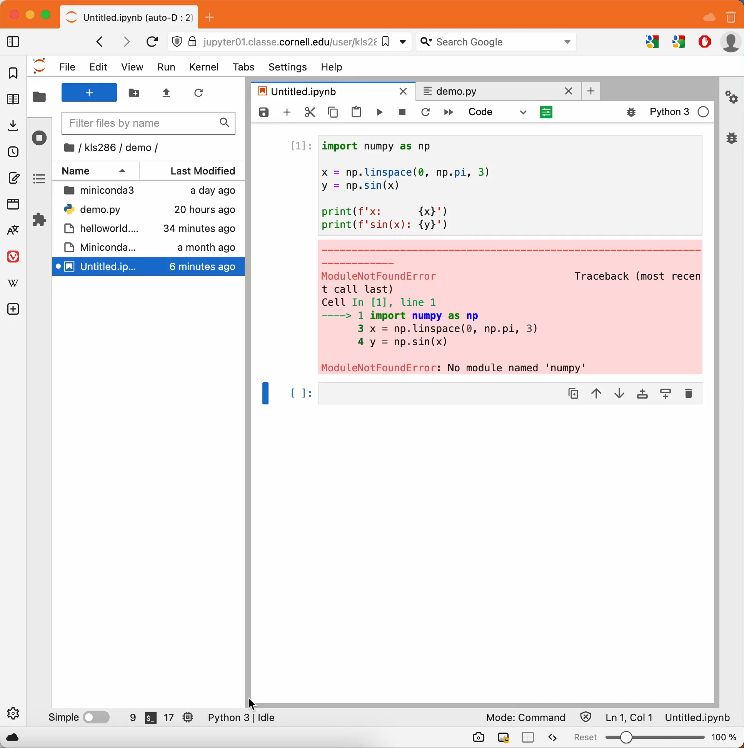
Demonstration
jupyter01.classe.cornell.edu
Since we’re already in jupyter, open a terminal there
Activate the conda environment in which we installed numpy earlier
Create an ipython kernel for this environment so you can use it in jupyter notebooks
  Need to install the ipykernel module first
Back in the notebook, select this new kernel and re-run the cell that failed earlier
I don’t use the python -n ipykernel … command often enough to remember all the arguments, but the CLASSE wiki for JupyterHub conveniently documents it for us
Notes:
Pause at the end of this demo for questions about jupyter. Next up: docstrings & style

Slide 22
Developing python code
Best practices — docstrings
Docstring conventions — https://peps.python.org/pep-0257/
Every module, class, and function in your project should have a docstring
Docstrings should be written with python’s built-in help(object)function in mind
Pick a canonical format for your docstrings and stick with it. If you don’t already have one picked out, I recommend choosing the sphinx docstring format
ChatGPT usually does a good job at writing docstrings for functions if you ask nicely

Slide 23
Developing python code
Docstrings & help(obj) example
def func_no_docstring(x, y=None):
# Describe what the function does.
# describe what the argument `x` represents
# describe what the argument `y` represents
# describe what this function returns
return None
def func_with_docstring(x, y=None):
"""Describe what the function does.
:param x: describe what the argument `x` represents
:type x: object
:param y: describe what the argument `y` represents,
defaults to None
:type y: object, optional
:return: describe what this function returns
:rtype: object
"""
return None
> help(func_no_docstring)
Help on function func_no_docstring in module __main__:
func_no_docstring(x, y=None)
> help(func_with_docstring)
Help on function func_with_docstring in module __main__:
func_with_docstring(x, y=None)
Describe what the function does.
:param x: describe what the argument `x` represents
:type x: object
:param y: describe what the argument `y` represents,
defaults to None
:type y: object, optional
:return: describe what this function returns
:rtype: object

Slide 24
Developing python code
Best practices — style
Style conventions — https://peps.python.org/pep-0008/
Variable / function names: snake_case
Class names: CamelCase
Line widths: 79 or 99 characters (code) or 72 characters (comments & docstrings)
…and many more guidelines that you are strongly encouraged to follow
You may break a guideline in PEP8 “when applying the guideline would make the code less readable, even for someone who is used to reading code that follows this PEP.”

Slide 25
Version control (git)

Slide 26
Version control (git)
What is git?
git: command-line tool for interacting with git repositories
git repository: a copy of your project files and the history of changes you made to them. It helps you:
  Preserve snapshots of your project at different stages of development
  Develop different versions of your project that branch from a common root
  Merge branching versions of your project back to a common root
A git repository can be hosted remotely using tools like github or gitlab. These help you:
  Share / distribute / deploy your project
  Track issues
  Publish documentation

Slide 27
Version control (git)
Where to host your repository
CHESS students:
  Your project’s git repository will be hosted in one of two places:
    For projects that should be public:
        https://github.com/CHESSComputing
    For projects that should be shared only within CLASSE:
        https://gitlab01.classe.cornell.edu
  There is a “correct” place to host every one of your projects. Ask your mentor if you are unsure where your project belongs.
All other students: ask your project mentor

Slide 28
Version control (git)
Vocabulary
repository: a collection of files with a history of developer-created checkpoints that preserve the state of those files at different stages (e.g. commits)
remote repository: a repository accessible via URL (i.e. the version hosted on github/gitlab)
local repository: a repository on your local filesystem
clone: a local repository that is a copy of a remote repository
push: an act that updates a remote repository with changes (like commits) made on a local repository
commit: an entry / checkpoint in the preserved history of a repository

Slide 29
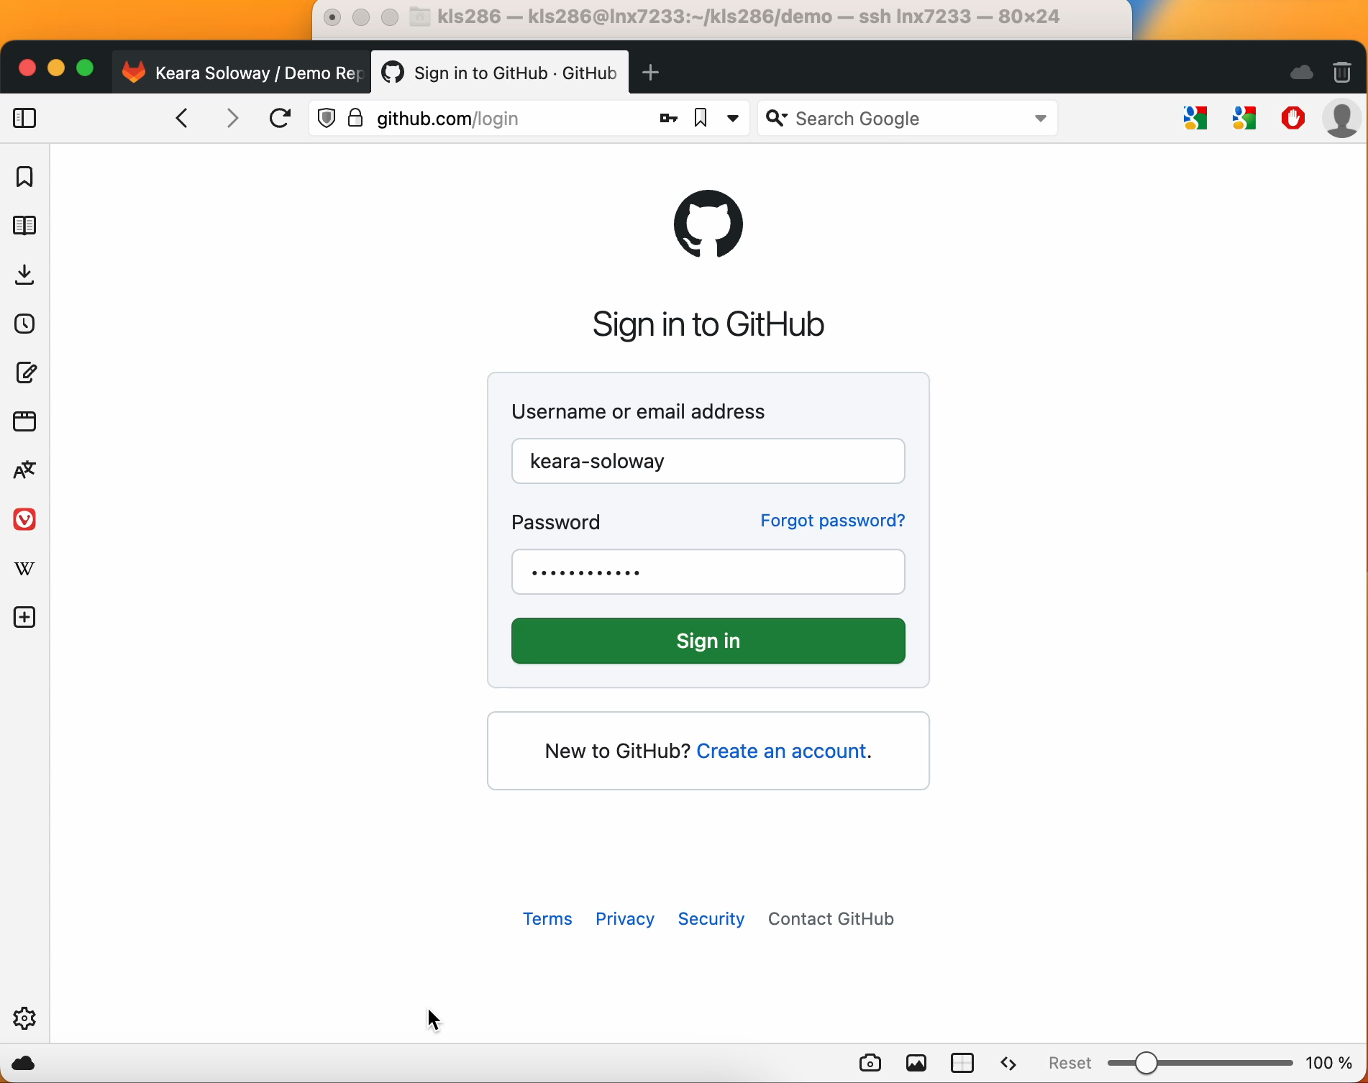
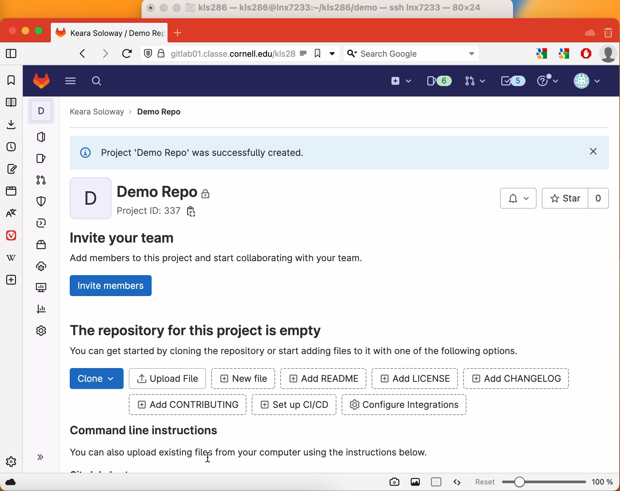
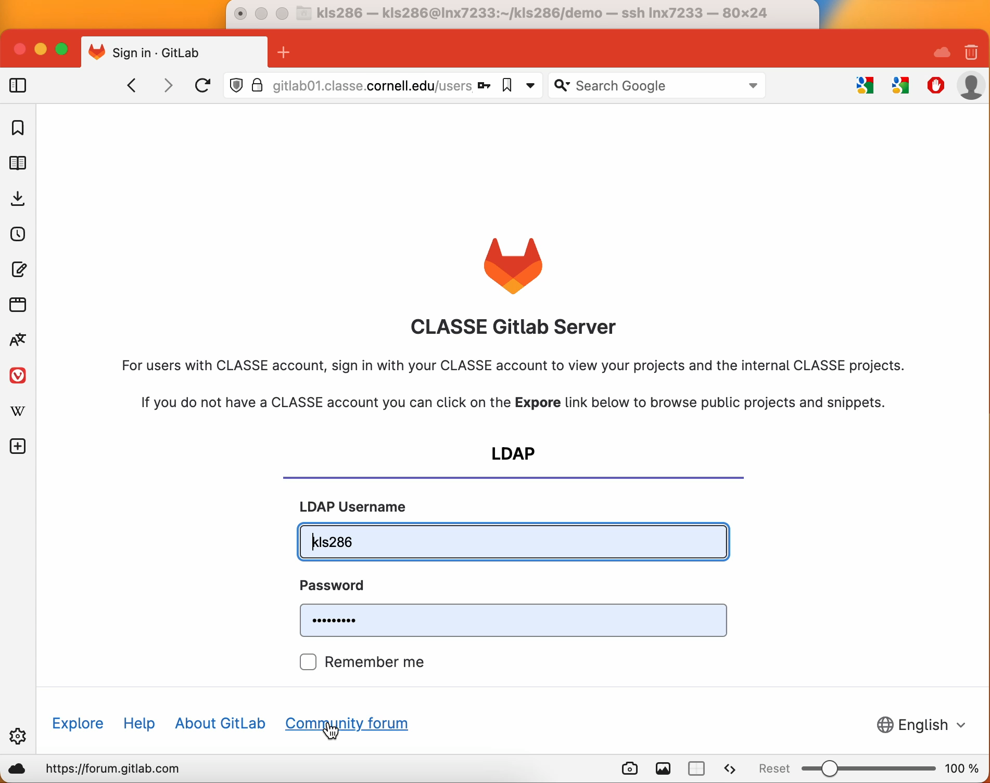
Version control (git)
Set up a blank repository
Create a blank remote repository on gitlab01.classe.cornell.edu or github through the web interface
Make a local clone of the remote repository
In the local version, create the main branch of the repo and add a blank README.md file NOTE: use git checkout -b main instead of git switch -c main
Commit the changes to the local repository
Push your commits to the remote repository

Slide 30
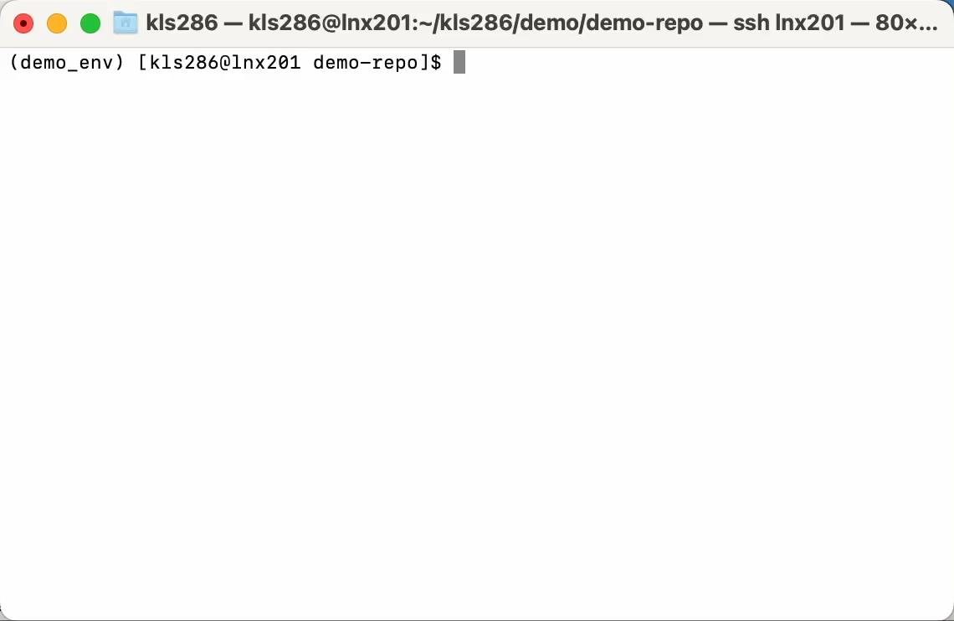
Version control (git)
Basic development workflow
At any point:
  Use git status to examine the state of your local clone
  Use git diff to examine the differences between files in the local clone and their “official” copy
To make changes:
  Create / modify files in a local clone
  git add the files whose changes you want to keep
  git commit the additions
  (optional) repeat steps 1-3
  git push the commits

Slide 31
Version control (git)
commits
Commit early and often so you can go back to previous versions of your project if needed
Each commit should represent one incremental change to your project (e.g. don’t fix a bug and update the documentation in the same commit)
Every commit needs a message that describes the changes you’re making
To make the commit history easy to read, stick to conventions
Notes:
Emphasize: commits are how you save your work & must be pushed to the remote repo.

Slide 32
Version control (git)
commit message conventions
Use the imperative mood (e.g. “Fix bug”, NOT “Fixed bug” or “Fixes bug”)
Format your commit messages:
Some common commit types and their descriptions:
Subject line will be previewed in github / gitlab UIs
type: short summary (50 chars or fewer)
More detailed description wrapped to 72 chars wide (optional)
Blank line
Commit message body is optional — be as detailed as is appropriate, and use Markdown syntax if it helps legibility
feat: addition of some new features
add: changes to add new capability or functions
cut: removing the capability or functions
fix: a bug fix
bump: increasing the versions or dependency versions
build: changes to build system or external dependencies
make: change to the build process, or tooling, or infra
ci: changes to CI configuration files and scripts
doc: changes to the documentation
test: adding missing tests or correcting existing tests
chore: changes for housekeeping (avoiding this will force more meaningful message)
refactor: a code change that neither fixes a bug nor adds a feature
style: changes to the code that do not affect the meaning
perf: a code change that improves performance
revert: reverting an accidental commit

Slide 33
Version control (git)
Some security considerations
Never keep passwords, API keys, or other “secrets” in regular files in any git repository
Never keep CLASSE hostnames, addresses, or file paths in a git repository not hosted on gitlab01.classse.cornell.edu
If you are unsure: bring it to the computing office hours on Wednesday at 9AM

Slide 34
Computing office hours — Wednesdays at 9AM
https://cornell.zoom.us/j/99337997736?pwd=S21XdEhmS2pYRUtIN1ZlTzVFQW1XQT09

Slide 35
End

Slide 36
Backup slides

Slide 37
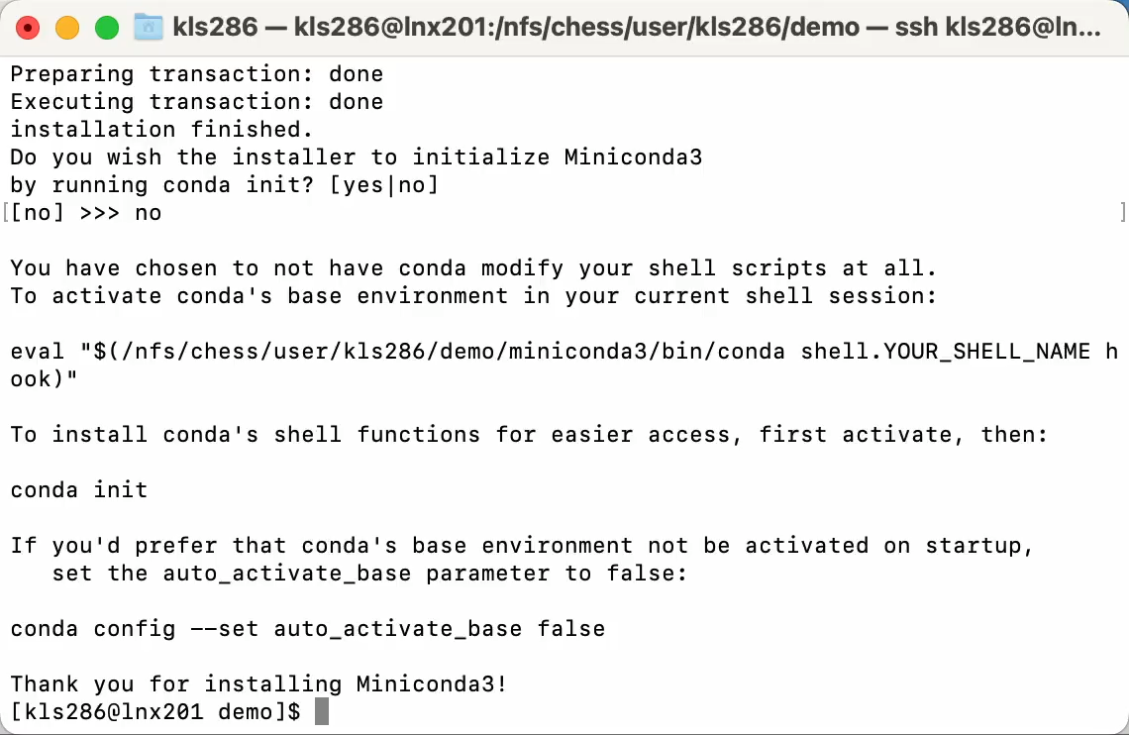
Developing python code
Managing environments — conda create
Activate the base environment of your new miniconda installation
source miniconda3/bin/activate
Create a new environment that contains python v3.11
conda create -n demo_env python=3.11
Activate the new environment
conda activate demo_env

Slide 38
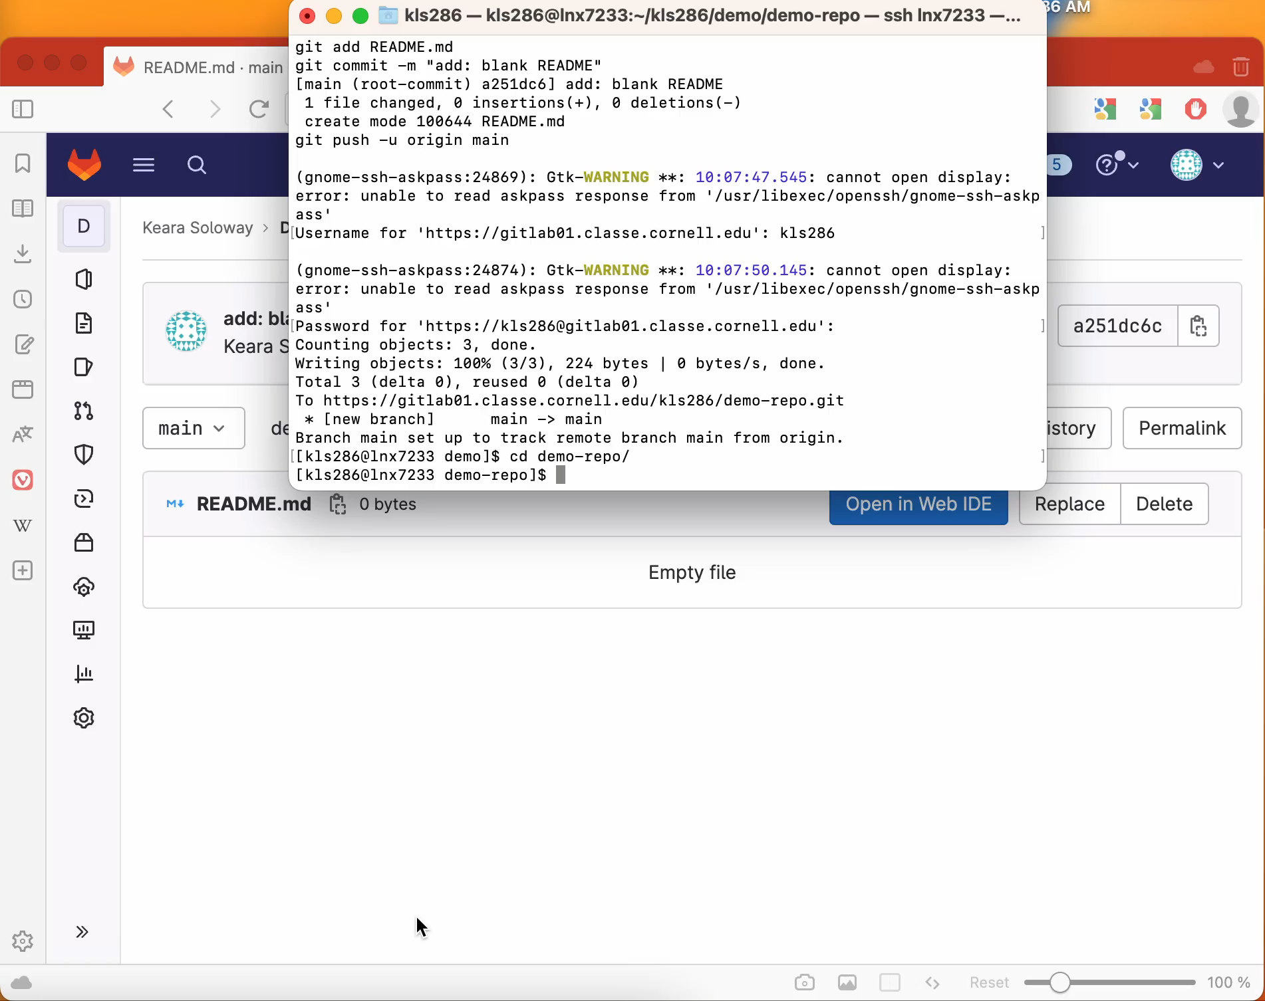
Version control (git)
Basic development workflow
At any point:
  Use git status to examine the state of your local clone
  Use git diff to examine the differences between files in the local clone and their “official” copy
To make changes:
  Create / modify files in a local clone
  git add the files whose changes you want to keep
  git commit the additions
  (optional) repeat steps 1-3
  git push the commits

