Slide 1
TO THE CHOICE OF FIELD IN CHICANE MAGNETS
AAM, October 62017

Slide 2
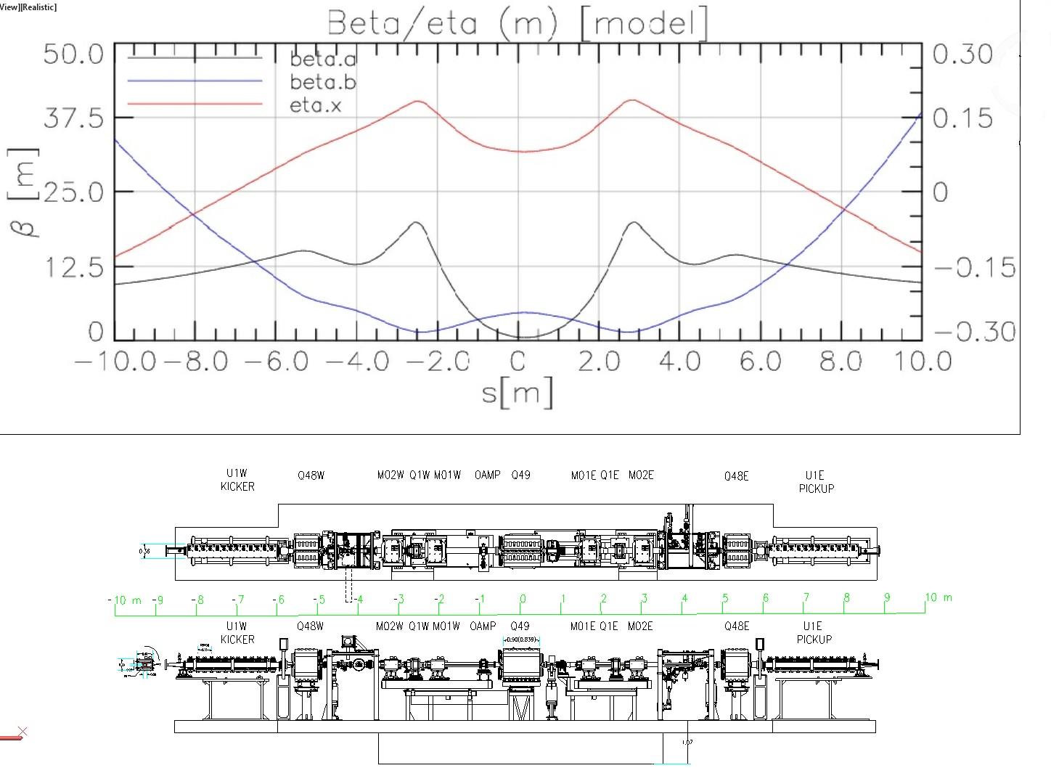
Allocation at CESR’s North area
DLR courtesy
Beam

Slide 3
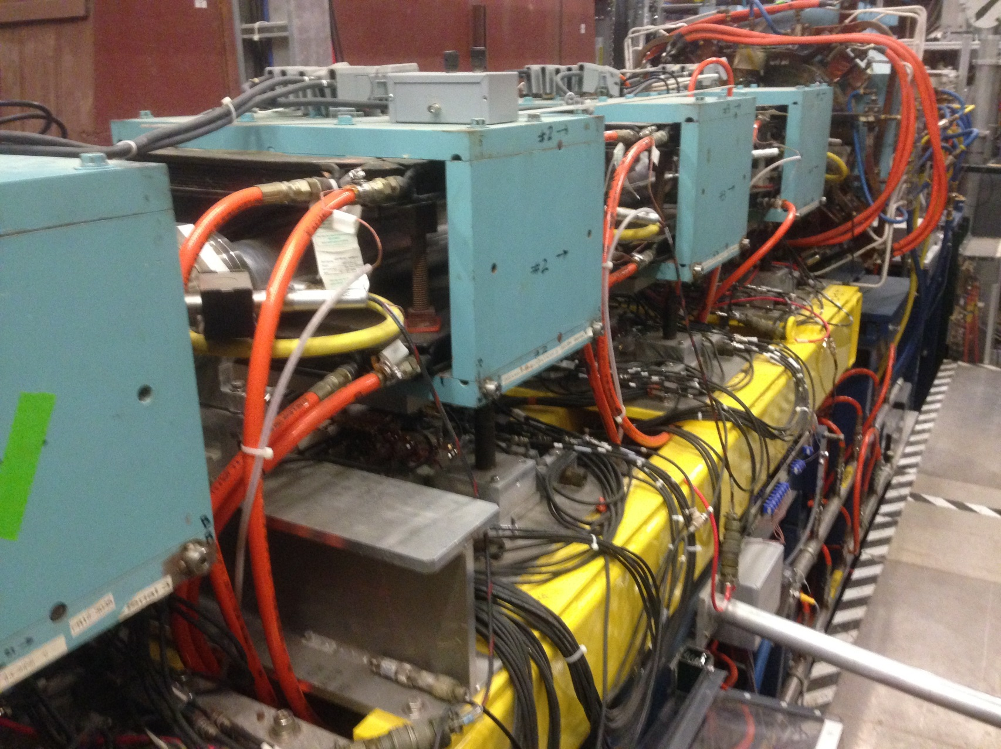
Existing magnets

Slide 4
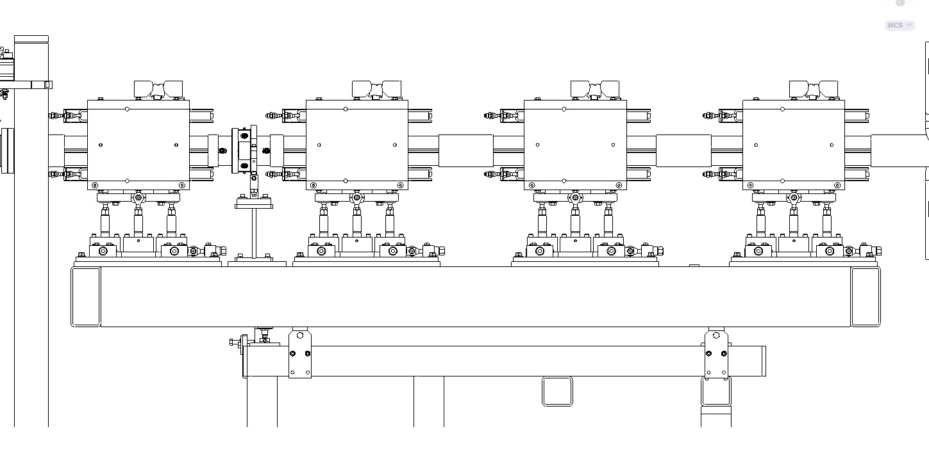

Slide 5
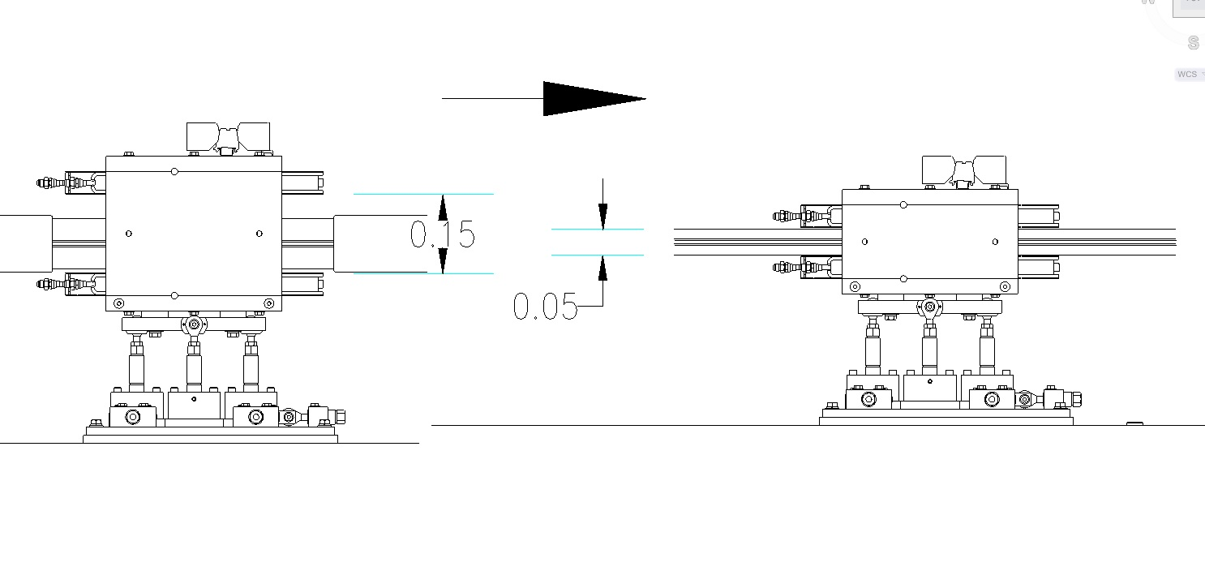
Magnets could modified with minimal efforts

Slide 6
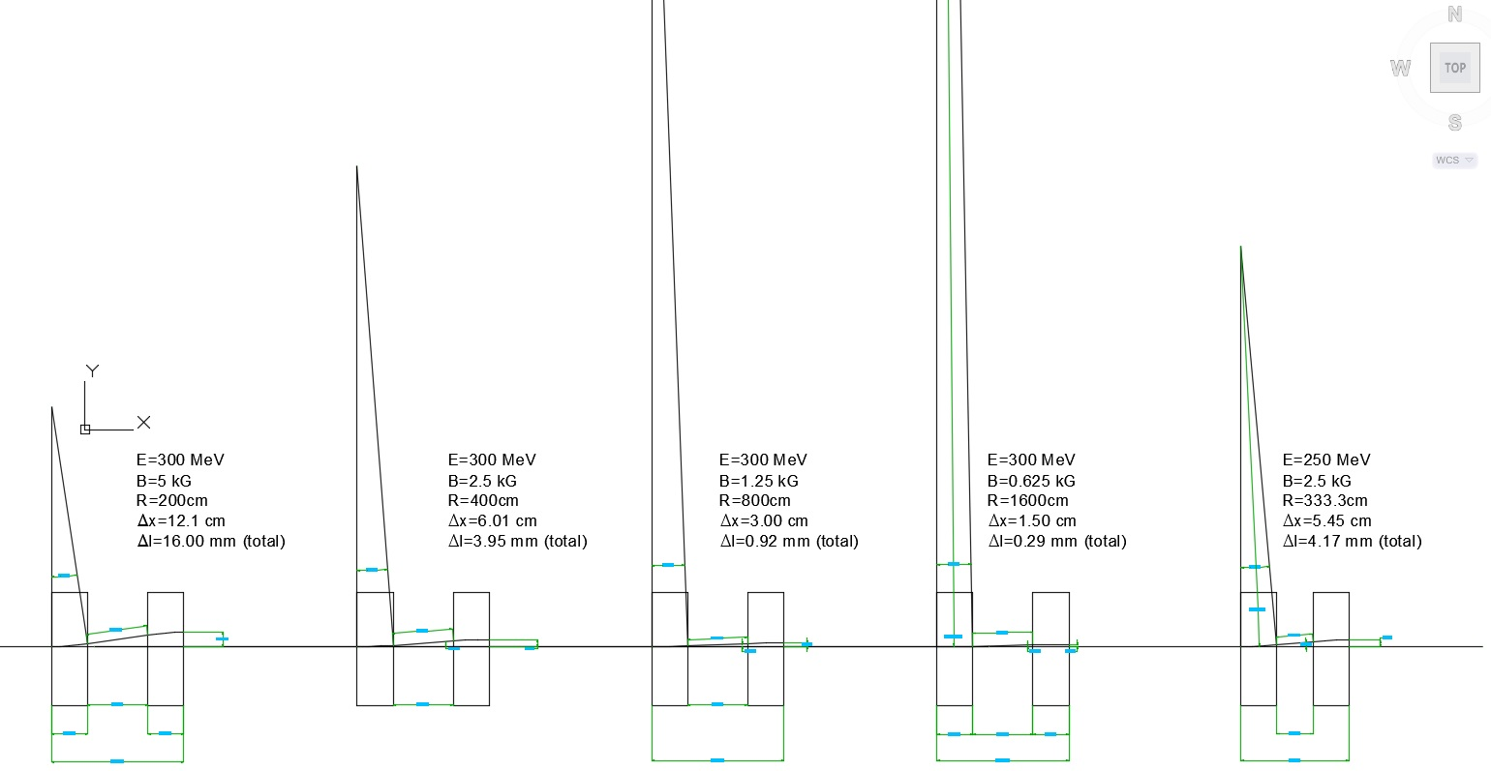
Some variants
Quadrupole lens fits in 30 cm space between magnets

Slide 7
THE END

