Slide 1
Baseline Injection/Extraction Configuration
  Aimin Xiao and Louis Emery, September 12th 2006

Slide 2
Fast Strip-Line Kicker
Technical specification (section 4.1.2 of Baseline Document) :
  Length L=300 mm
  Gap d=30 mm
  Pulse V=10 kV
  Need maximum beam acceptance Ax,max= 0.09 m-rad
Kicking angle of kicker is 0.04 mrad
Acceptance and aperture sets the maximum beta functions at strip-line kicker:
Including room for orbit excursion, say, 2 mm:

Slide 3
Optical Requirement of Fast Strip-Line Kicker
Inj. Beam Orbit
d
Cir. Beam Orbit
Cir.
Inj.
Trajectory after kicks
Required beam separation at septum
Neglecting septum thickness, assume sin  = 1, the minimum number of strip-line kicker is about 38.

Slide 4
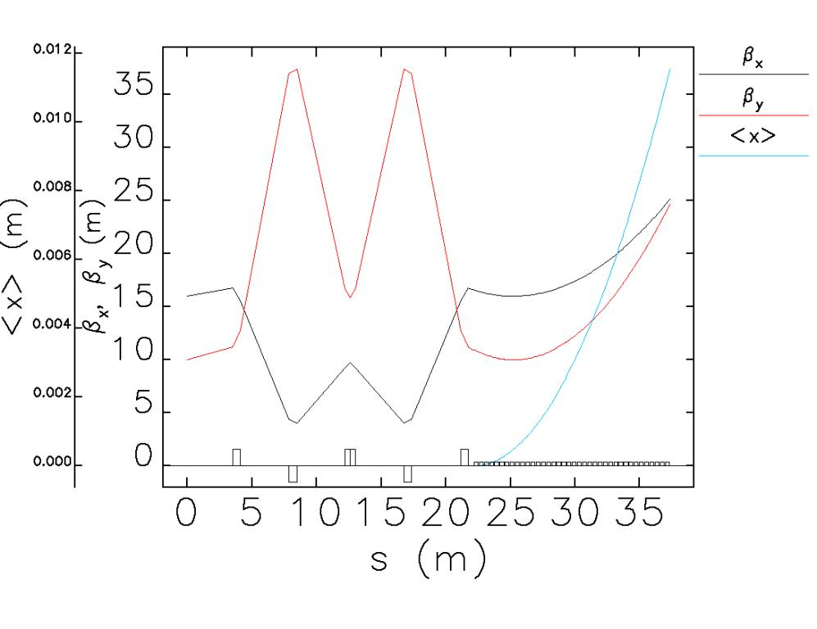
Injection Section – If we put all strip-line kickers in one drift space
12 mm
trajectory

Slide 5
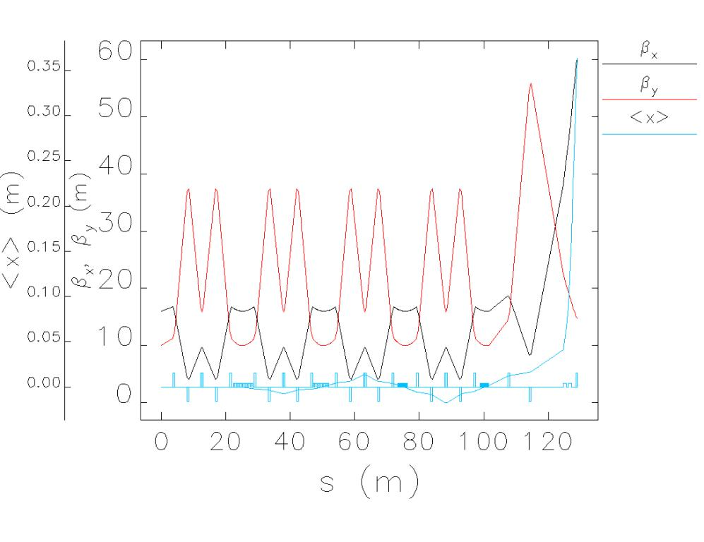
Distributed Kicker Scheme
-phase advance cells
Entire injection line optics
25 mm
at
quadrupole

Slide 6
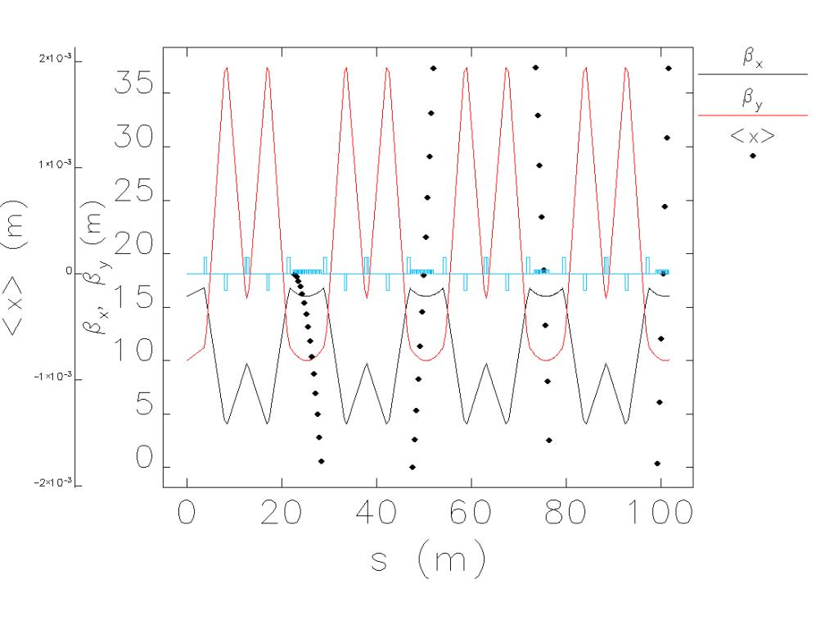
Distributed Injection Scheme
Only
2-mm
trajectory
inside
kickers

Slide 7
Extraction Section
Similar to injection except the extracted beam size is much smaller
Required kicker angle in about half of that of injection
The tolerance on the beam orbit excursion can be large
Cir.
Ext.

Slide 8
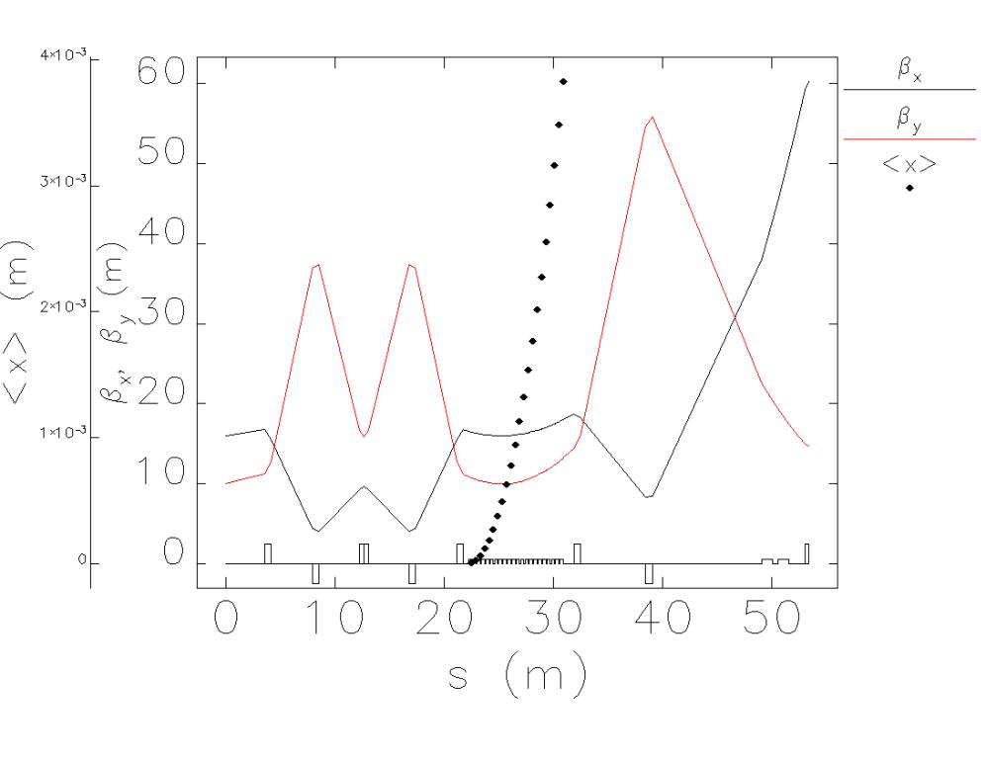
Extraction Section
4 mm trajectory

Slide 9
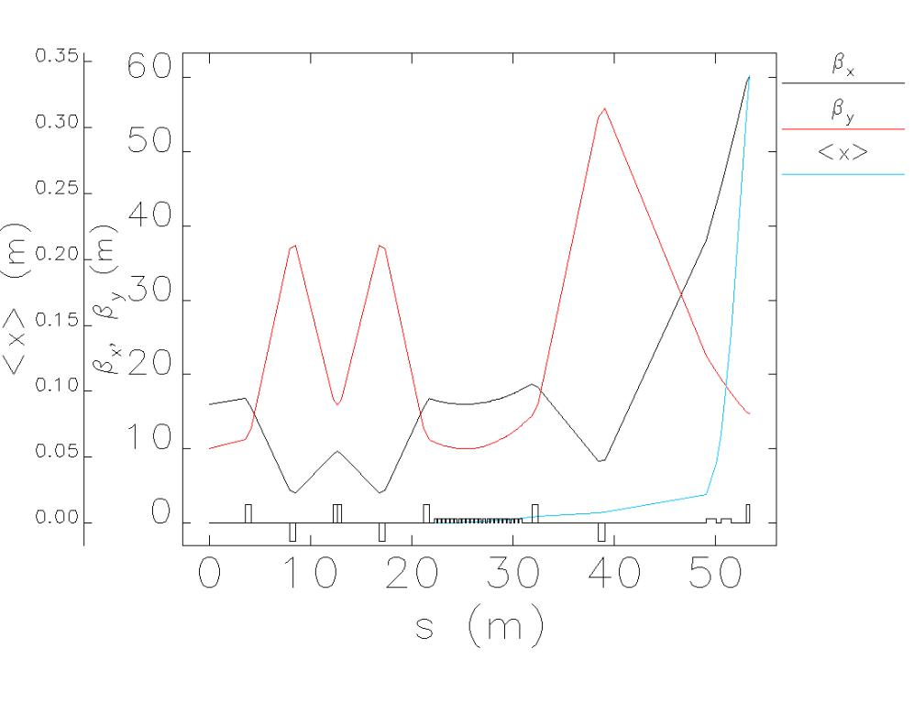
Lattice of Extraction Scheme

Slide 10
Possible Pulsed Septum Magnet
Inspired by APS injection septum magnets that run at 7 GeV
  Pulsed with 10 ms sine wave instead of DC because of heating (80 kW peak power)
Thick septum, 70 mrad, 1T, 700 A, N=36, 10 ms half-sine
Thin septum, 33 mrad, 0.7 T, 14000A, N=1, uses 3:1 transformer
5 m
Thick (and stronger)
septum
Thin septum
Need sufficient large angle to clear the
closest quadrupole

Slide 11
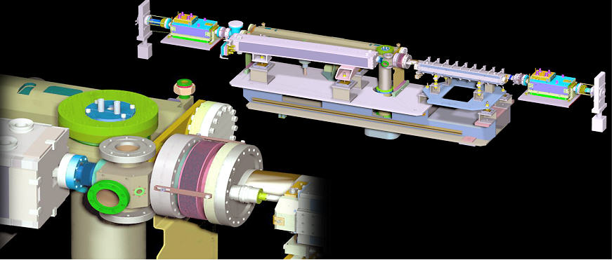
Layout of injection at APS
Thin septum
Thick septum
APS Injection 5-m section

Slide 12
Pulse requirements
APS septums discharge capacitors into the magnet inductance
  Charge supply is controlled to 10⁻⁴ using 20 kHz (?) pulse injection just before discharging
  Resulting trajectory angle jitter is 0.01 mrad
  For a 1 ms period thick septum variation is ±60x10⁻⁴, too large!
    Thin septum pulse is already shorter than 1 ms!
To control the flat top, one must regulate during 1 ms of the discharge period, which is harder because of the much higher currents
10⁻⁴
APS thick
septum
500 ms
THS = 10 ms

Slide 13
Pulsed Magnet Flat Top Regulation
APS engineers think regulation may be possible for thick septum
  Spring-8 booster ramp 100 ms flat-top regulation of 1500 A to 10⁻⁴ (Fukami)
Thin septum design requires a short pulse for reduction of leakage fields using eddy currents, so a 1 ms pulse may defeat this feature.

