Slide 1
DR 3.2 km Lattice Requirements
Webex meeting
10 January 2011

Slide 2
Steps for the 3.2 km lattice choice
Today webex meeting
Discussion on 3.2 km Lattice Requirements
19 January 2011, SLAC, 11:00-13:00 (within BAW2)
Define further steps and procedure for the lattice choice
19-23 March 2011, Linear Collider Workshop of the Americas (ALCPG11)
Lattice choice

Slide 3
References
Configuration Studies andRecommendations for the ILC Damping Rings, February 2006 https://wiki.lepp.cornell.edu/ilc/bin/view/Public/DampingRings/ConfigStudy
ILC RDR Report, August 2007 http://www.linearcollider.org/?pid=1000437
Specifications for the ILCDamping Rings EDR baseline lattice, A. Wolski, December 2007 https://wiki.lepp.cornell.edu/ilc/pub/Public/DampingRings/LatEvalPage/EDRLatticeSpecifications.pdf
DCO4: ILC-NOTE-2010-057 http://ilcdoc.linearcollider.org/record/30937/files/ILC-NOTE-2010-057.pdf
“Parameters and scope for low-power option discussions” N. Walker , AD&I meeting: BAW-2 preparation, 07 January 2011, http://ilcagenda.linearcollider.org/getFile.py/access?subContId=0&contribId=0&resId=0&materialId=slides&confId=4962

Slide 4
Nominal parameters of beams injected into damping rings

Slide 5
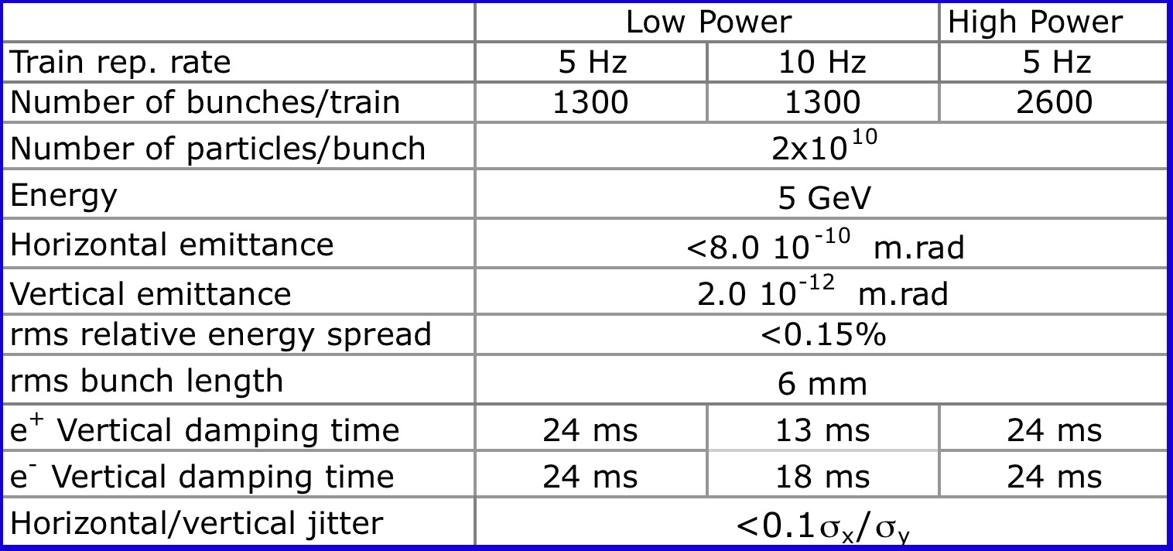
Nominal parameters of beams extracted from damping rings

Slide 6
Layout and Components
Racetrack
Injection/extraction in straight section 1
RF and wigglers in straight section 2
Magnets (reduce cost with respect to RDR)
Reduce number of magnets, strenghts, number of different types)
Injection/extraction
β_{x} and ΔQ_{x} at kickers and septa as DCO4
Space for kickers and septa as DCO4
Phase adjustment
DCO4: ΔQ_{x} = ±0.5 and ΔQ_{y} = ± 0.25 per straight section
Minimum: ΔQ_{x} = ±0.25 and ΔQ_{y} = ± 0.25 per ring?
Chicane
DCO4: ΔC/C = ± 10⁻⁶ (±7 mm / 6.4 km)
How much is needed?

Slide 7
Layout and Components
RF section
Longitudinal space per cavity 3.5 m
Leave space for a number of cavities sufficient to cover all the options
RF cavities upstream of wigglers
Wigglers
Space for synchrotron radiation absorbers >0.75 m
Use present RDR CESR-c type wigglers
Or new optimization of field and period for the shorter damping time

Slide 8
Energy acceptance and lifetime
Injection acceptance δ_{max} =±5e-3
Energy acceptance gives quantum lifetime:
δ_{max} =5e-3 and σ_{p} =1.3e-3 ➔ δ_{max} = 3.9σ_{p} ➔ 2-3 sec lifetime
For emittance tuning ~ 30min is needed ➔
δ_{max} ≥ 5.5σ_{p}≥ 7e-3
also consider Touschek lifetime, less critical since tuning can be done at low current
The indications are for an energy acceptance larger than ±0.5%

Slide 9
RF system and momentum compaction
It’s an expensive system, cost containment is important
RF has to be sufficient for 5Hz Low Power and High Power, and 10 HZ Low Power
6 mm bunch length
Overvoltage V_{RF}/U₀ ~2 or less for 50% duty cycle needed at 10Hz for the e⁺ ring (100 ms full current, 100 ms empty ring)
Indications are for a low momentum compaction ~ 1.5e-4 (<2e-4)

Slide 10
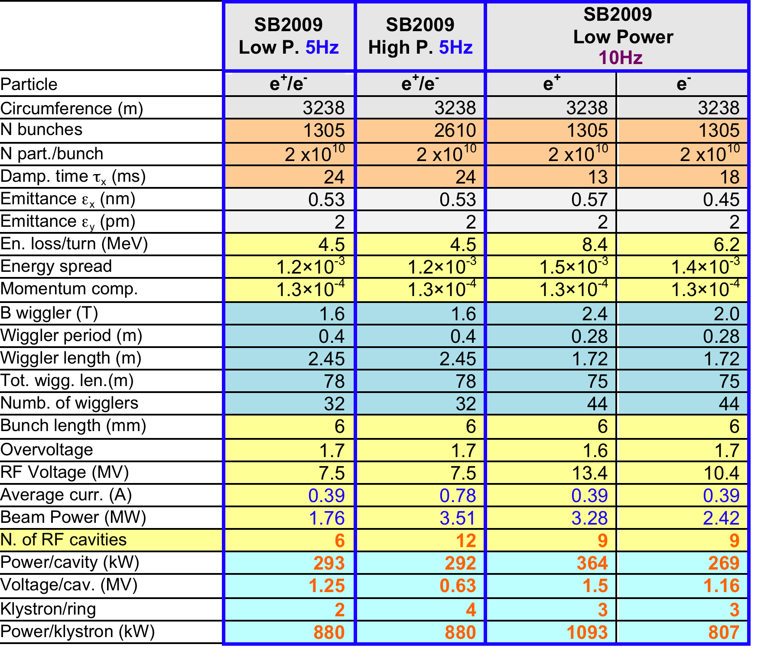
DSB3 RF parameters options

