Slide 1
MAIN LINAC CRYOMODULE DESIGN REVIEW
INPUT COUPLER

Slide 2
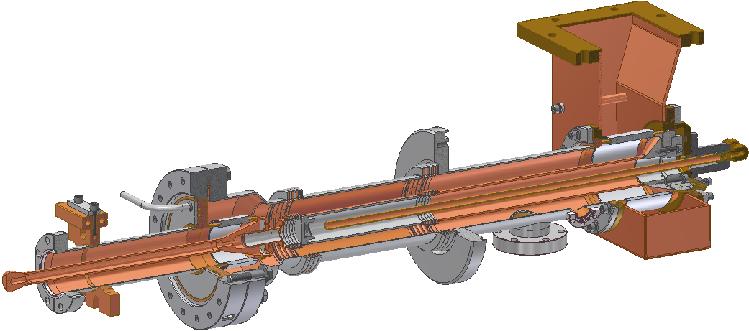
INPUT COUPLER
Most of the Parts:
316 Stainless Steel
with 5m Copper Coating
Waveguide Flange
Warm Ceramic Window
40K Flange
Air Cooling
40K He Gas
Cooling
300K Flange
Cavity
Flange
(2K)
Bellows
Instrumentation Port
Pump Port
Antenna
(Solid Copper)
5K Intercept
Cold Ceramic Window

Slide 3
INPUT COUPLER
Main Parameters of the Coupler
Operating frequency | 1.3 GHz
Maximum power (CW) | 5 kW
Q_{ext} (fixed) | 6.5×10⁷
Cold coaxial line impedance | 70 Ohm
Warm coaxial line impedance | 46 Ohm
Cold coax line outer diameter | 40 mm
Warm coax line outer diameter | 62 mm

Slide 4
INPUT COUPLER
Heat Load on Cryogenics
 | Static Heat Load | Dynamic Heat Load | Full Heat Load
To 2 K | 0.05 W | 0.06 W | 0.11 W
To 5 K | 0.64 W | 0.32 W | 0.96 W
To 40 K | 3.78 W | 5.94 W | 9.72 W

Slide 5
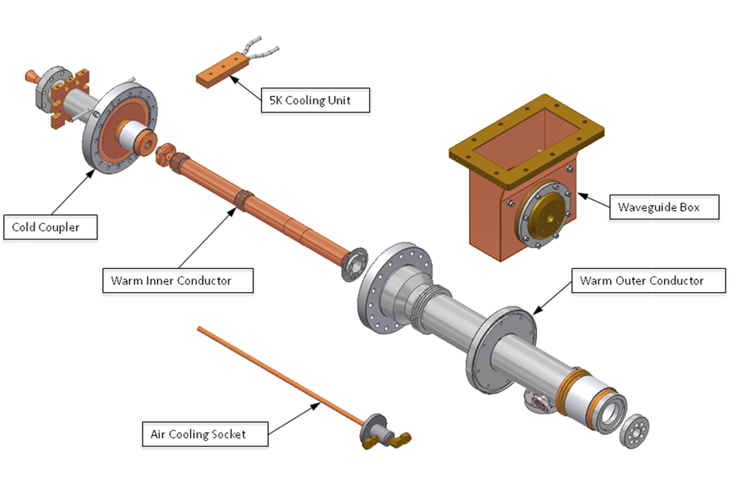
INPUT COUPLER
Parts of Coupler

Slide 6
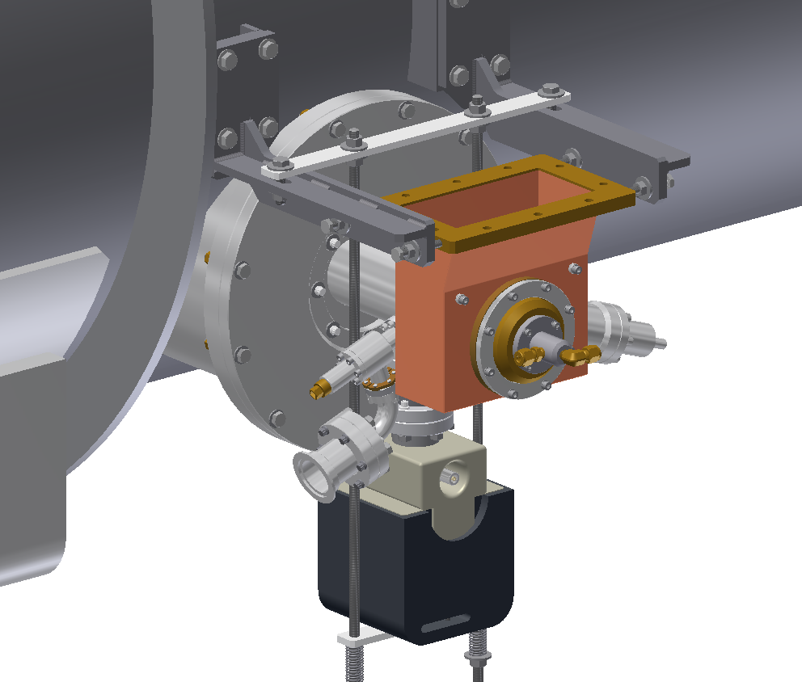
INPUT COUPLER
Cold Cathode Gauge
Ion Pump
Coupler Port
Cryomodule
with Coupler
VAT Valve

